Slide 1
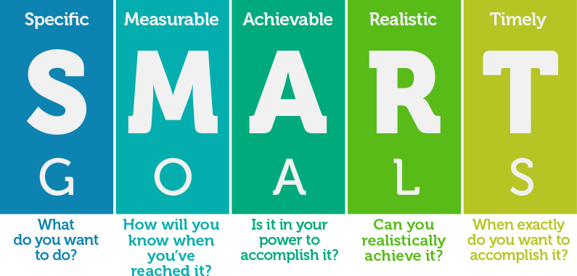

What is something that you can do in the NEXT 2 WEEKS that will help make this workshop be most useful in your continued discovery about science?
SMART GOALS

