Slide 1

[Year]
Mentoring Program Kick-Off Workshop
Welcome!
Grab a seat, grab some breakfast!
Notes:
[Facilitator] - 10:00 am, Introduction
Welcome to the PROGRESS workshop. I’m [NAME] and I’m [TITLE]
Before we get started, I want to give you a bit of history on this program.
A few Earth Scientists wanted to figure out how to better support undergraduate women entering the Earth Sciences. They remembered being a bit lonely in our classrooms - there were not that many women around, and they wanted to have a better welcome for the next generation.
In 2014 they wrote a grant to the National Science Foundation and have continued to run this program with support from the National Science Foundation since 2015.
The program started in Colorado and in the Carolinas.
The program then expanded to Texas, Georgia, California, DC, & Maryland.
So welcome to the club!
This matters deeply to me personally because the Earth and Environmental Sciences are essential to society's most wicked problems.
Climate change will continue to make this worse.
We need the absolute best teams working on challenges in the Earth and Environmental Sciences, and we know that gender diverse teams produce solutions that are more actionable faster.
I want to do our land acknowledgement and then I’ll introduce the rest of the team.
Summary of slide:
Tell the story of how you got here today.
How they got here today.
Why this matters to you personally?
Genesis of idea to today AND team that made it happen.
Next slide for land acknowledgment then team introduction

Slide 2
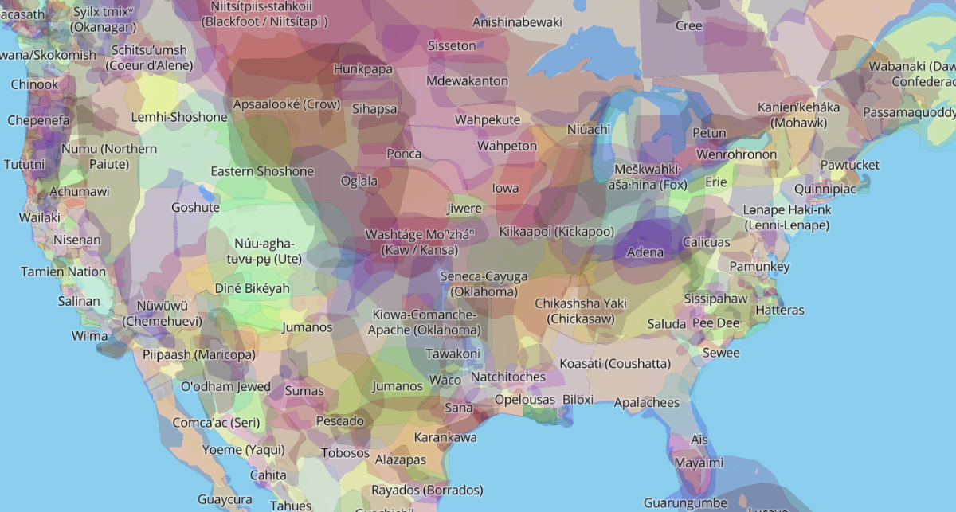
Land Acknowledgment
Truth and acknowledgment are critical to building mutual respect and connection across all barriers of heritage and difference.
[Enter land acknowledgment]
Notes:
[Facilitator] - Land Acknowledgement
Why does this matter today?
Ways of knowing, all women and children. And disproportionate impact

Slide 3

Your PROGRESS Support Team
Name,
Organization or University
Name,
Organization or University
Name,
Organization or University
Name,
Organization or University
Name,
Organization or University
Name,
Organization or University
Name,
Organization or University
Name,
Organization or University
Notes:
[Facilitator] - Team Introduction (introduce individuals who are at the workshop)

Slide 4
Goals for Today:
Connections. Let’s connect you with us, each other, and a regional mentor network.
Curiosity. Let’s learn about the earth sciences, how they work, and why they matter.
Notes:
[Facilitator] - Big picture goals
Big picture goals for today
Connect with us, mentors AND connect with each other
Learn more about geosciences
We are excited. We are here for you.

Slide 5
Site Logistics
Meals/snacks
Bathrooms
Breaks
Paperwork
Photo release
Notes:
[Facilitator] - Site Logistics

Slide 6
Our Agenda
Time | Event
10:00 AM - 10:20 AM | Welcome, Process Overview, and Community Connections
10:20 AM - 10:30 AM | Introduction to the Earth and Environmental Sciences
10:30 AM - 11:30 AM | Panel Discussion: Pathways to the Earth and Environmental Sciences
11:30 AM - 11:45 AM | Break
11:45 AM - 12:45 PM | Support Map Exercise
12:45 PM - 1:55 PM | Lunch and Outdoor Break
1:55 PM - 2:00 PM | Lunch Recap
2:00 PM - 3:00 PM | Panel Discussion: What Mentoring Means to Me
3:00 PM - 3:05 PM | Break
3:05 PM - 3:40 PM | Growing Equitable Inclusion
3:40 PM - 4:10 PM | Connection Toolkit
4:10 PM - 4:30 PM | Concluding Remarks, Resources, Evaluation, Mentee-Mentor Connections
Notes:
[Facilitator] - Agenda
Agenda is approximate mostly.
Manage your energy.
Use break times to get up, stand up, walk around, refresh.
We are ready to dig in.

Slide 7
Engaging with one another today
Listen actively and respectfully. Speak actively and respectfully
Be open and curious - ask questions!
Speak from your own experience; use ‘I’ statements
Honor confidentiality – we can share learning, keep stories here
Notes:
[Facilitator] - Participant Agreements
Also, we would like to propose some other guidelines to help us engage together today.
We will cover a lot of topics, have a lot of guests, so here is what we are hoping for.
We want a safe space where you can share thoughts, things you are excited about, concerned about.
Please do feel free to share learnings from today...AND keep other people’s stories here in our safe space.
Engaging with one another
Listen attentively and be respectful
Keep focused on ideas, no directed personal comments
All voices should be heard
Seek to understand others’ perspectives
Be kind to yourself and others***
“Ouch and Educate”: Permission to speak up if you feel uncomfortable or if comments are offensive in some way. Help others to see your perspective.
Honor confidentiality
This is hard work: feel free to take a break
There will be mandatory reporters here….
Talk about safe space. Ask everyone to respect that and feel free to speak up if they are uncomfortable.

Slide 8
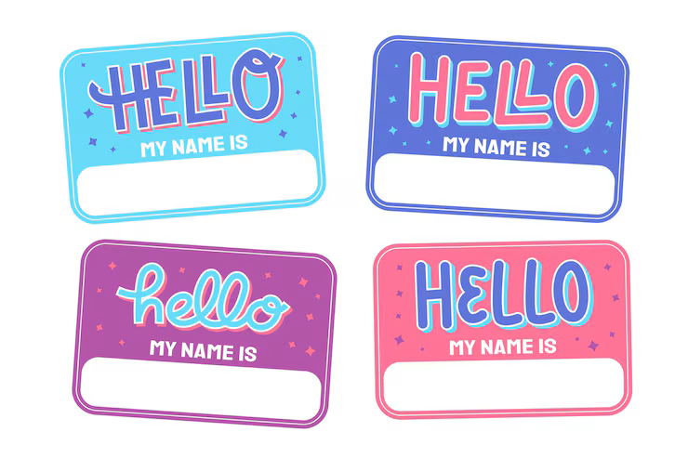
Let’s get started…
Who is here today?
  Introduce yourself
  What school are you from?
  What is your major or major interest?
What are you hoping for today?
Why are you here?
Notes:
[Facilitator] - Participant Introductions
At tables, introduce yourselves.
Separate conversation about what you are hoping for today and why you are here.
Fill out post-its on the table about why you are here/ what you are hoping for and then we move to wall.
Start with a bday line up.
Groups of 3 with people next to you - unique in common.

Slide 9

earth & environmental scientists will be part of solving many of today’s greatest challenges
Notes:
[Facilitator] - 10:20 am

Slide 10

Why earth and environmental sciences
Why are you interested in the earth & environmental sciences?
Why are these fields important to you?
lookhuman.com/design/62473
Notes:
[Facilitator] - Get the conversations started
Talk in groups.
Ask for volunteers to share reasons.
Annotate the screen

Slide 11
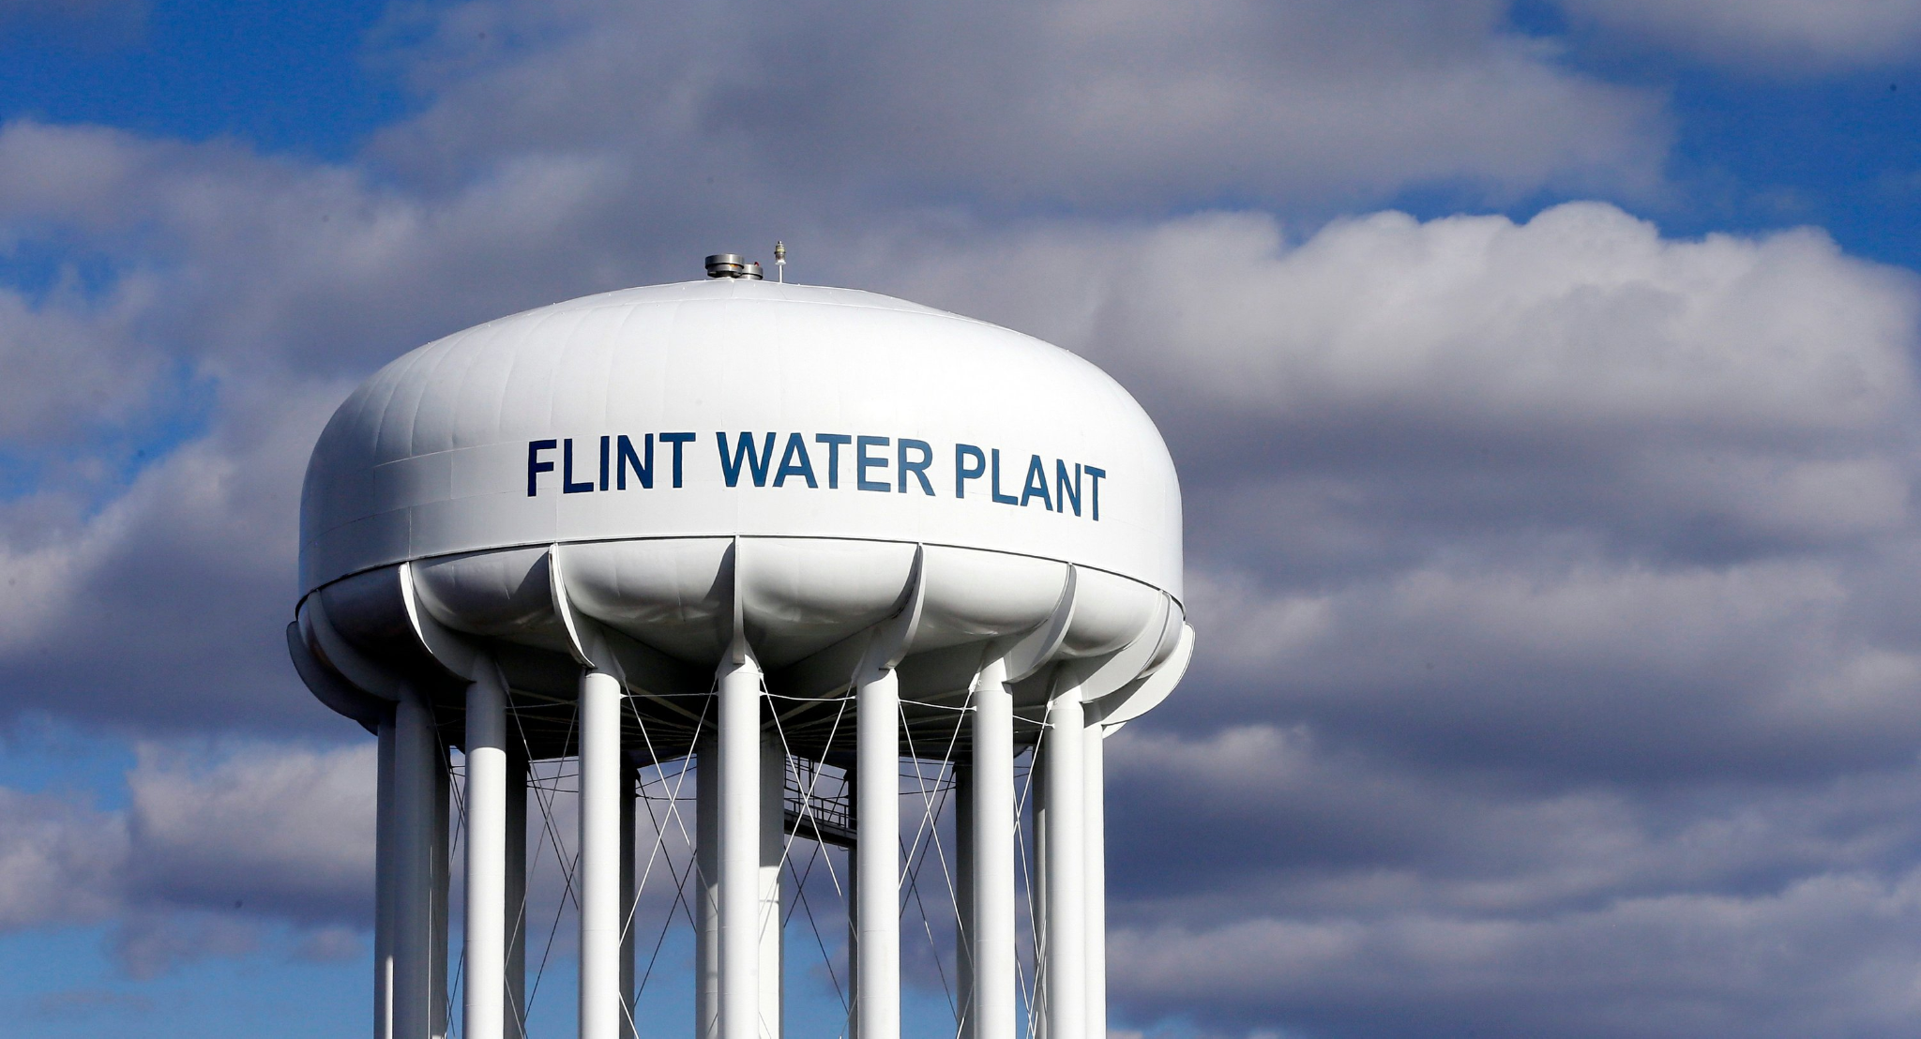
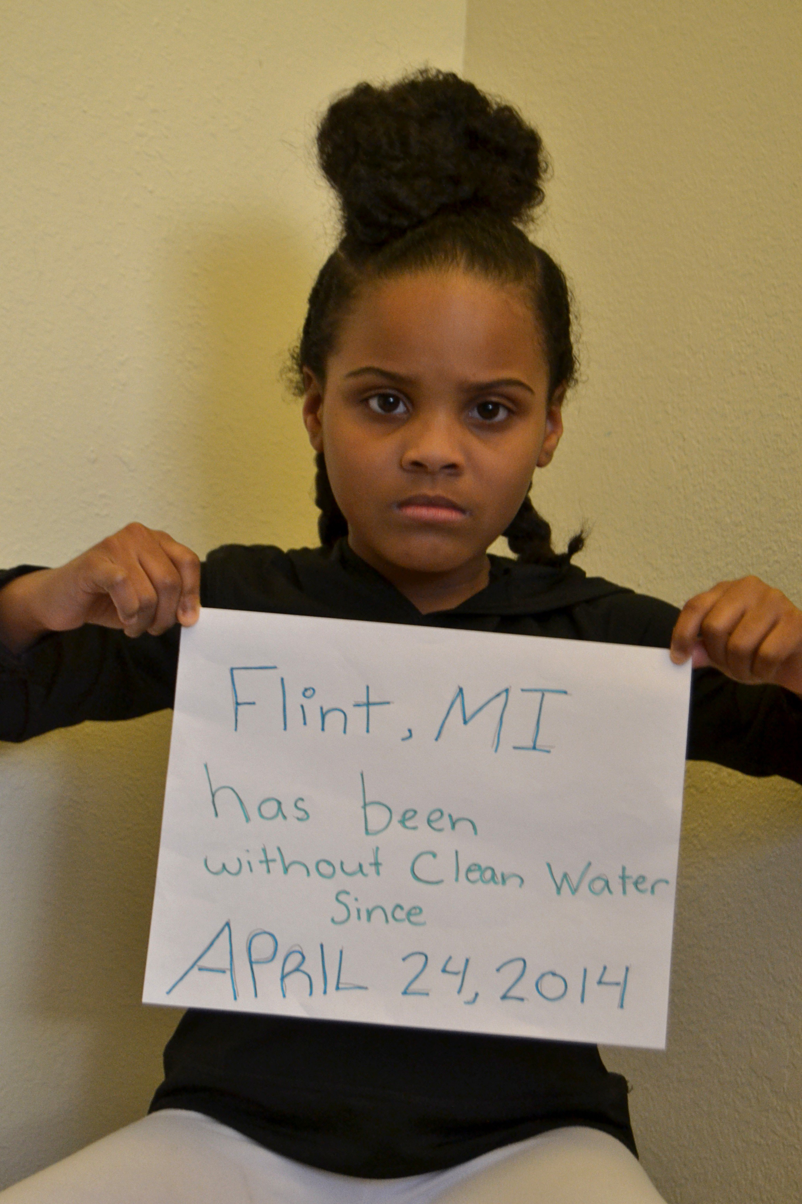
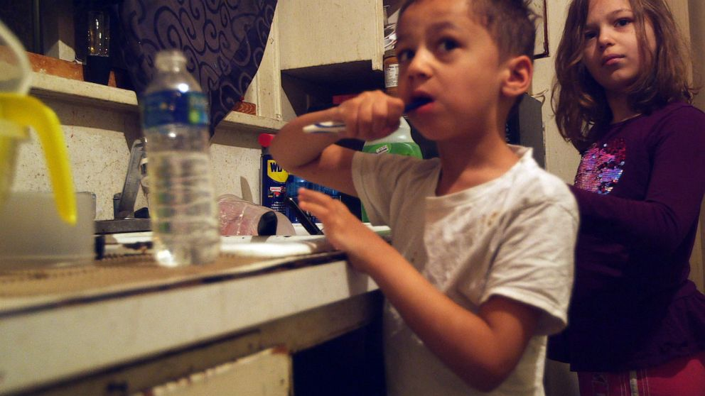
I care about clean water.
Notes:
[Facilitator] - Clean Water Example
I care about clean water
Earth & environmental sciences advance the common good
May 13 2017: https://twitter.com/LittleMissFlint/status/863554476271173634/photo/1
April 25, 2019 5 years after Flint water crisis, city battles widespread mistrust
Half of the residents surveyed said they still don't use the drinking water. https://abcnews.go.com/Politics/trust-eroded-years-flint-drink-water/story?id=62582926

Slide 12
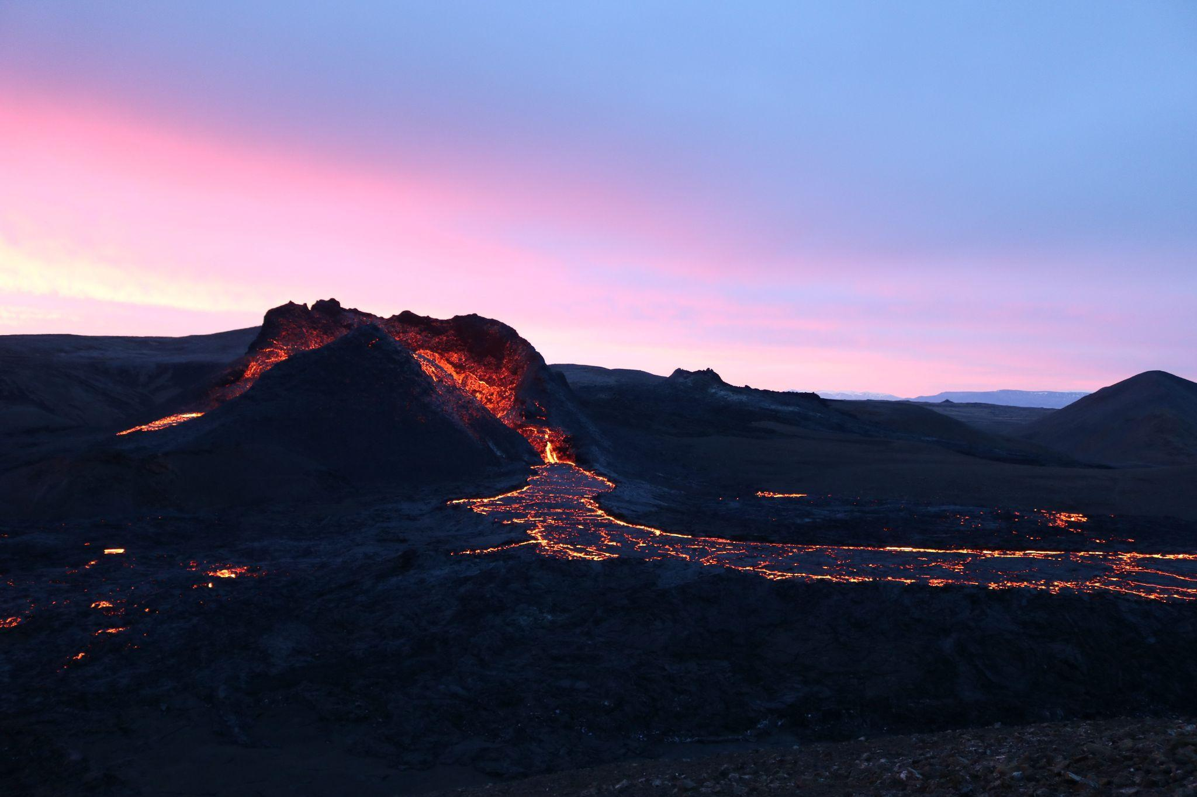
I think volcanoes are amazing!
Photo by Izabela Kraus on Unsplash
Notes:
[Facilitator] Example
Volcanoes are AMAZING

Slide 13

I feel most at peace
when I am in nature.
Photo by Karsten Winegeart on Unsplash
Notes:
[Facilitator] Example
Im at peace when i am in nature

Slide 14

I want to make a difference.
Photo by Markus Spiske on Unsplash
Notes:
[Facilitator] Example
I want to protect our planet

Slide 15

Let’s talk about an issue that matters here in [location].
Flames come close to a home near Potrero on June 20, 2016 Mike Blake / Reuters
https://en.wikipedia.org/wiki/Front_Range
City Dock Annapolis, January 2024. Photo: James Ronayne
Notes:
[Facilitator] - Share an issue that matters locally

Slide 16
Location Specific Issue 1
Flames come close to a home near Potrero on June 20, 2016 Mike Blake / Reuters
https://en.wikipedia.org/wiki/Front_Range
Notes:
[Facilitator] - Share an issue that matters locally

Slide 17
Location Specific Issue 2
Flames come close to a home near Potrero on June 20, 2016 Mike Blake / Reuters
https://en.wikipedia.org/wiki/Front_Range
City Dock Annapolis, January 2024. Photo: James Ronayne
Notes:
[Facilitator] - Share an issue that matters locally

Slide 18
[State a local issue]
In groups,
WHO do we need to assemble to protect people moving forward?
Notes:
[Facilitator]
Activity: Brainstorm -- could do in breakout groups if there is time
Examples of the who: Hydrologists, Geomorphologists, Forest Ecologists, Climate Scientists, Architects, Urban Planners, Atmospheric Chemists, Physicians

Slide 19
Panel Discussion:
Pathways to the Earth and Environmental Sciences
[Name]
[Name]
[Name]
[Name]
[Organization or University]
[Organization or University]
[Organization or University]
[Organization or University]
Notes:
[Facilitator]- 10:30 am, Pathways Panel
Take a chair stretch before starting
Panelist bios can be found on the table & on the workshop website
Explain the ignite format of the talk

Slide 20

Break: 11:30 - 11:45 AM
Be back @ 11:45AM!
***To help be ready for the next session,
please find your Mapping Exercise
Notes:
[Facilitator] - 11:30 am
Tell students we’ll start back up at 11:45 am.
You can encourage students to mark the “First Impressions Poster” during this break, or wait until the lunch break.

Slide 21
Professional Ecosystem Support Mapping Activity
Finding* support in world of science
*We have already done some “finding” for you. More soon.
Notes:
[Facilitator] - 11:45 am, Support Mapping Activity

Slide 22
What is the truth about Science work?
Geoscientists do not work alone.
The myth of independence:
  Gives the false impression that scientists work independently.
  Being disconnected from the scientific community is not normal.
Science is a team sport!
  Scientists benefit in terms of productivity and well-being.
  Scientists at multiple career stages and with differing expertise often work together.
Notes:
[Facilitator] - 11:45 am, Support Mapping Activity
After hearing from our fabulous panel, you will notice all of their paths were different AND all of them had many people on their path that helped, supported, and worked WITH them to get them where they are.
We all have people in our worlds who help us navigate current and new steps.
Let’s first address a potential piece of misinformation about science.
What IS the truth?

Slide 23
Professional Ecosystem Support Mapping Activity Template
Notes:
[Facilitator] - Support Mapping Activity
We want to help you consider the same thing
What have you done
Who has helped AND how have they helped.
We will be using a tool to guide your thinking.
It is meant to be something for you to think about AND develop and grow as you move forward.
Let’s consider the word support first...

Slide 24
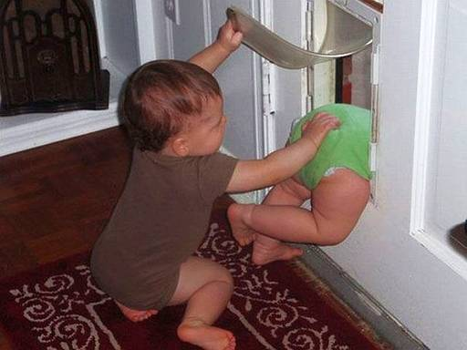
Everyone needs different types of support
What can support look like?
Who supports you?
  Put individual names on post its
Who helped you get to today? i.e.Teacher, Role Model, Counselor
What are your 5 or 10-year academic and professional goals?
What kinds of support do you need to get there?
Who gives you the most support for these goals currently?
Notes:
[Facilitator] - Support Mapping Activity
What did you come up with?
Annotate on the screen.
What will get you through school?
Your career choices along the way?
What do you need?
What really helps you and/or supports you?
Let’s think about all the people who might be contributing to one OR more of these things in your life.
On post-its, put 1 name per post-it - ALL the people you can think of who do something to support you.

Slide 25
Professional Ecosystem Support Mapping Activity:
Getting Your Work Done
Getting your work done
Intellectual Community
Professional development
YOU
Notes:
[Facilitator] - 11:56 am, Support Mapping Activity
We are going to build out this tool and explain some different categories that can help structure your thinking about what you need and what you get.
There are 3 bigger categories, each with smaller sub-categories.
First one, Getting Your Work Done.
Examples for IC are things like:
Studying
Advice on what classes to take
Feedback on an app for an internship
Professional Development - time mgmt, conflict mgmt, public speaking, etc.
Have participants fill out their maps – 2 different graphics of how to do this – the circles and the list with checkboxes
Participants can use one or both (interestingly about half the group uses one and the other half use the other – only a few fully do both)

Slide 26
Professional Ecosystem Support Mapping Activity: Career Advancement
Getting your work done
Career Advancement Support
Intellectual Community
Professional development
Networking and Sponsorship
YOU
Role Models
Notes:
[Facilitator] - Support Mapping Activity
Next category - Career Advancement
Networking examples include:
People that make sure you know about things that are happening
People who can introduce you to others
Role models
Who is doing what you might enjoy
How you might enjoy it
You appreciate some things in their character, etc.
Have participants fill out their maps – 2 different graphics of how to do this – the circles and the list with checkboxes
Participants can use one or both (interestingly about half the group uses one and the other half use the other – only a few fully do both)

Slide 27
Professional Ecosystem Support Mapping Activity: Well-being
Getting your work done
Career Advancement Support
Intellectual Community
Professional development
Networking and Sponsorship
YOU
YOU
Role Models
Values and Identity
Safe space
Kindness and Belonging
Well-being
Notes:
[Facilitator] - Support Mapping Activity
Last category - Well Being
Safe space examples
Who encourages you to speak your truth? Can hold confidence? Help you navigate problems and/or just listen with empathy?
Kindness
Who lets you know that you belong, you are welcome, you are included
Values
Who shares your values?
Your culture?
Your character?
Perhaps aligns with your struggles?
Etc.

Slide 28
Each of these groups help you succeed in different ways
Getting your work done
Career Advancement Support
Intellectual Community
Professional development
Networking and Sponsorship
YOU
YOU
Role Models
Values and Identity
Safe space
Kindness and Belonging
Well-being
Notes:
[Facilitator] - Support Mapping Activity
All add value
We need more of one or more at different times
We will come to rely on each of these in different ways at different times

Slide 29
Getting your work done requires:
Intellectual community
Study and work together
Buddy for attending academic related activities on campus
Advice on classes and internships
Feedback on writing
Professional development
Time-management
Conflict resolution
Public speaking training
Scientific skills
Confidence building
Substantive feedback
Intellectual Community
Professional development
Networking and Sponsorship
YOU
Role Models
Values and Identity
Safe space
Kindness and Belonging
Notes:
[Facilitator] - 12:02 pm, Support Mapping Activity
Brainstorm Q is a build
Who are people who might fill these roles?

Slide 30
Career Advancement requires:
Networking and Sponsorship
Letters of recommendation
Mention your name for opportunities
Mediate for you
Alerting you to opportunities
  Scholarships
  Internships, jobs
  Awards
Role models
School-life balance
Work ethics
Productivity
Career Choices
Skill Set
Intellectual Community
Professional development
Networking and Sponsorship
YOU
Role Models
Values and Identity
Safe space
Kindness and Belonging
Notes:
[Facilitator] - Support Mapping Activity
Keep adding to it.
Okay to repeat certain kinds of people...we will find that some people fill MORE than 1 role

Slide 31
Well-being requires:
Values and Identity
Cultural
Spiritual
Other professional values
Kindness and Belonging
Convey friendliness
Build community
Safe Space
Trustworthy
Let you vent without judgment
Blow off steam, express your frustration
Help you problem-solve
Help you regain composure
Intellectual Community
Professional development
Networking and Sponsorship
YOU
Role Models
Values and Identity
Safe space
Kindness and Belonging
Notes:
[Facilitator] - Support Mapping Activity
Keep going, who else?
If you draw a bit of a blank, that’s ok too.
You may not know who specifically or what kind of person might be BEST to help.
We continue to learn and develop new relationships for different things as our career path and journey continue.
Where are you getting support now?
Cast net wider - Insert INDIVIDUAL EXAMPLE

Slide 32
Who is in your ecosystem of support?
Career Advancement Support
Getting your work done
Intellectual Community
Professional development
Networking and Sponsorship
YOU
YOU
Role Models
Values and Identity
Safe space
Kindness and Belonging
Use your Support Map
Well-being
Notes:
[Facilitator] - Support Mapping Activity
It’s time to put your post-its to work.
Initially, you thought of people who supported you in some way.
Perhaps these categories made you think of MORE people.
First step - add any post-it notes you need to.
Then arrange them on this map - you MAY need to make additional post-it notes for ONE person if they fit more than 1 category - that is totally FINE.
It’s fine to have empty circles, especially at this point in your journey.
You’re not limited to the people they added in the first exercise (i.e. they can expand to as many as they want)
At least 10 minutes to work on their own, then lead discussion via reflection on their ecosystem map (as well as others)

Slide 33
Who is in your ecosystem of support?
Name
Networking and Sponsorship
Values and Identity
Professional Development
Kindness and Belonging
Intellectual Community
Role Models
Safe Space
Notes:
[Facilitator] – 12:08 pm, Support Mapping Activity
You can list names - this might be helpful to determine all the post-its you need.
Of course, people can land in more than ONE category.
Alright, time has come to work on YOURS.
We want to give you 8 minutes to work on your own.
When they come back - questions? Comments on that experience? What did you notice?

Slide 34
Who is in your ecosystem of support?: Example
Name
Mary Awesome |  | x |  |  |  |  | x
Keisha Rockstar |  |  |  | x
Dan the Man | x |  | x
Networking and Sponsorship
Values and Identity
Professional Development
Kindness and Belonging
Intellectual Community
Role Models
Safe Space
Notes:
[Facilitator] – 12:08 pm, Support Mapping Activity
You can list names - this might be helpful to determine all the post-its you need.
Of course, people can land in more than ONE category.
Alright, time has come to work on YOURS.
We want to give you 8 minutes to work on your own.
When they come back - questions? Comments on that experience? What did you notice?

Slide 35

Do you have any unicorns?
Every mentor can offer you something, but you should be careful to not go to one person with everything
Name
Mary Awesome |  | x |  |  |  |  | x
Keisha Rockstar |  |  |  | x
Dan the Man | x |  | x
Unicorn Human | X | X | X | X | X | X | X
Intellectual Community
Networking and Sponsorship
Kindness and Belonging
Professional Development
Role Models
Values and Identity
Safe Space
Notes:
Chris - 12:16 pm, Support Mapping Activity
Do you have any unicorns?!
Yes, some people ARE amazing and you think of them for everything, AND they respond.
AND just be careful.
It can be SO useful to spread it out a bit and be curious about other perspectives.
At the same time, we need to be GRATEFUL for the people that show up for you in many ways.
Say thank you!

Slide 36
Let’s look at an example:
Notes:
Chris - Support Mapping Activity

Slide 37
[Facilitator]’s Map in [enter a year]:
[Name]
[Name]
[Name]
Intellectual Community
[Name]
Professional development
Networking and Sponsorship
YOU
Role Models
Values and Identity
Safe space
Kindness and Belonging
[Name]
Notes:
[Facilitator] - Support Mapping Activity
If you draw a bit of a blank, that’s ok too.
You may not know who specifically or what kind of person might be BEST to help.
We continue to learn and develop new relationships for different things as our career path and journey continue.
Where are you getting support now?
Cast net wider - INDIVIDUAL EXAMPLE

Slide 38
Your ecosystem will change over time.
[Facilitator]’s Map in [enter another year]:
[Name], [Name]
Intellectual Community
[Name], [Name], [Name]
Professional development
Networking and Sponsorship
[Name]
YOU
Role Models
[Name], [Name], [Name]
Values and Identity
[Name]
[Name], [Name], [Name]
Safe space
Kindness and Belonging
[Name]
Notes:
[Facilitator] - Support Mapping Activity
If you draw a bit of a blank, that’s ok too.
You may not know who specifically or what kind of person might be BEST to help.
We continue to learn and develop new relationships for different things as our career path and journey continue.
Where are you getting support now?
Cast net wider - INDIVIDUAL EXAMPLE
Know that ANY way your map looks is okay.
It will grow and change - actually it NEEDS to grow and change over time.
You are early in your journey.
We wouldn’t expect every circle to be filled.
More, different and it will change again after graduation.
AND it doesn’t have to just be a picture of what you have
It can be helpful to also decide what you need AND how you might try to locate more support.
And there is good news about that… (next slide)

Slide 39
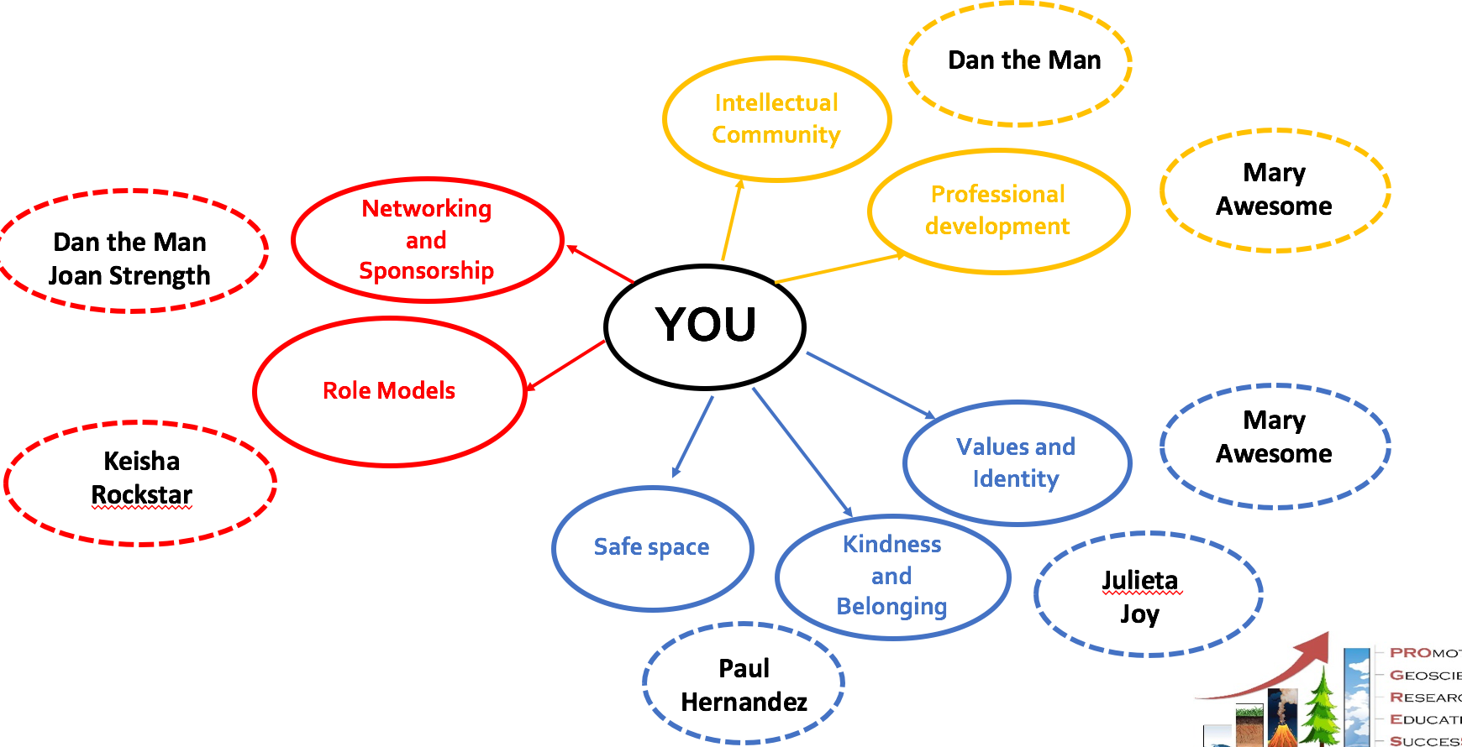
Remember everyone in your network…
...also has a network!
Notes:
[Facilitator] - Support Mapping Activity
All your people have people.
We just need to learn WHAT we need AND how to ask for what we need to some of the right/best people.
In the meantime, let’s see if we can get more clear on your experience with this and connect with others who did the same exercise.

Slide 40
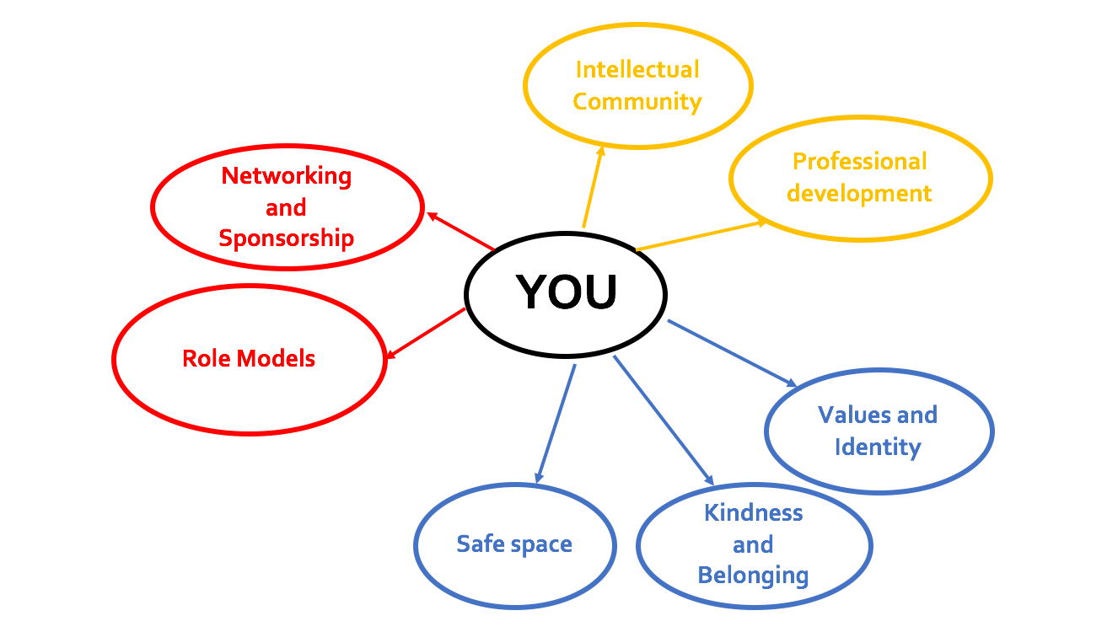
Professional Ecosystem Support Map Discussion
At your table, discuss:
  What is one category you are ‘sure of’?
  What is one category you are ‘unsure of’?
Notes:
[Facilitator] - 12:21 pm, Support Mapping Activity
Talk about what categories feel really ‘clear’, and those that don’t.
Breakouts in 3’s for 5 minutes
Reflect on your own situation and hear someone else’s experience as well.
Ask about their conversations – any trends?
Usually sponsorship is lacking, sometimes intellectual community.
Clarify the difference between safe space and other well-being.

Slide 41
How do I find people for all of these areas?: Your Work
Intellectual community
Classmates
Neighbors
Friends at other universities
Offer to be this type of support for someone else and they will often reciprocate!
Professional development
Workshops
Professional organizations
Online resources
University emails
Notes:
[Facilitator] - Support Mapping Activity
Tips for the future on how to continue to build your support network map – help on how to find these people for the future
Highlight that each of the sheets LOOK similar yet do provide different information that can help them.
Remind them that it’s a dynamic, living document – it is okay for it to change often AND can be helpful when we need to be proactive about what it is that we need.

Slide 42
How do I find people for all of these areas?: Career
Networking and Sponsorship
Who has seen you at your best?
Who has seen you overcome a challenge?
Who depends on you?
Email announcements
Campus career center
Befriend people who always seem to be “in the know”
Forward information, be a “hub”
Mentor
Role models
Professors/working scientists
Grad students
Recent graduates
Classmates a year or two ahead of you
People outside of school
Notes:
[Facilitator] - Support Mapping Activity
Tips for the future on how to continue to build your support network map – help on how to find these people for the future
Highlight that each of the sheets LOOK similar yet do provide different information that can help them.
Remind them that it’s a dynamic, living document – it is okay for it to change often AND can be helpful when we need to be proactive about what it is that we need.

Slide 43
How do I find people for all of these areas?: Well-being
Values and Identity
As important as career support
Family & friends
Trained professionals
Kindness and Belonging
Professor you relate well to
Student a year or two ahead of you
Teaching assistant
Safe Space
Be careful to trust too early
Consider people removed from the situation you need to vent about
Who can you always count on to be outraged on your behalf?
Who will keep things private?
Notes:
[Facilitator] - Support Mapping Activity
Key theme: We need to ask if we don’t know...and choosing the wrong person who CAN’T help isn’t bad, we just move on and ask someone else.
Now, HOW we ask can be important...

Slide 44
Let’s practice reaching out!
You would like an opportunity to shadow in a lab at your institution (or do a virtual visit)
Write an email to a professor that you think can help make this happen
***A hybrid virtual world makes it easy to join remote lectures, lab meetings, etc. Just ask!
Notes:
[Facilitator] - 12:24 pm, Support Mapping Activity
If we are interested in learning more about someone/working with them, etc., we need to know how to be smart about reaching out.
Quick practice.
Imagine scenario described above.
Take a few minutes to write a draft of what you would say.
After a few minutes, share at their tables and see what they like and don’t (listen to different styles – no one ‘right’ way to do it).
Ask for a few brave people to read theirs to entire group and offer insights – ‘that’s great’ – ‘let’s reconsider this’ – what else could we do?

Slide 45
Let’s help each other
Share your practice emails with each other
Listeners can offer examples of what they liked, what other ideas they have to make it better and/or different
Take any notes and/or ideas that will make your email better
Notes:
[Facilitator] - 12:29 pm, Support Mapping Activity
Go into breakouts in trios for 6 minutes.
Feel free to ask questions, make comments, this isn’t about perfection - it’s about being interested, respectful, and creative

Slide 46
DO’s and DON’T’s for Making Requests
DO’s
Tell them why you want this, include your interest AND any experience
Tell them what you already know about them
Be professional (Dr. __)
Acknowledge they are busy AND appreciate and be open any opportunity
DON’T’s
Ask them what they are currently working on (do your homework!)
Ask them to be a mentor right away
Be TOO specific about exactly what and when you want something
Expect them to find out everything for you
Notes:
[Facilitator] - 12:38 pm, Support Mapping Activity
To review (perhaps) or add new things – here is a general list of Do’s and Don’t’s
Clarify as we go and see what additional questions they have

Slide 47
Professional Ecosystem Support Map
Will you add someone to your map today?
What are things that you can do to meet the right people moving forward?
How can you use Social Media to build your map?
Notes:
[Facilitator] - 12:41 pm, Support Mapping Activity
Short-term application – who can you add from today?
Long-term application – what can you do to add to people moving forward intentionally?
Ask the group – what things can you do to add people to your list intentionally (this can either be a table discussion that they report out on OR done as a large group – depending on time)
Ask any scientists in session - what have you done to find the right people?

Slide 48
Be sure to vote on your first impressions!
Stamp for YES!
Working Lunch Plan
12:45 – 1:35 pm | Your time! Eat, go outside, talk to someone new!
1:35 – 1:40 pm | Make your way back to your seat
1:40 pm | Start back up!
Notes:
[Facilitator] - 12:45 pm, Support Mapping Activity
Join mentors for lunch. What mentors are joining at lunch? Do we have a PROGRESS team person in each breakout to facilitate conversation?
Some questions, if needed:
How did you know science is what you wanted to do seriously?
How good are you at asking for support?
For students - what qualities are important for you in a mentor?
What has support looked like for you?
2:00 pm - Welcome back!
Ready for our second half?
Reshuffle students to encourage new networking
60 sec, line up by hair length
Count off for new table groups

Slide 49
Panel Discussion: What Mentoring Means to Me
[Name]
[Name]
[Name]
[Name]
[Organization or University]
[Organization or University]
[Organization or University]
[Organization or University]
Notes:
[Facilitator] - 2:00 pm, Mentoring Panel

Slide 50

Be back at 3:05!
Notes:
[Facilitator] - 3:00 pm, Stretch Break
Back up yoga video (5 minutes, standing only): https://www.youtube.com/watch?v=lsw39ao17h0&pp=ygUXeW9nYSA1IG1pbnV0ZXMgc3RhbmRpbmc%3D

Slide 51
Growing Equitable Inclusion
Centering all of us in science
Notes:
[Facilitator] - 3:05 pm, Growing Equitable Inclusion
How can we all better feel included and invited into the world of science?
We all likely need some work in this area.
Things aren’t easy in workplaces, that’s for sure.
We want to think about how we view others, how others may view us and how do we contribute to creating inclusion for all.
We all want to be able to bring our full selves to our studies and work life.
This starts with us as individuals.

Slide 52
Who are we?
Social Identities
Flower Power Exercise
Notes:
[Facilitator] - Growing Equitable Inclusion
One way to do this...is we want to know who is in the room.
What is social identity?
Write down a few identities that you think about yourself and how other people may see you/associate with you.
Example: Black Women Scientist
Think about your identities and write some of those /characteristics down on a piece of paper.
Provide examples.
I identify as female.
Generously speaking, I am middle-aged.

Slide 53
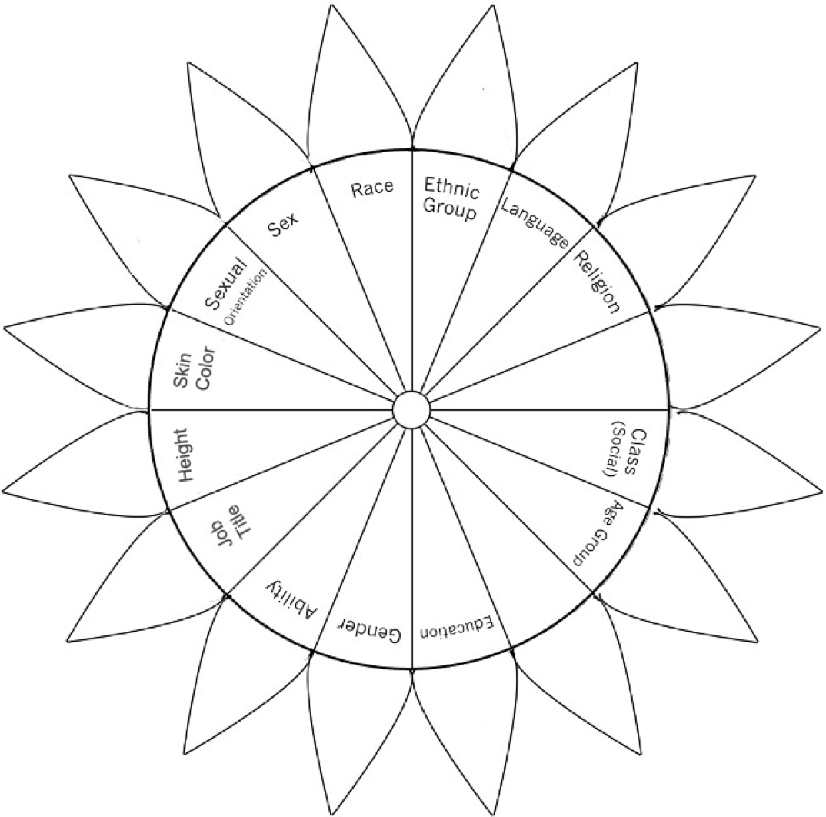
Flower Power Exercise
Notes:
[Facilitator] - Growing Equitable Inclusion
While who we are remains consistent in any group, how we show up and use any of our identities differs in different settings.
Keep in mind, some of these identities are visible to others, some are not, so people may not even know what is true for you.
Who we are ends up being in relation to where we are in the group - regardless of what they fully know to be true and what they make up in their head.
In this case, I want us to think about influence.
When do you have low influence or are part of a lower influence group?
When do you have higher influence? (or at least when do you believe you have either).
As a student, in America, think of your day to day life.
Add marks in the different petals above.
Use the outer petals for when you feel part of the higher influence group & use inside for lower influence group.
Note the empty one if there’s something from you that’s missing here.

Slide 54
Discussion
Which identities do you think about the most (i.e., most salient)?
How does context change any of this? Does this change depending on what class you are in (e.g., History versus STEM)?
How do our experiences impact how we see others?
Notes:
[Facilitator] - Growing Equitable Inclusion
Come back to large group.
Key learning is that this is not the same in every environment.
We all come into a room with a variety of social identities and we tend to pay attention to the identities that make us feel most vulnerable in a given context. We sometimes ignore social identities in which we have power.
Whatever your identities might be, know that you are welcome here and that means all of you.
Help everyone see that this can be more or less salient depending on the context.
Follow up could be asking about or noting differences based on living situation or other (e.g. Residential learning communities, engineering learning community)

Slide 55
2. First Impressions
[Name]
[Name]
[Name]
[Name]
Notes:
[Facilitator] - Growing Equitable Inclusion
Who we are plays a role in how we show up.
And those same identities play a role in how we view others and likely even treat them.
In addition to our identities, how and when we meet people play a role too.
(include people who are in the room on the ‘first impressions poster’)

Slide 56
2. First Impressions
Based on what you have seen so far:
Annotate in the box if it’s a yes
Does she easily extend deadlines for students?
Does she draw and paint?
Does she consistently gets high ratings in teaching?
Is she good at telling a joke?
Is she an organized professor?
Did she play a sport in college?
Did she sing in the choir or play a musical instrument in college?
Notes:
[Facilitator] - Growing Equitable Inclusion
Use stampers to mark the box if it’s a yes.
(you can customize these ahead of time)

Slide 57
First Impressions Example
2. First Impressions
Based on what you have seen so far:
Annotate in the box if it’s a yes
Does she easily extend deadlines for students?
Does she draw and paint?
Does she consistently gets high ratings in teaching?
Is she good at telling a joke?
Is she an organized professor?
Did she play a sport in college?
Did she sing in the choir or play a musical instrument in college?
Notes:
[Facilitator] - Growing Equitable Inclusion
Use stampers to mark the box if it’s a yes.
(you can customize these ahead of time)

Slide 58
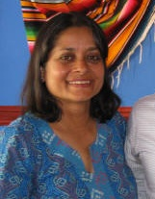
2. First Impressions
The Power and Impacts of Impressions
Happens FAST - ’Thin Slices’ - 10 second clips
  Implicit biases and stereotypes can contribute
AND they LAST - Hard to change
  We form schemas that impact our thinking and what we remember
  After they are formed, biases help to sustain the impression
  Impressions can result in imposter experience, if we conclude we are not like everyone else.
Notes:
[Facilitator] - Growing Equitable Inclusion
Thin Slice Theory - This activity brings us into our next slide of the power and impact first impressions have on how we view and treat others, and how others do the same to us.
They happen quickly as research from Ambady and Rosenthal found when they did a study with students who watched 3 10 second clips (thin-slicing) of professors’ teaching nonverbally where they rated their teaching quality and then compared their rating to students who sat in a full class with that same professor.
They found that brief judgments based on thin-slicing are similar to those judgments based on much more information.
The rating from those 10- second clips were very similar to students who sat through that professors full class and rated the teachers after having substantial interactions with them.
This demonstrates the impressive amount of information that is conveyed in thin slices of everyday behavior and the insight that it can provide about an individual's personality, no matter how briefly the behavior is observed.
This also contributes to creating implicit biases and stereotypes because of how fast first impressions happen.
What does this mean?
We have a lot of information in our heads -- which can include stereotypes or what is called in cognitive psychology “schemas” -- that we use to “read” and predict other people’s behavior.
Sometimes they’re accurate, but sometimes they’re not.
What to know?
They form fast and when we don’t pay attention to them, they can shape our thinking going forward:
We form schemas that can impact what we pay attention to, what we remember of people going forward, and what we ignore.
Another word for this is that we have biases that sustain our first impressions.
Impressions of others can result in feeling like “they all belong” and I don’t - which is an imposture experience.

Slide 59

Antidotes
Slow down thinking. Take a breath.
We all have biases, formed to keep us safe.
Be willing to challenge assumptions and look for ‘other information’.
Be aware that attention goes to threats - often we notice different identities.
Remember not to believe everything your mind says to you.
Notes:
[Facilitator] - Growing Equitable Inclusion
When we feel under threat, remember these.
If safe, remember different things.
Be open to being wrong and seeing new info.
Remember others could be working off inaccurate first impressions of you.

Slide 60
3. Reflecting on Support that comes from Kindness
Notes:
[Facilitator] - Growing Equitable Inclusion
TRANSITION: Ways to extend kindness are all around (next slide)

Slide 61
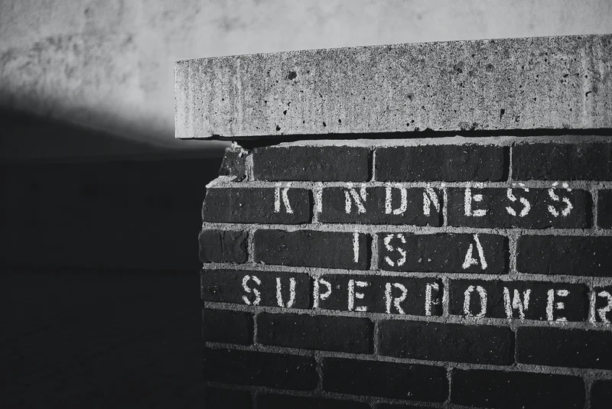
3. Reflecting on Support that comes as Kindness
Recall a time when someone was kind to you in your academic life.
Write about what happened, where it happened, and how you felt. (2 min)
SOME PHOTO
Notes:
[Facilitator] - Growing Equitable Inclusion
Provide as much detail as possible.
Recreate that experience in your brain and body, recall emotion

Slide 62
Discussion
Share your stories with each other
What similarities and differences do your stories have?
Notes:
[Facilitator] - Growing Equitable Inclusion
Groups of 3.
How does it feel in your body?
Oxytocin, serotonin, physical responses to gratitude, appreciation.
Similarities in stories...these people didn’t HAVE to do it; AND these people usually have more power/influence than you.
This CAN be you in the future.
It matters & changes our experience, what we remember, our motivation going forward and our feeling of inclusion.
How can you be kind to others coming into the space? Opportunity for kindness to influence others - it matters

Slide 63
Summary
Awaken to yours and others social identities
Slow down and notice how impressions form, impact our thinking, and inform our behaviors towards self and others
Choose to use your influence, privileges, and power to grow kindness in your academic world -- starting with actions that uphold the dignity of everyone here today.
Notes:
[Facilitator] - Growing Equitable Inclusion
Given all of this, here is a summary of what we hope you carry forward from this time
[read slide]

Slide 64
Connection ToolKit
Making connections to expand our opportunities
Notes:
[Facilitator] - 3:40 pm, Connection ToolKit

Slide 65

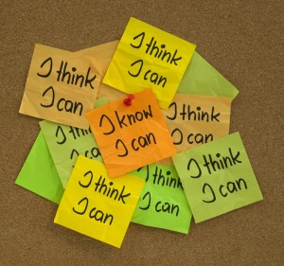

How do you feel about professional networking?
How are you feeling about Science in your future?
I love it!
Love meeting new people and learning about them!
Eh, if I have to...
I know it’s important and I can make myself do it when needed.
I’m hiding!
This is painful. I don’t know what to say and why would they want to talk to me.
Notes:
[Facilitator] - Connection ToolKit
Where are you networking?
Use the thumb method to assess where folks are (up is I love it, sideways is Eh, down is No)
Don’t HAVE to love it to get better at it.
If you love it, what helps you feel great about it?

Slide 66
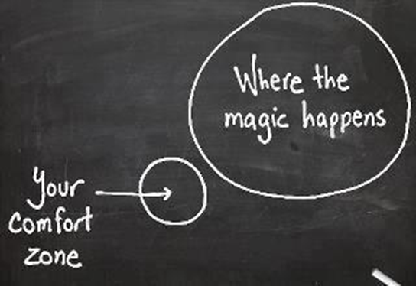
Bad news: Life is one giant networking opportunity
Good news: Networking …Building relationships
Notes:
[Facilitator] - Connection ToolKit
Networking isn’t always comfortable.
We may dread big events, conferences, places we don’t know hardly anyone.
Optional: Share your first reaction when someone says it is time to network.
There are MANY opportunities to connect all the time.
Do we see them?
Notice them?
Create them?
Take advantage of them?
How do we feel about networking?

Slide 67
Networking Tools
Play to your strengths.
We need to be interested, not just interesting.
Set SMART goals.
Notes:
[Facilitator] - Connection ToolKit
Networking - relationship building.
We gotta do it.
AND everyone has some way or something they bring to these interactions.
Here are 3 ideas/tool to help

Slide 68
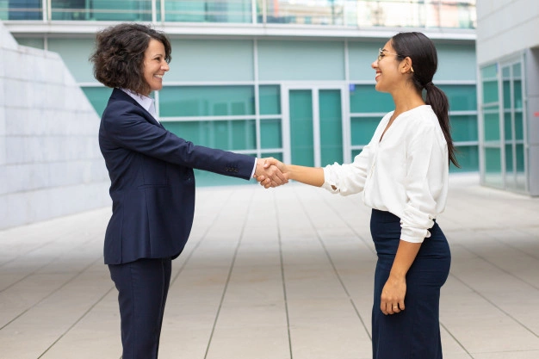
1. Play to your strengths
Recall a time when you made a new connection
What worked? What did you actually do? What qualities and/or skills contribute to it?
SOME PHOTO
Notes:
[Facilitator] - Connection ToolKit
Think about a time it worked.
What about you helped?
Your skills?
Qualities?
Ex: Curiosity, kindness wanting to make other people feel comfortable, liked.
Here we are reframing from instrumental networking to human relationship connections.

Slide 69
Discussion - Let’s Hear from the Room
Networking might feel hard
Connecting to others is rewarding
Notes:
[Facilitator] - Connection ToolKit
Share specifics.
How do you know it worked?
And what about you - those qualities, skills align with connecting and making new relationships?
Admit that networking is hard. Then imagine a time that someone reached out.

Slide 70
Recap
We are built for connection and community.
You have skills to connect, they don’t have to be just like others’ skills.
You have connected to new people here today.
Notes:
[Facilitator] - Connection ToolKit
We likely said versions of all of these.
No one wants to be left out.
Belonging/reference to inclusion.
Sometimes just fear taking first step.
We can all do this differently.
Go to where you are most comfortable.
You already did it today.
What did you like?
What would you do differently?

Slide 71

2. Be interested, not just interesting
People love talking about themselves
Have questions ready
Notes:
[Facilitator] - Connection ToolKit
If you are worried about what to say about yourself (yes, you need to prepare something), makes sense AND people love talking about themselves.
Have questions ready.
Go beyond generic - How was your weekend?
Make it specific to the person or event.
Think about it beforehand.
Like today, what do you really want to know about another student in this workshop?
Get people talking and your talking will feel easier
What could you ask a mentor here today?
What about another participant?

Slide 72
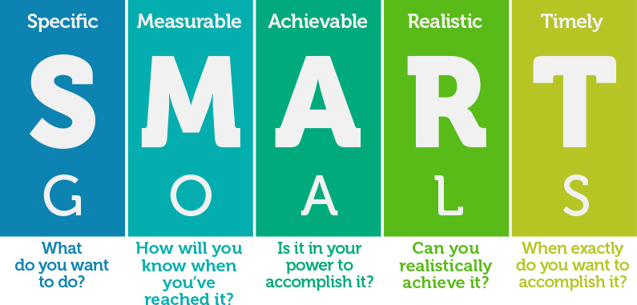
3. Set SMART goals
In the NEXT 2 WEEKS, how can you apply something you have learned in this workshop?
Notes:
[Facilitator] - Connection ToolKit
Explain SMART goals.
Slide builds with question.
Give 90 seconds to write.
Ex:
Maybe it’s re-writing that email and sending it?
Maybe it is looking up other seminars on campus?
Maybe it is asking your advisor about a particular internship?
Maybe learning more about one of our panelists and reaching out?
Share one or two out loud
Write them down! - Writing down your goals increases your chance of success by 40%.

Slide 73

Get to know your GROUP
Share your goals with each other
Share your contact information
Find a time to connect in the next 2 weeks
Notes:
[Facilitator] - Connection ToolKit
We want to help you stay connected.
We also want to help you meet your goals - Sharing goals with someone else increases your chances of success by 77%
We are going to randomly create GOING HOME GROUPS to accomplish this.
One more Breakout.
Inviting you to STAY CONNECTED after today - at least in the next 2 weeks.
Share goals, contact info, find a time in next 2 weeks.
Help each other help yourselves (5 minutes)
This is a great first step of making the most of today.
Start to bring our day to close AND give you MORE information to help.

Slide 74
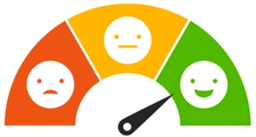
We are in this together.
Let’s make more PROGRESS!
How to Participate
We can keep making this better
Fill out a brief workshop evaluation
  5-10 minutes to complete
  Please do this now
What You Receive
Our gratitude for helping to improve PROGRESS!
Introduction to your mentor
  Matched based on shared similarities
  Meet mentor in public spaces (or online) at reasonable times of the day
Your mentor will reach out to you! Respond and put them on your map!
Notes:
[Facilitator] - 4:10 pm, Closing out
We are in this together now.
We can’t do this without you.
AND you help make us AND this better.
We have emailed you and evaluation. We ask you to do this now - It will take 5-10 min to complete.
As researchers, this is critical for us. After all, as scientists, we love to collect data!
We will email your mentor’s name & email and they will reach out soon.
We want you to have another connection - and we hope you are a great fit with who we assign. It’s okay if it is not.
If you want to meet someone else, just reach out to us. The goal is that you find a good match. So let us help you do that...
With that, I want to officially close this workshop.
We recognize the system isn’t perfect and we can’t fix the system tomorrow. Our hope is to give you tools to navigate the system a little better AND have people who support that process.

Slide 75
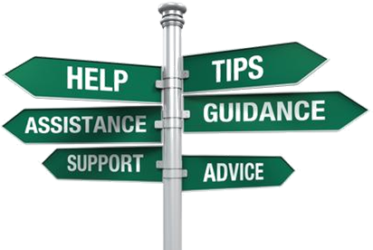
More Resources
[ADD WEBSITES WHERE STUDENTS CAN FIND MORE RESOURCES]
[SHARE CONTACTS HELPFUL TO STUDENTS]
[SHARE ANY OTHER RESOURCES THAT DIRECTLY SUPPORT PROGRESSERS]
Notes:
[Facilitator] - 4:30 pm, Closing out
What a day.
We want to keep helping you in your journey.
Here are some other things you can access to help.
Review each.
Feel free to stick around and speak with us AFTER you complete your evaluation. And don’t forget to take leftovers back with you!
Thank you for spending your day with us!

