Slide 1



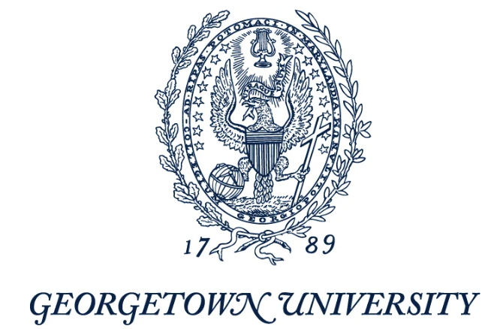





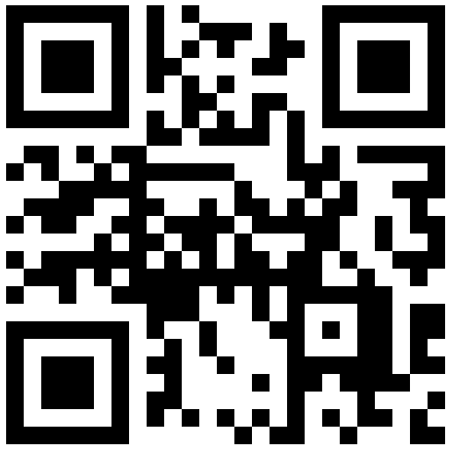
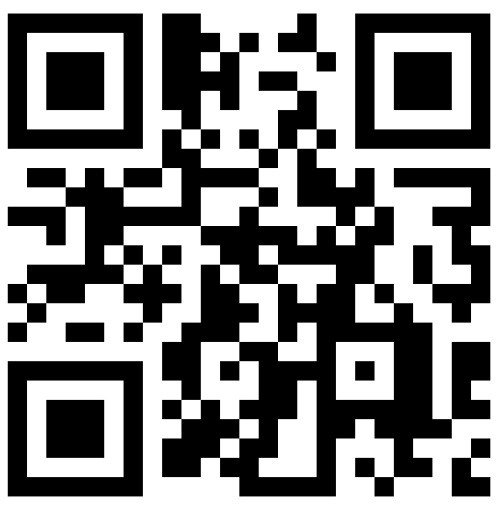

Are you an undergraduate student who identifies as a woman and is interested in the earth and environmental sciences?
Participation begins with a one-day professional development workshop, where you will meet peers with similar interests, learn more about careers, and expand your network.
The 2024 workshop will be Friday, November 8th 10:00 am - 4:30 pm
in UMD’s Atrium in the Stamp Student Union.
Your professors are not involved in the research and your decision to participate will have no bearing on your course grade or credit. Your application to participate will be confidential.
In Fall 2024, we are welcoming students from the following schools:
Visit col.st/fBQwO or scan the QR code to sign up for the workshop
For more information on the workshop visit col.st/HhwVE or scan the QR code
PROGRESS is a mentoring program for you that is supported by the National Science Foundation.

