Slide 1



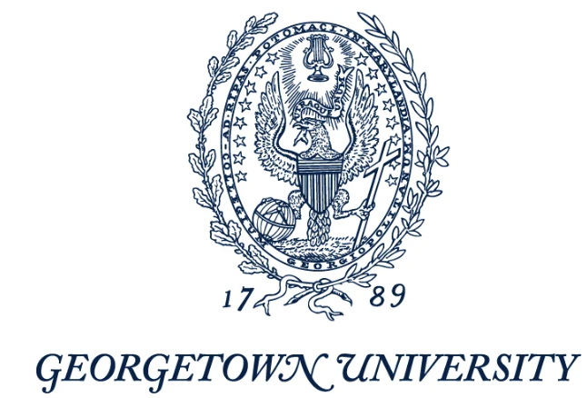





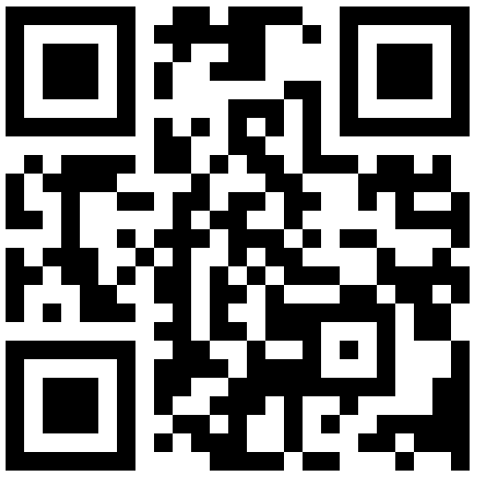
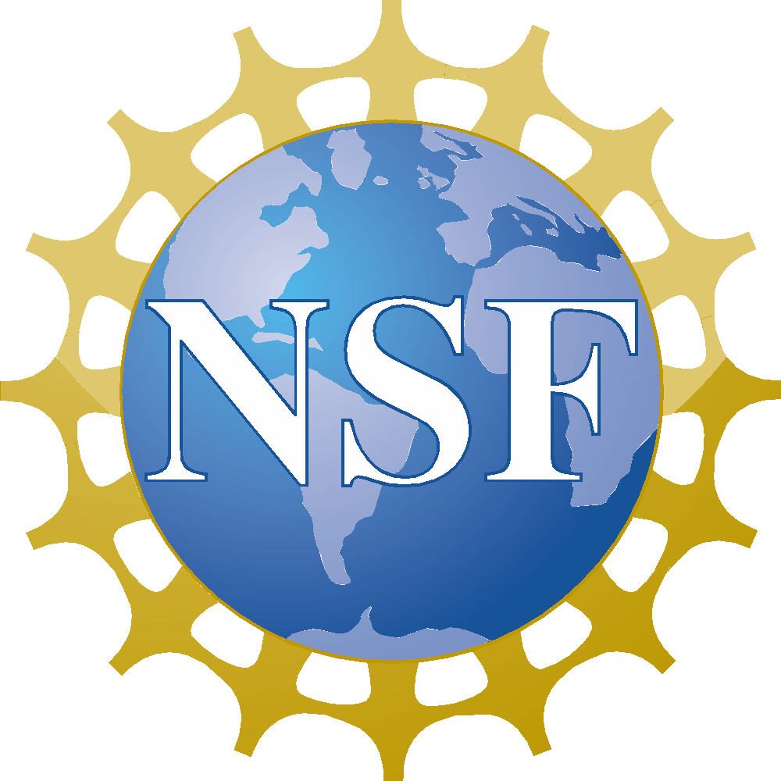
Are you interested in serving as a mentor for undergraduate women pursuing earth and environmental science careers?
PROGRESS supports undergraduate student’s interest in Earth Systems and Environmental Science careers through peer/professional development and connection to a mentor.
Currently recruiting women in all career stages.
Mentors are expected to:
  Participate in a 1-hour virtual training session and
  Meet in-person with their mentee once per semester to check-in, provide support, encouragement, and guidance.
In Fall 2024, we are recruiting mentors in the DC/Baltimore area for students from these schools:
Scan the QR code or visit our website to sign up col.st/lWDwF
PROGRESS is funded by the National Science Foundation

