Slide 1
Designing Effective Assignments and Activities
Barbara Tewksbury, Hamilton College
btewksbu@hamilton.edu

Slide 2
As you enter a classroom, ask yourself this question: “If there were no students in the classroom, could I do what I am planning to do?” If the answer to the question is yes, don’t do it.
General Ruben Cubero, Dean of the
Faculty, United States Air Force Academy
(Novak et al., 1999, Just-in-Time Teaching)
Notes:
One of my favorite quotes about teaching. Why is it one of my favorites?

Slide 3
Research into how people learn (cognitive science) and how to teach to promote better learning (pedagogy) has shown clearly that (e.g., NRC How People Learn):
  Traditional lecture (students as passive receivers of knowledge) is not effective in terms of student learning
  Strategies that actively engage students result in better student learning
Notes:
It encapsulates what has been learned over last 30 years about how people learn and what teaching techniques promote the best student learning If we care about student learning (and not just teacher presentation), we need to incorporate strategies that actively engage students during class. Otherwise, classroom time is lost student learning time.

Slide 4
Importance of having a teaching toolbox
If all you have is a hammer, everything looks like a nail.
Same goes for teaching. If the only tool in your teaching toolbox is lecturing, then….
Notes:
If we want to focus on student learning, it’s important to have a teaching toolbox.

Slide 5
Importance of having a teaching toolbox
Learn about successful student-active assignment/activity strategies
  think-pair-share, jigsaw, discussion, simulations, role-playing, concept mapping, concept sketches, debates, long-term projects, research-like experiences….
  assignments involving writing, poster, oral presentation, service learning….
Make deliberate choices of the best strategy for the task

Slide 6
A simple change can make a huge difference
Think-pair-share
  Divide lecture into ~10 minute sections
  Ask a question
    Give students time to think (or think and write)
    Have students pair up and discuss responses
    Ask teams to share answers with the class
  Changes pace before attention span is reached
  Actively engages everyone in applying what you’ve just lectured about
  Gives everyone time to arrive at an answer
  Less threatening to answer as a team
  You find out where students are wrong-headed

Slide 7
Plan for session
Link between effective assignments and effective courses
Characteristics of effective assignments/activities
Evaluation (ruthless!) of a sample activity
Strategies for improving the sample activity
A bit of time for you to think about how you might implement some of the ideas

Slide 8
Link between course goals & assignments/activities
Course goals – things that we want students to be good at doing by the end of the course
Assignments/ activities are the way that students acquire experience and practice
Students need repeated practice - one-off practice is not enough!
  Timely feedback
  Increasing independence
Assignments/activities are an important part of that practice and of assessing student progress toward the goals

Slide 9
Role of effective assignments/activities
What do we want?
  That students make progress toward the goal(s)
  That students learn from the assignment/activity
  That we can determine what students have learned
Design of the assignment or activity is crucial to both

Slide 10
What makes an effective assignment/activity?
Students learn best when:
  They have a context for new knowledge and new experiences
  Example
    Launching directly into a lecture on mineral chemistry.
    vs.
    Taking ten minutes to have students brainstorm what they already know about the chemistry of minerals and how it ties to their own “real world” before lecturing about mineral chemistry.

Slide 11
What makes an effective assignment/activity?
Students learn best when:
  Their interest is captured (hook)
  Example
    Lab on water analysis that covers sampling technique, use of instrumentation, and critique of results.
    vs.
    Activity that also incorporates an introduction that sets the stage for why knowing water chemistry matters, focusing on a problem of interest and/or relevance to students.

Slide 12
What makes an effective assignment/activity?
Students learn best when:
  They use what they know to tackle problems and think independently
  Example
    Assignment that leads students through identification and interpretation of a set of samples, with answers to leading or nuts-and-bolts questions.
    vs.
    Assignment that teaches the above but also provides opportunity for independent thought, work on open-ended questions, application to solve a problem. “What does it mean, not just what did I do?”

Slide 13
What makes an effective assignment/activity?
Students learn best when:
  They have the opportunity to synthesize, reflect on what they have learned, explain what they know
  Example
    Activity that ends after students have answered questions on a worksheet.
    vs.
    Activity that asks students to step back, think about what they know, write a plan for a new analysis, talk about “aha” insights, explain it to a particular audience (e.g., write an Aunt Tillie statement)

Slide 14
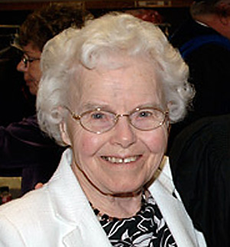
Can you explain it to your Aunt Tillie in 4 sentences?
Born: 1920
Education: B.S., 1942, Chemistry, Simmons College
M.S., 1944, Chemistry, Vassar College
Career: organic chemist at Eastman Kodak Company
Smart, very smart. Loves to learn new stuff. Reads a lot but allows as how she rarely reads novels. Says she’s getting old and figures there’s too much nonfiction out there for her to learn from to waste the time she has left on reading novels. Apt to point out bad grammar, even in your emails. Can’t wait to read your statements.

Slide 15
What makes an effective assignment/activity?
Students learn best when:
  They are motivated
  Example
    Assignment to make a portfolio of work.
    vs.
    Assignment to make a portfolio specifically designed to be useful for the future (e.g., “showcase” work, annotated list of data sources, techniques matrix, resource tables) with a clear focus on how the portfolio might be useful

Slide 16
What makes an effective assignment/activity?
An effective assignment also has an adequate mechanism for determining what students have learned
  Can you verify what students have learned, not just what they have done?
    Students can answer a series of nuts and bolts/leading questions correctly and still not “get it”.
  Can you assess the progress that students have made toward the goal(s)?

Slide 17
Summary: what makes an effective assignment/activity?
Maximizes student learning
  They have a context for new knowledge and new experiences
  Their interest is captured (hook)
  They use what they know to tackle problems
  They have the opportunity to synthesize and reflect on what they have learned
  They are motivated
Allows instructor to determine what students have learned

Slide 18
Task: evaluating a sample activity
How well does it promote student learning?
Could it be better, and, if so, how?

Slide 19
Task: evaluating a sample activity
Goal is to have students
  Interpret the sediment record
  Determine what the environment was like
  Draw conclusions about the nature and timing of rainfall changes in the Sahara
Student background: they know that
  Lakes accumulate sediment eroded from the surrounding areas
  Sediments can preserve features that reflect the nature of the environment (e.g., fossils)

Slide 20
Task: evaluating a sample activity
Evaluate for student learning
Read the activity, paying attention to:
  How the activity starts
  How the activity ends
  The flavor of the questions and what students are asked to do
  Don’t get bogged down in the details
Discuss evaluation with group and arrive at scores for student learning only

Slide 21
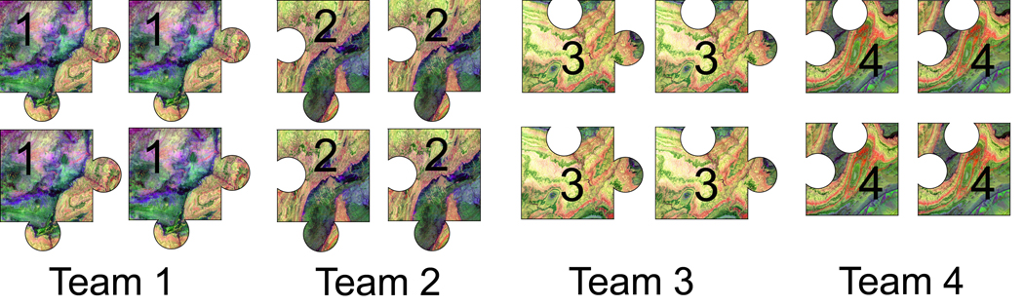
Jigsaw technique
Prepare several different assignments for the class
Divide class into teams
Each team prepares one of the assignments

Slide 22
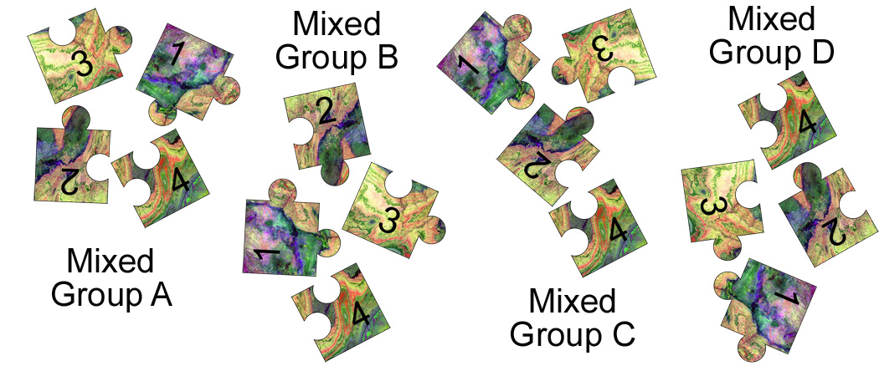
Jigsaw technique
Divide class into new groups with one member from each team
Individuals teach group what they know

Slide 23
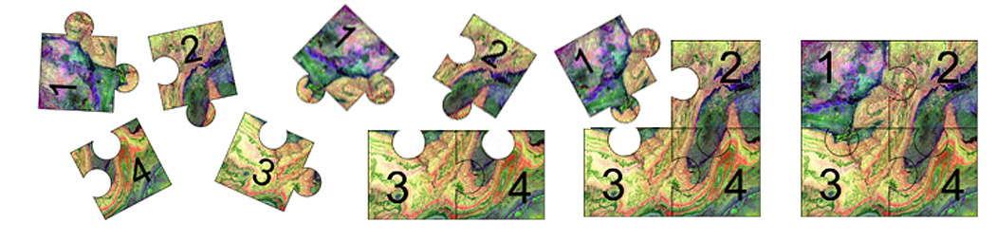
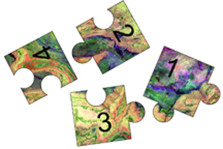
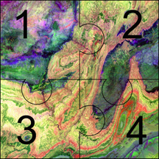
Jigsaw technique
Group task puts picture together
Critical – big difference between:
and

Slide 24
Value of the technique
Students must know something well enough to teach it
Gives students practice in using the language
Students can learn one aspect/example well but see a range of aspects/examples without doing all the work
Well-structured group activity

Slide 25
Critical elements of jigsaw
Students must be prepared and not be wrong-headed
You must be happy that each student knows his/her assignment well and the others much less well
The group task is crucial - without it, it’s not a jigsaw
Some type of individual follow-up is valuable

Slide 26
The Gallery Walk
Prepare several posters each with a different question, data set, or an object to observe and interpret
Hang the posters around the room
Divide the class into as many teams as there are posters
At first station, team makes observation/interpretation, writes it down
At second station, team reads existing observations/interpretations, makes additions and corrections, and adds a new one.
Back at first station, team summarizes and reports to class; class wrap-up.

Slide 27
Value of the technique
Gets students up and moving
Students can work directly with a range of examples without having to do all of the analyses on all examples
Incorporates critical analysis, synthesis, and presentation
Generates a written record of student thinking
Well-structured group activity

Slide 28
Critical elements of Gallery Walk
Topics/objects must be broad/complicated enough for multiple teams to comment
You must be happy that each student knows his/her final topic well and the others much less well
The synthesis and reporting at the end is crucial
Some type of individual follow-up is valuable

Slide 29
Modifications of Gallery Walk
Hidden Gallery Walk
  Each team writes on separate page, puts page in envelope
  Once back at first station, teams open envelopes and resolve discrepancies
Clipboard Gallery Walk
  Teams pass clipboards instead of moving from poster to poster
  Great for larger class

Slide 30
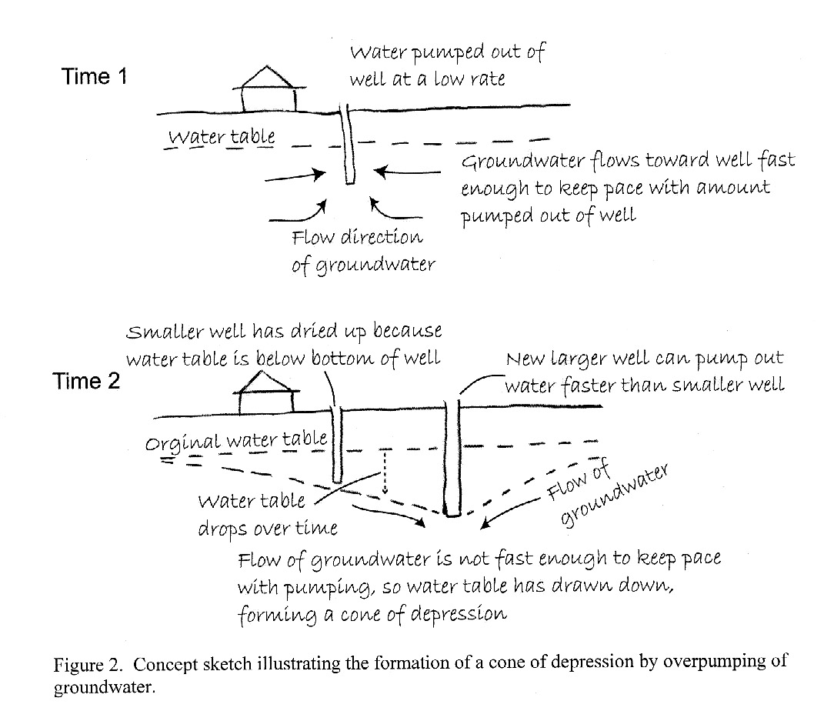
Concept sketches
More than a labeled sketch
Includes processes, concepts, observations, interpretations, interrelationships

Slide 31
Using concept sketches
Any central graphic object will work
  Diagram or illustration
  Satellite image
  Graph or equation
  Set of photographs
  A poem or piece of text
  Student-generated sketch
Homework/lab prep, in-class activity, exams, field work

Slide 32
Value of concept sketches
Students have to organize their knowledge and convey it to others
Have to do more than paraphrase and parrot back
Easy to tell whether students know what they’re talking about
Quick to grade

Slide 33
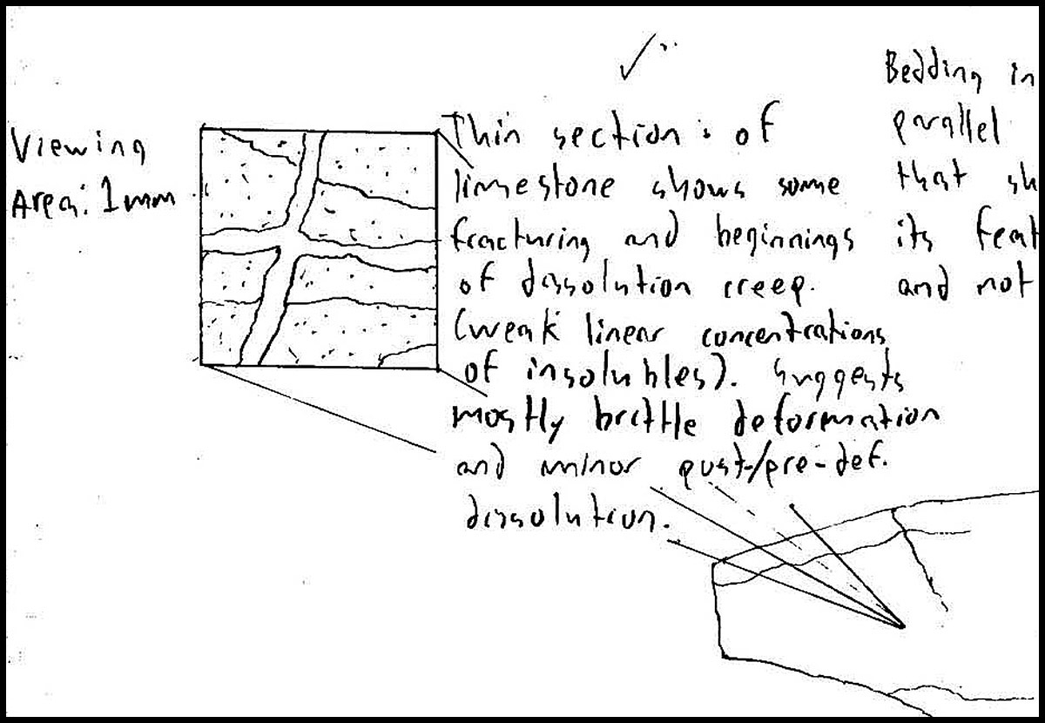
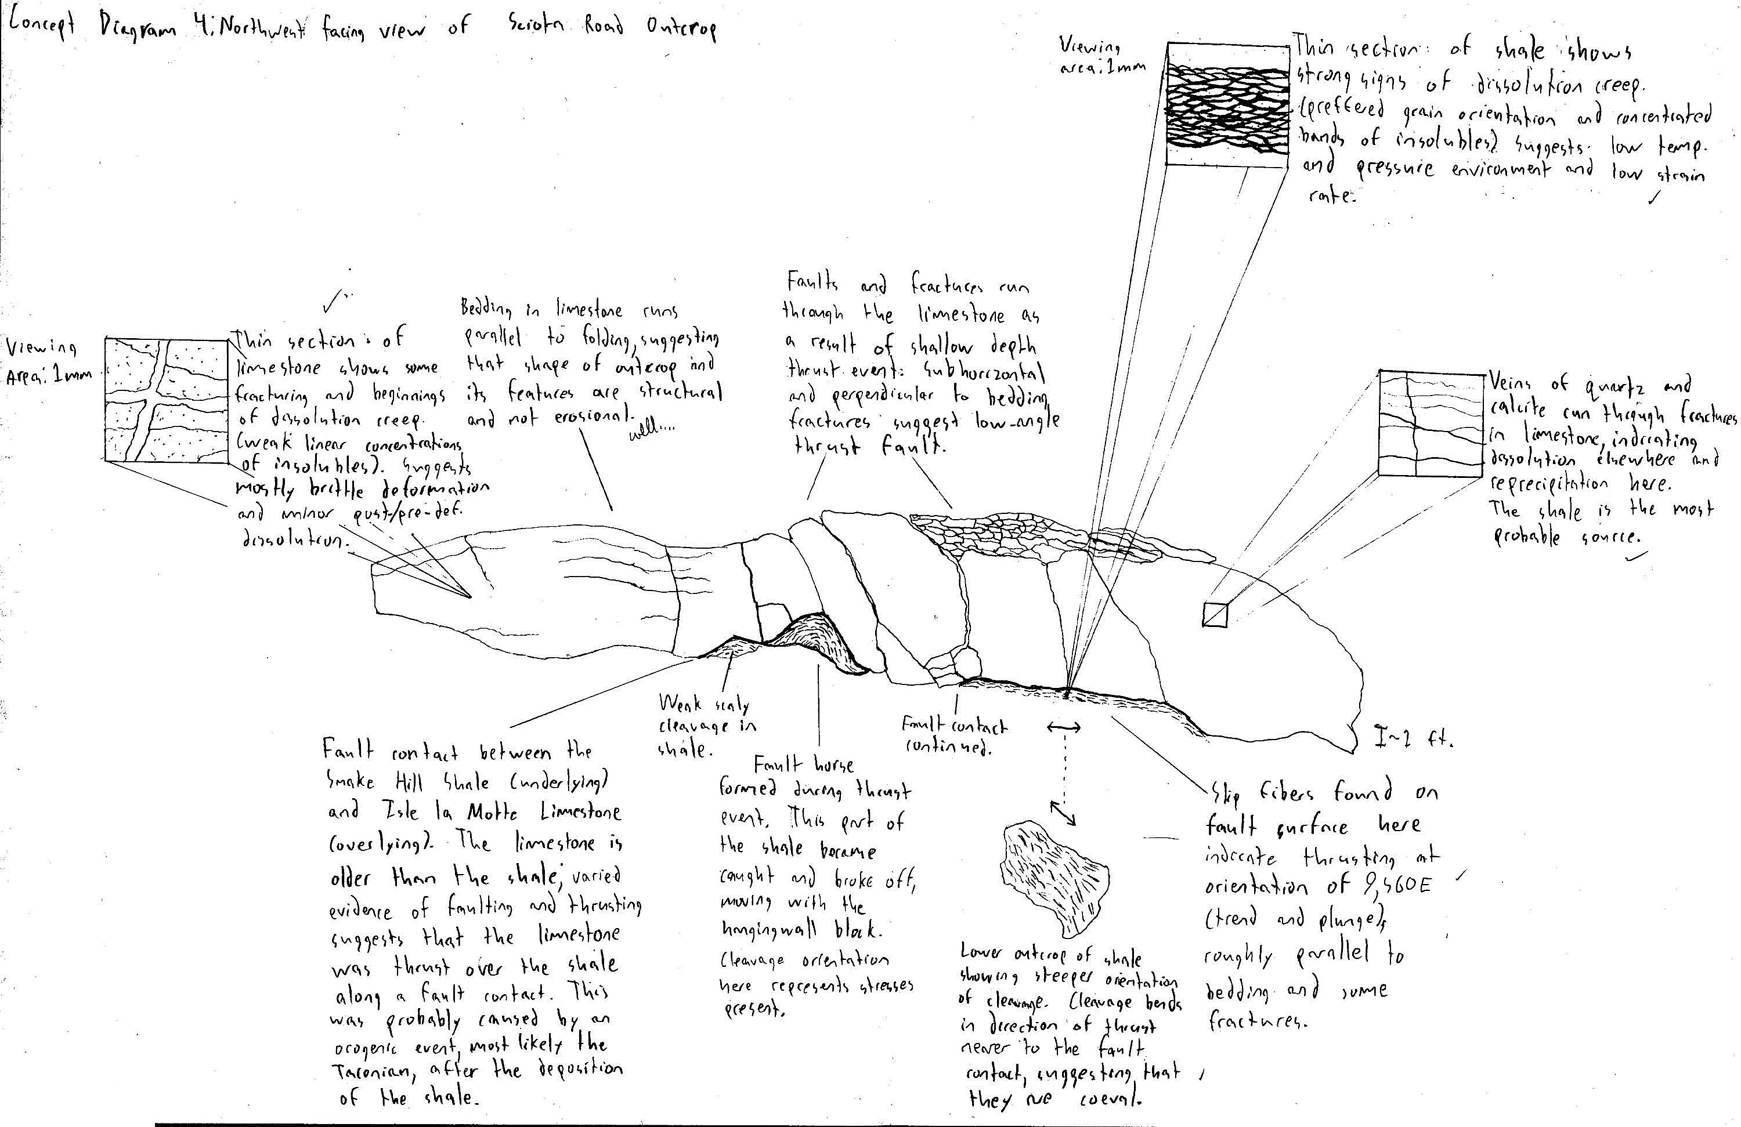
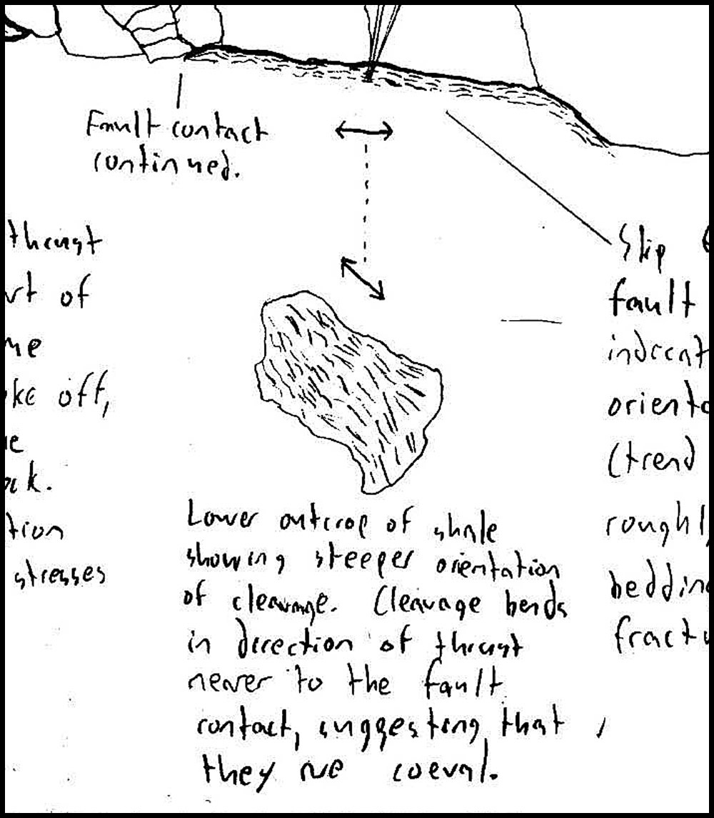

Slide 34
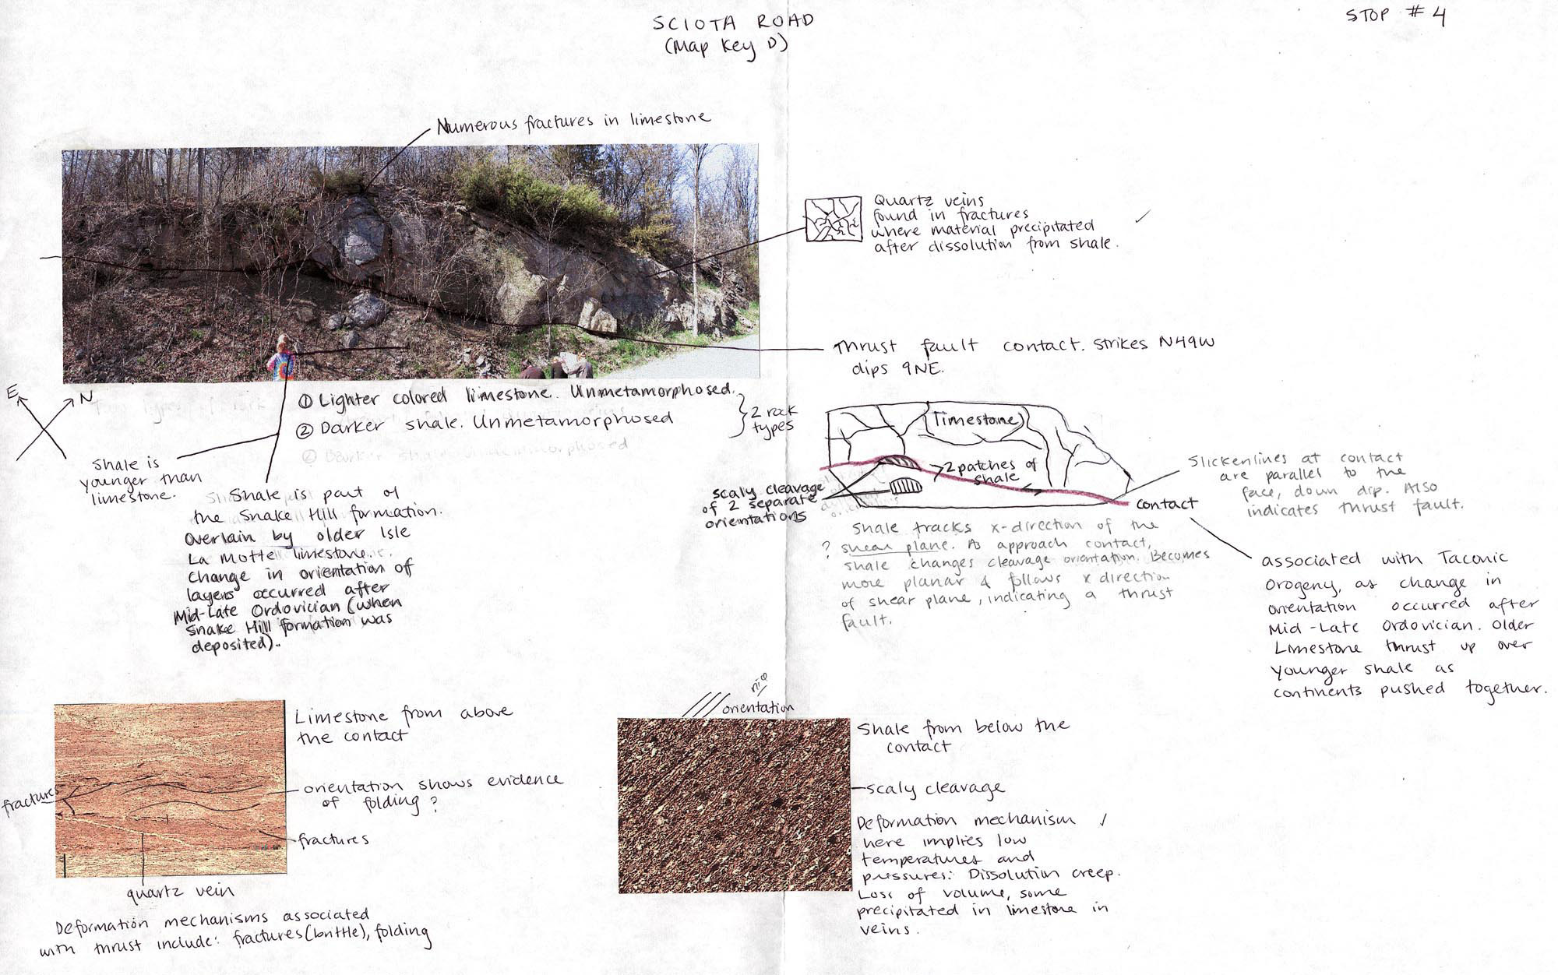

Slide 35
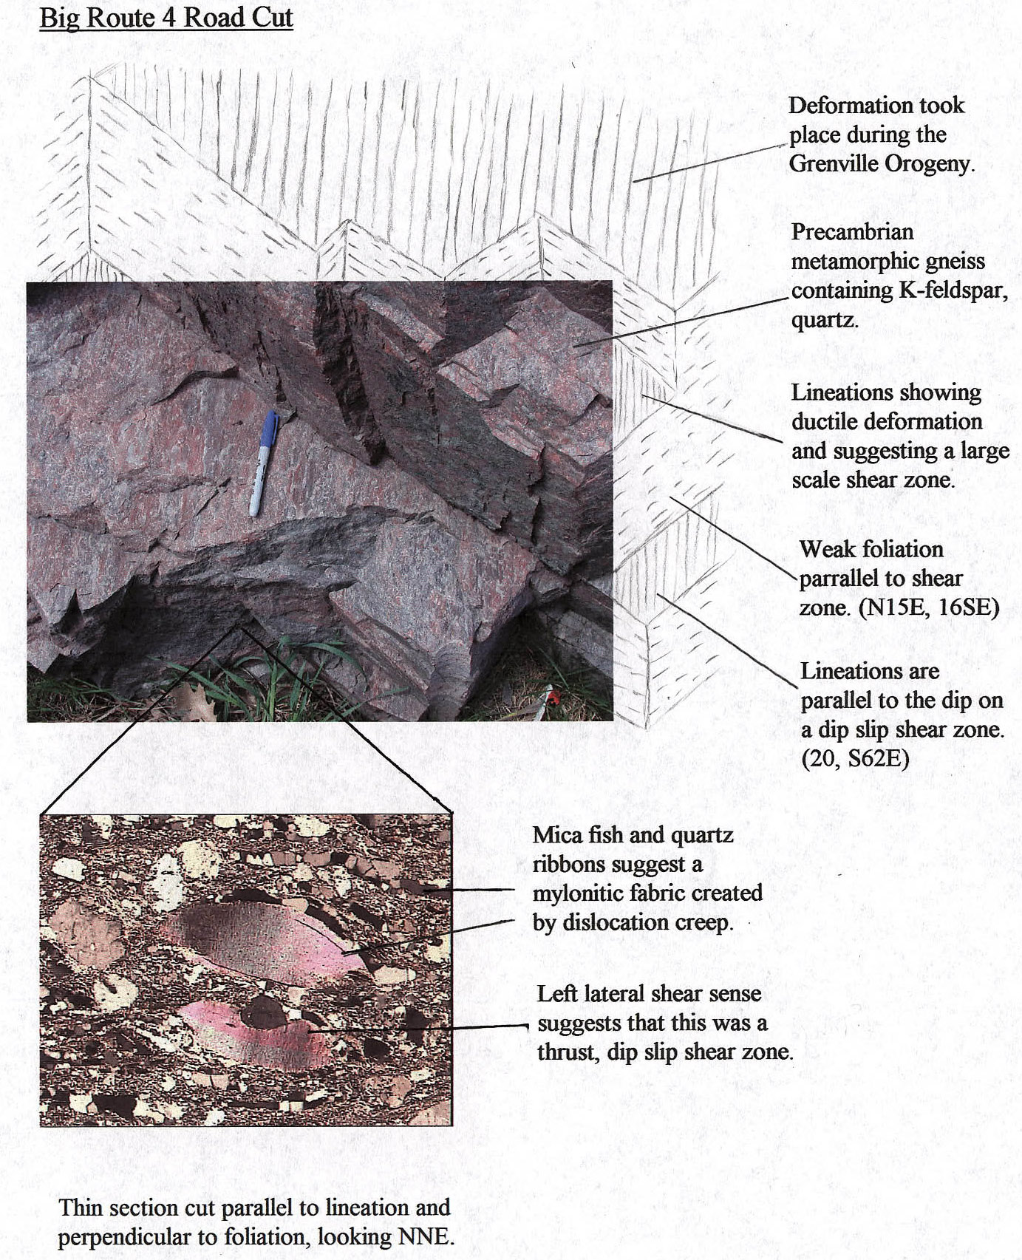

Slide 36
Jigsaws, concept sketches & incorporating leading edge ideas
Challenge of building assignments around the primary literature
  Students read but most don’t prepare effectively
  If all students actually read and come prepared effectively, it’s hard to “discuss the reading” in class in an interesting way
  Achieving breadth/depth by assigning multiple articles is too much for most undergrad courses

Slide 37
Jigsaws, concept sketches & incorporating leading edge ideas
Jigsaw for reading the literature
  Students prepare different but related articles as homework
  Peer teaching aspect of jigsaw allows students to see a broader/deeper range of ideas about the topic
  Mixed groups have something interesting to discuss in comparing the different articles
  Ideal for leading edge ideas where a consensus hasn’t emerged.
    Example: exhumation of UHP rocks?
    Different approaches? different case examples? conflicting results? different models?

Slide 38
Jigsaws, concept sketches & incorporating leading edge ideas
Effective pre-class prep is critical
  Don’t just say “read and come prepared to discuss the article”
    Ask students to answer guiding questions in writing to insure that they understand the critical aspects
  Assigning concept sketches of critical figures is useful
  Hold students accountable – if they know that you will explain it all, they won’t do the prep effectively.

Slide 39
Jigsaws, concept sketches & incorporating leading edge ideas
Effective in-class prep for group work is critical
  Provide time/guidance to prep for peer teaching; ask students to write out:
    What are the most important messages to convey?
    What is the evidence, and what illustrations do you need to make your point?
  Having students prepare a written teaching prep also gives you time to check in with each team/student to make sure they will not teach something wrong-headed

Slide 40
Jigsaws, concept sketches & incorporating leading edge ideas
Effective group work is critical
  Consider having students role-play the researcher in the article – “We/I did XXX”
  Help if a group gets stuck.
  Be sure that students have the group assignment in mind before peer teaching.
  Be sure that the group assignment is more than just a summary/comparison
    Whole bigger than sum of parts?
    How to resolve a conflict?
    Analysis of approaches?
    Directions for future research?

Slide 41
Jigsaws, concept sketches & incorporating leading edge ideas
Effective individual follow-up is valuable
  List of aha insights after group work
  Analysis of a new article based on insights from group work
  Re-analysis of own article based on insights from group work
  Concept sketch of current understanding
  Literature search for additional work
  Analysis of hypothetical situation based on insights from group work

Slide 42
More info
http://serc.carleton.edu/sp/library/jigsaws/index.html
http://serc.carleton.edu/NAGTWorkshops/careerdev/AcademicCareerTeach2013/jan.html
http://serc.carleton.edu/NAGTWorkshops/careerdev/AcademicCareerTeach2013/march.html
http://serc.carleton.edu/NAGTWorkshops/coursedesign/tutorial/strategies.html
http://serc.carleton.edu/NAGTWorkshops/coursedesign/tutorial/index.html
http://serc.carleton.edu/introgeo/gallerywalk/index.html

