Slide 1
Change can happen quickly: An engaging physical sciences faculty learning community
June 11, 2025
Rachel Kennison, UCLA
ASCN Transforming Institutions
St. Louis, MO

Slide 2


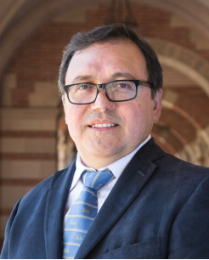
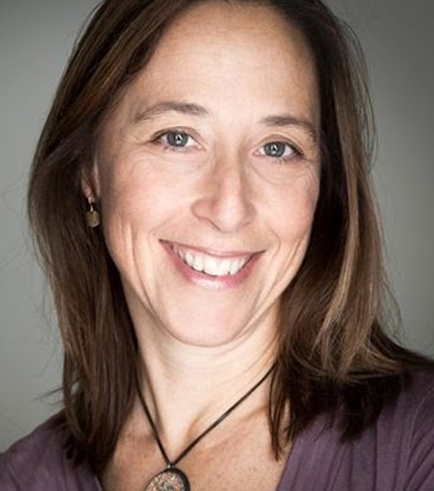
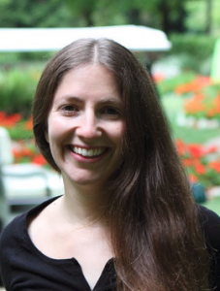
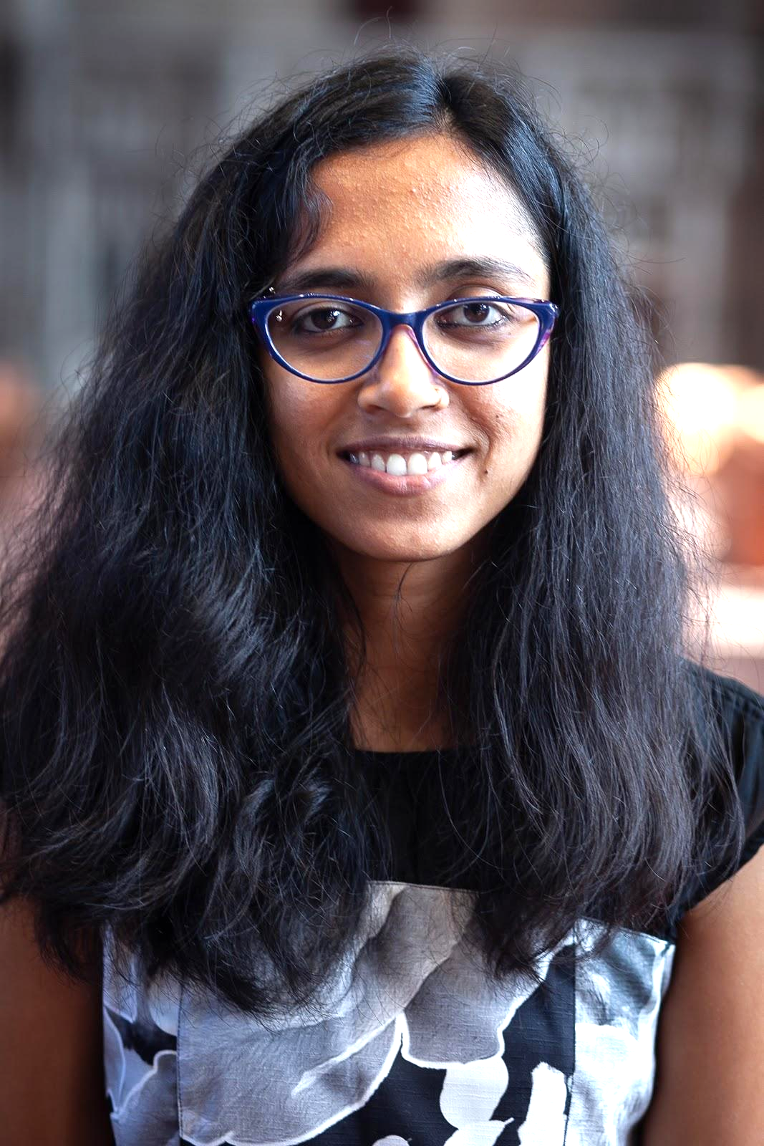
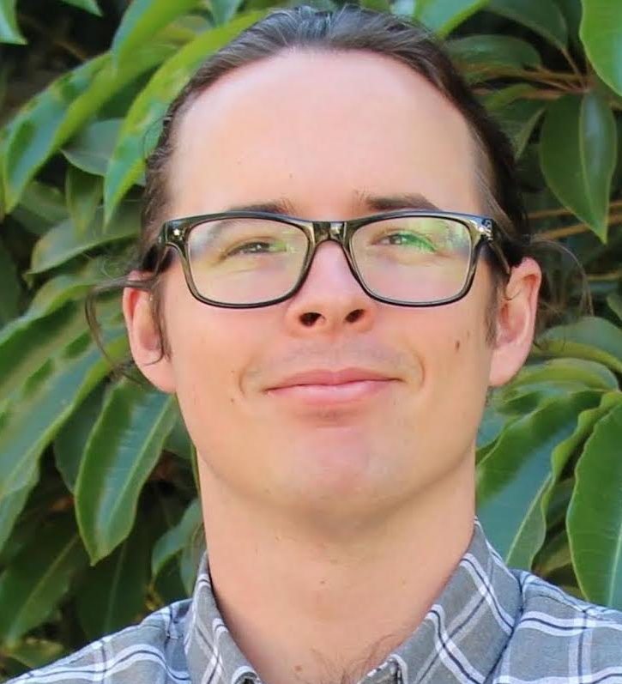
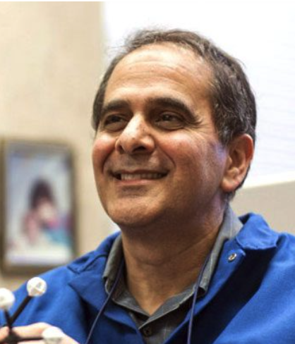

UCLA’s Physical Sciences Faculty Learning Community for Inclusive Teaching Team
Miguel Garcia-Garibay
(he/him)
Senior Dean of the College and Dean of Physical Sciences
Rachel Kennison
(she/her)
Executive Director,
Associate Teaching Professor, EEB
Shanna Shaked
(she/her)
Senior Associate Director
Supriya
(she/they)
Associate Director for Student Success
Harrison Parker
(he/him)
Postdoctoral Scholar
Al Courey
(he/him)
Faculty Emeritus,
Associate Dean for Inclusive Excellence

Slide 3
Outline
Why a faculty learning community?
Design, support and adapt
Discussion of Key elements of a faculty learning community
Preliminary results of the impacts
Discussion of Faculty Learning Communities and how you might implement an FLC at your institution

Slide 4
Why a Learning Community?

Slide 5
Effectiveness of faculty learning communities (FLC)
What is a faculty learning community?
A faculty learning community is one evidence-based approach for supporting reflective practitioners of implementing inclusive and research-based teaching (Beach et al. 2012)
What are key elements to create an effective FLC (Shadle et al. 2017)?
Identify barriers and drivers
Compensate faculty for time spent learning and implementing new practices
A community of practice facilitated by pedagogy experts to discuss and reflect on implementation

Slide 6
How we designed, supported and adapted this Faculty Learning Community

Slide 7
Designing the Learning Community
This project is the collaboration of researchers, administrators, multiple units, and learning center staff to support building of change agents (the participants, the facilitators, etc.)
Intramural Grant Proposal to EDI office, partnership between CEILS and Physical Sciences (PS) Associate Dean for EDI, funding support by the Dean of PS, matching EDI grant
Needs assessment to understand how to focus the curriculum → Results of focus groups informed the curriculum
All participants asked to engage in STEM inclusive teaching workshops prior to engaging in learning community, so that everyone came in with similar foundational knowledge
Goal was not to be didactic, but to provide a structured experience with time to connect and build relationships that also included pre-work to ground the learning in prior knowledge and post-work to integrate what was learned from the conversations
Called PS-Faculty in Inclusive Teaching (PS-FIT) Fellows to elevate a commitment to teaching excellence

Slide 8
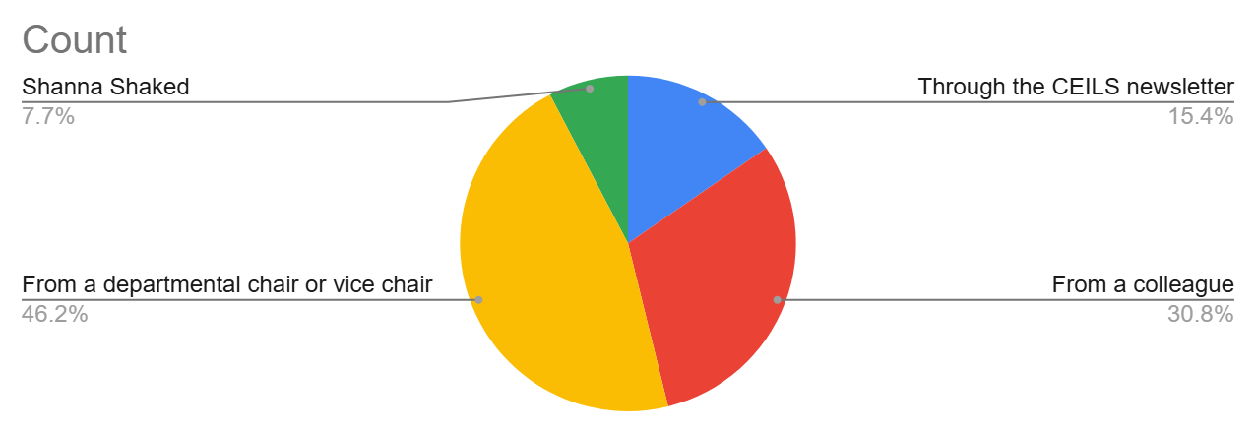
The Needs Assessment informed the design
4 focus groups of 3-5 people per focus group → 16 total
4 of the 16 focus group participants signed up to join the FLC, others participated in recruiting their departmental colleagues
Faculty shared the topics and tools/resources they would you like to be discussed to support them in creating a more equitable course
Focus group members asked for concrete tools and checklists, so we integrated Inclusive Teaching book by Hogan and Sathy
The Dean sent an invitation to all PS faculty through chairs (46% of fellows heard about the program through their chair or vice chair; 30% through a colleague)

Slide 9
Emergent Themes
Many topics were discussed explicitly through the lens of large or GE courses
A preference for small, actionable changes - feeling a lack of time to or burnout from redesigning courses (from going to remote for COVID or going to hybrid coming back from COVID)
General concerns about having less teaching support (e.g. via fewer TAs)
Faculty recognize the value of discussing topics with fellow faculty and by extension maybe a learning community
A desire for proof or reassurance that the changes that they make will be effective either from evidence-based approaches and primary literature and/or from discussions with fellow PS faculty that have implemented the changes and will speak to the efficacy and the details of their experiences

Slide 10
Expressed interest in Topics/Resources
Topics
Data-based/evidence-based approaches to improving teaching
How to balance flexibility of material access and encouraging students to come to class in person to maximize student learning
Understanding and accounting for variance in student academic backgrounds and preparation
How to improve student engagement with the class
Resources
A (check)list of small, quick, actionable, evidence-based, ‘proven’ items to implement in a course the next time it is taught
An assessment plan to understand if and to what extent teaching interventions were effective

Slide 11
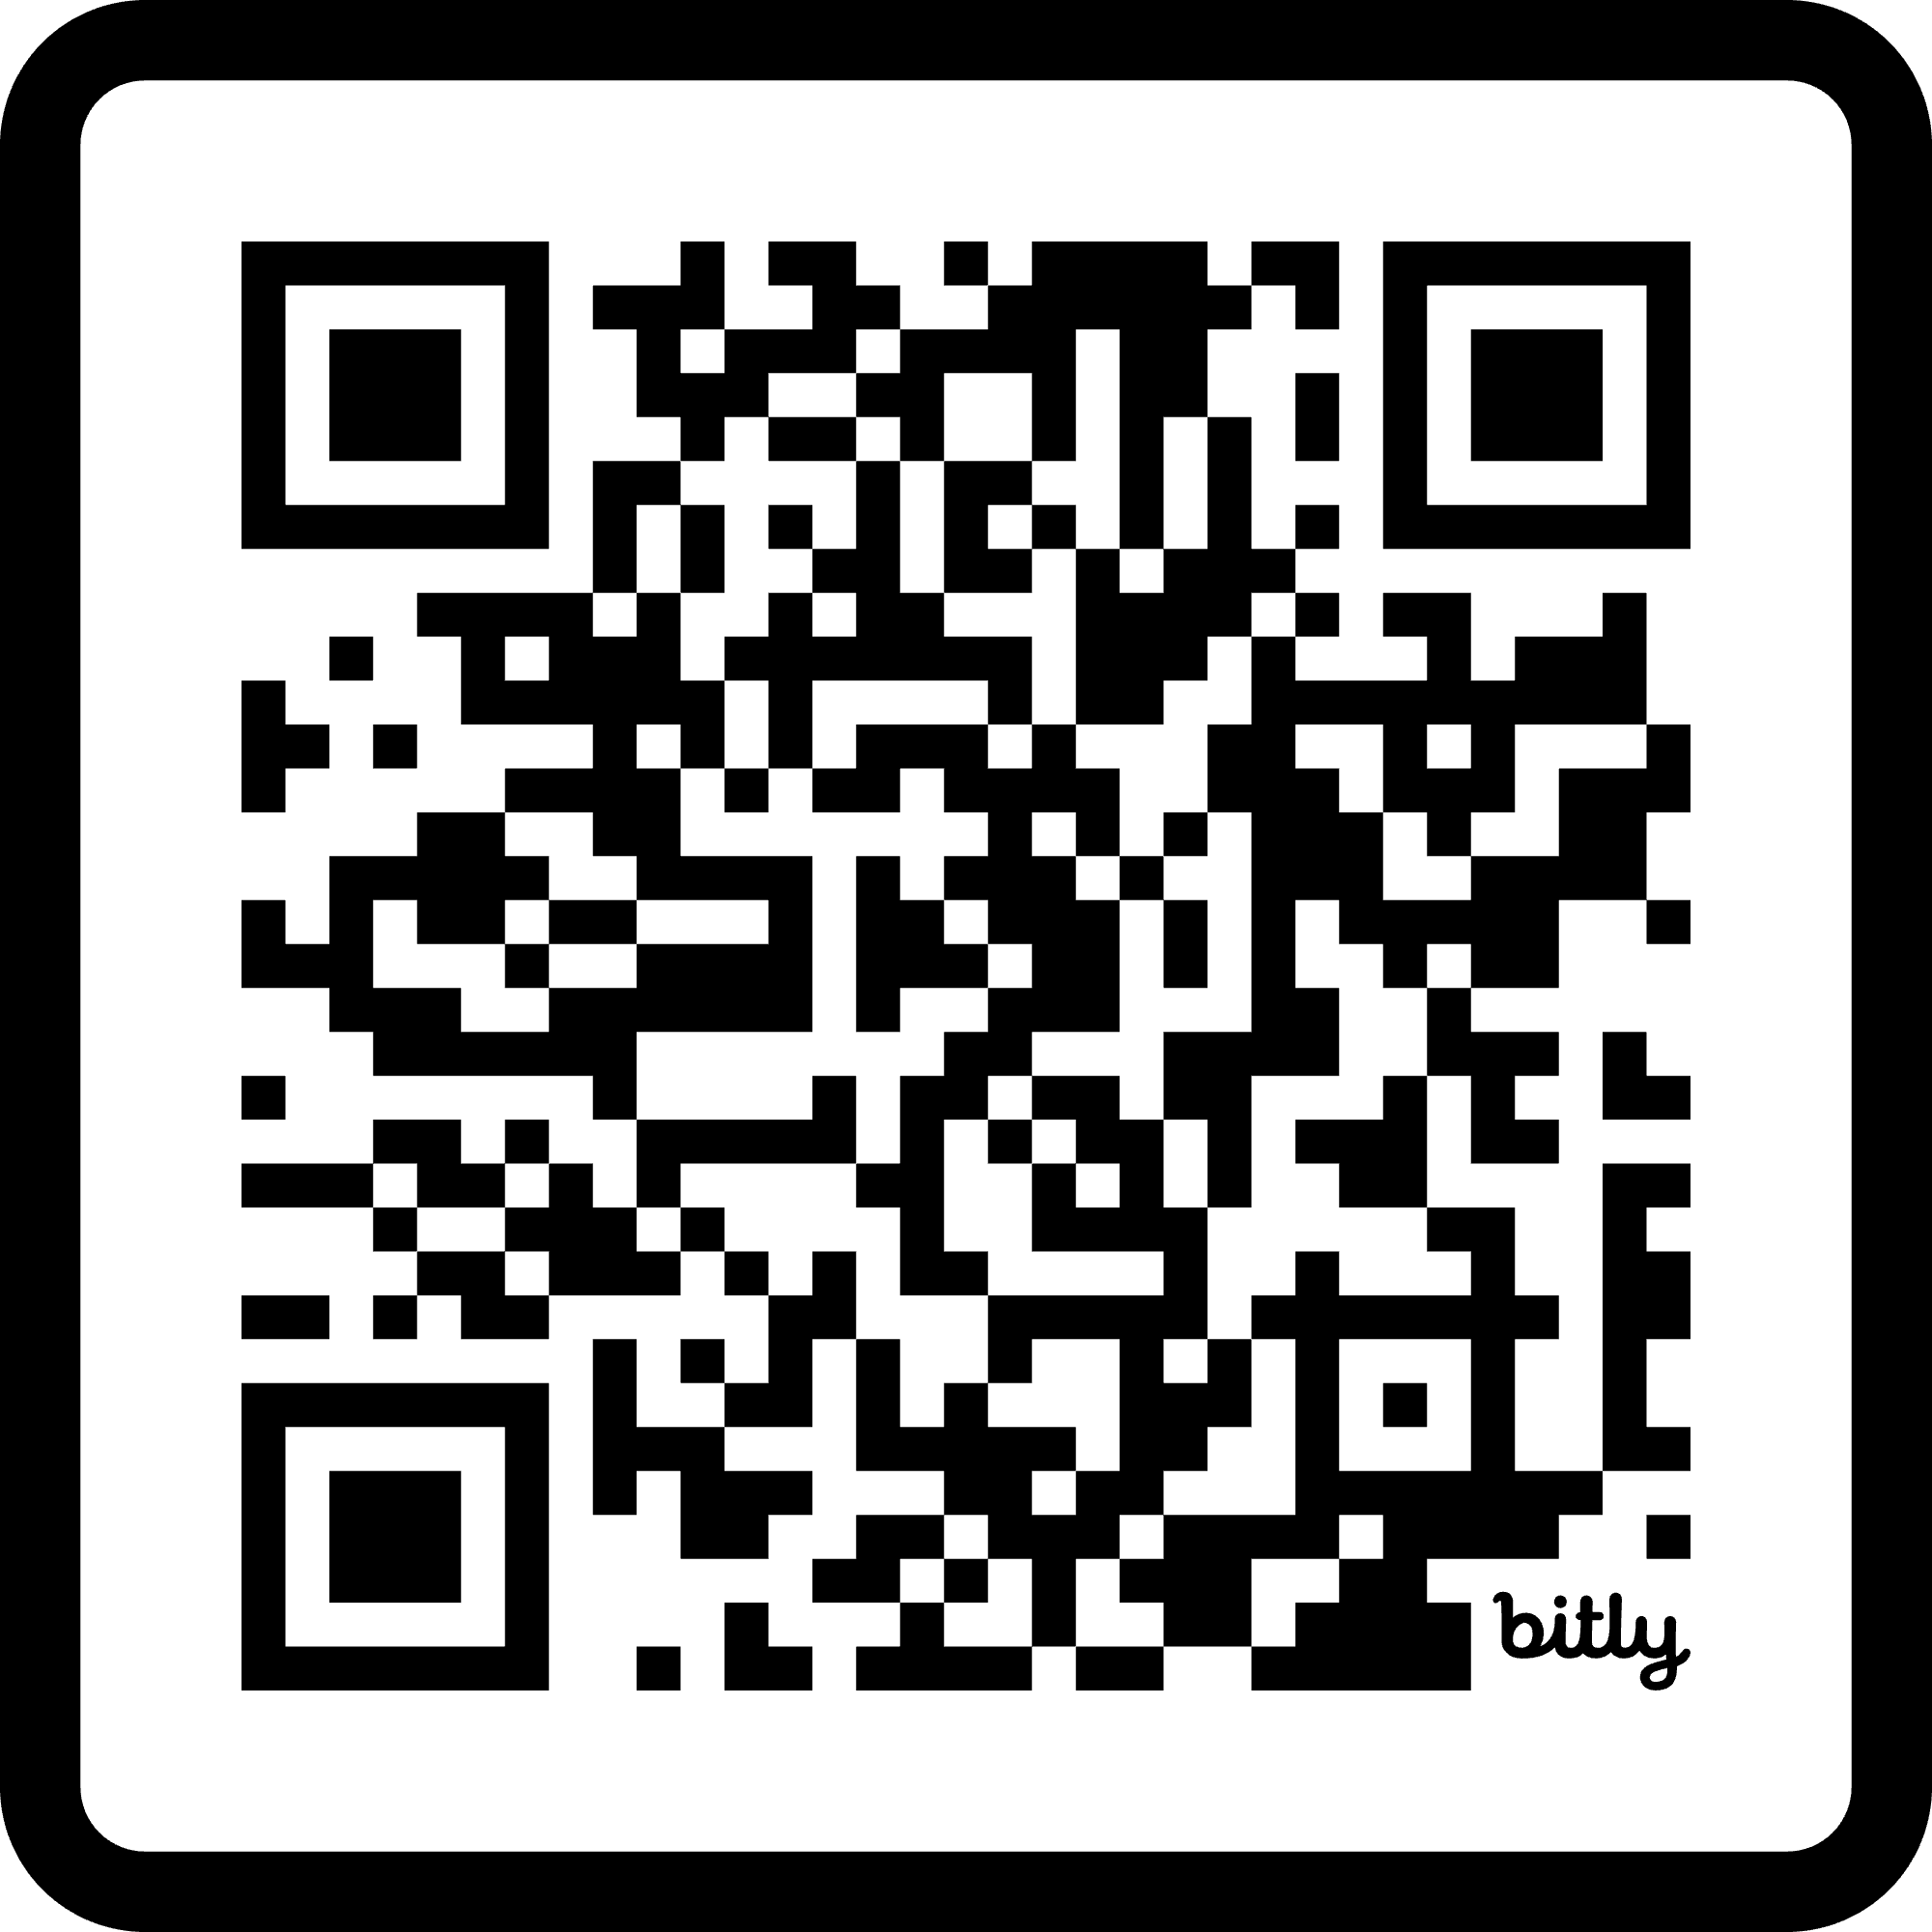
Learning Goals and Participant guide (https://bit.ly/PSFITguide)
Session 1 Goals
Engage in community
  Outcome: Build community with one another and reflect on ways to build community with students
Revise syllabus to reflect a more equitable and welcoming environment
  Outcomes: Reflect on what it means to have an “inclusive teaching mindset”, including starting with self-awareness, Practice aligning assessments with your primary course learning goals, Learn about and discuss more inclusive teaching approaches
  HW: Reflect on session; Review syllabus (+ revise as necessary) to integrate some of these inclusive teaching approaches
Session 2 + 3 Goals
Integrate at least one substantial shift
Use student surveys to reflect and iterate
Session 3 + 4 Goals
(Begin to) Assess the impacts of the substantial shift
Develop a plan for becoming a change agent
After Session 4:
Implement part of plan to become a change agent
Notes:
Digital copy: https://tinyurl.com/ps-fit

Slide 12

How we supported faculty in completing work
Pre- and post-session work
Friendly reminders to folks missing things
They could make up missed meetings by going to other CEILS-facilitated discussions
Mixed up groups so they talked to people outside their department

Slide 13
Key elements of this learning community

Slide 14
Key elements of PS-FIT Learning Community
$1000 to attend 6-hour workshop on inclusive teaching and 4-5 2-hour lunch sessions; and completing plan for mid-quarter survey, teaching intervention and reflection
Informed by needs assessment (focus group of relevant faculty and departmental leaders)
Mix of folks teaching (about half) and not teaching that quarter
Pre- and post-session work to prepare for discussion and synthesize thoughts afterward
Each session had handouts instead of slides to foster individual reflection and then discussion, including time for anything arising in their own teaching in the moment.
Everyone devised teaching intervention and approach for reflection on that intervention

Slide 15
Discuss Key Elements
Discuss the faculty learning communities you’ve been a part of or involved with - what’s similar and different, compared to this community?
How can joining a learning community of colleagues support departmental change?
Are there other ways to compensate faculty or recognize the time and effort they are investing?
$1000 to learn, discuss and plan changes; and free lunch
Informed by needs assessment
Mix of folks teaching and not teaching
Pre- and post-session work
Handouts instead of slides
Everyone devised teaching intervention and approach for reflection on that intervention

Slide 16
Preliminary Results

Slide 17
Many faculty engaged in community!
Cohort 1 - Fall quarter 2024
19
Fellows Registered
14
Fellows attended first session
12
Fellows completed all the work

Slide 18
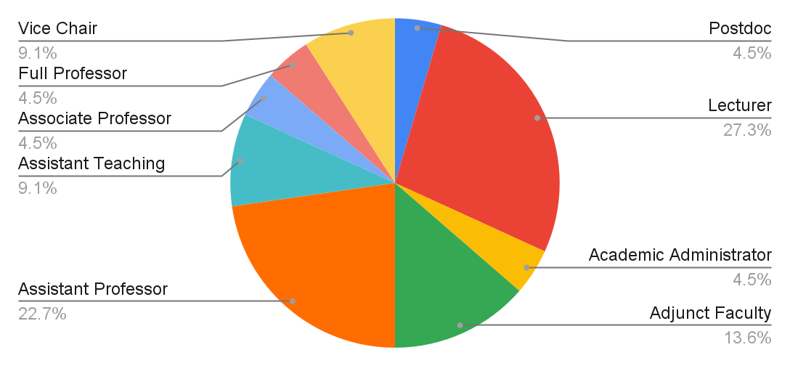
Half of participants were non-Senate faculty and half Senate faculty, including two vice chairs

Slide 19
Departments of participants
Cohort 1 (Fall 2024)
Cohort 2 (Spring 2025)
1 Atmospheric and Oceanic Sciences
1 Institute of the Environment and Sustainability
7 Chemistry and Biochemistry
2 Mathematics
1 Earth, Planetary and Space Sciences
1 Statistics
1 Atmospheric and Oceanic Sciences
3 Chemistry and Biochemistry
1 Computer Science
1 Mathematics
3 Statistics
Taught between 100 and 1400 students per year, totalling 6,900 students per year
Taught between 30 and 1400 students per year, totalling 5,700 students per year

Slide 20
We were able to form a learning community fairly quickly
Participants shared that they liked
talking with and hearing from their peers
the “vibe” of the approach and the discussions
“Really appreciate having other teachers to talk to and get ideas from. I've learned so many inspiring ideas about interactive teaching, making grading more fairs, and how to use new technology.”
“It is really helpful to talk through ideas with others, and having the amazing friends at CEILS facilitate this is what makes it rise way above routine course-prep help.”

Slide 21
12/13 fellows indicated they would make a substantial instructional shift
At least 8 fellows implemented one or more of these shift(s) by Spring 2025
Seven pre/post syllabus pairs analyzed, 3 showed changes
Instructional Shift | #
Increasing active learning | 4
Reducing the weight of high-stakes exams | 4
Implementing LAs | 2
Integrating a TA expectations guide | 2
Added a mid-quarter or end-of-term feedback survey | 2
Integrating exam wrappers | 1
Adding a group project | 1
Incorporating an alternative grading system | 1
Implementing credit for discussion section | 1
Incorporating learning pods in discussion section | 1

Slide 22
Limited or indistinct responses to prompt about plan for “becoming a change agent”
Differences in interpreting the “becoming a change agent” question (e.g. many had the perspective of change between an instructor with their students instead of an instructor with their colleagues/department)
We added some examples of what being a change agent might look like, and folks tended to stick to those instead of adding anything else in their response (e.g. supporting other colleagues incorporating evidence-based teaching)

Slide 23
Adaptations based on what we learned from cohort 1
Focus on implementing a change rather than becoming a change agent
Practice active learning strategies in the FLC
Peer-observation of their intervention
Made distinction between active learning and whole class discussions as an intervention
Asked for an annotated Syllabus

Slide 24
Discussion
We were able to support participants engaging in community and making substantial changes to teaching, but didn’t have enough time to also foster agents of change.
How can we help faculty see themselves as agents of change (or do we need to)?
How might you implement, adapt, or build on this learning community approach in your own institutions?
Share how your institutional role informs the approaches you are considering.

Slide 25

Thank you

