Slide 1


Sharing the impacts of 5 years of STEM faculty development
Holly Cho, Victoria Sellers, Martin Storksdieck, Devon Quick, Lori Kayes, Carmen Harjoe, Mary Beisiegel
Notes:
930
Welcome
Don't forget to introduce yourself!
Why are we here today… to celebrate, to reflect, to look forward, to build community on the things that have happened during, since, and around IE@OSU. Our grant funded project to make STEM education more inclusive, equitable and accessible. Before XXX welcomes us, first let’s acknowledge….

Slide 2
Outline
HHMI IE
Institutional context
IE@OSU program
Evaluation findings
Key takeaways

Slide 3
The IE@OSU Team
Our Advisory Board
Mary Beisiegel - Professor, Mathematics
Holly Cho - IE@OSU Program Coordinator, Researcher, STEM Research Center
Carmen Harjoe - Associate Professor, Integrative Biology
Lori Kayes - Director of UG Studies, Integrative Biology
Devon Quick - Professor, Integrative Biology
Victoria Sellers - Researcher, STEM Research Center
Martin Storksdieck - IE@OSU Program Director, Director, STEM Research Center
Maya Feezell - PhD student, Integrative Biology
Liz Gire - Professor, Physics
Regan Gurung - Professor, Psychology
Kristina Holton - Dean, Science, Engineering and Mathematics, LBCC
Jessica Hopkins - Dean, Math, Science & Engineering, LCC
Kameron Kadooka - Director of Diversity, Equity, and Inclusion, College of Science
Michael Lopez - Mathematics, LBCC, IE@OSU alum
Bob Mason - Professor, Integrative Biology
Janet Nishihara - Executive Director, Educational Opportunities Program
Scott Vignos- Vice President, Chief Diversity Officer
Notes:
9:45

Slide 4
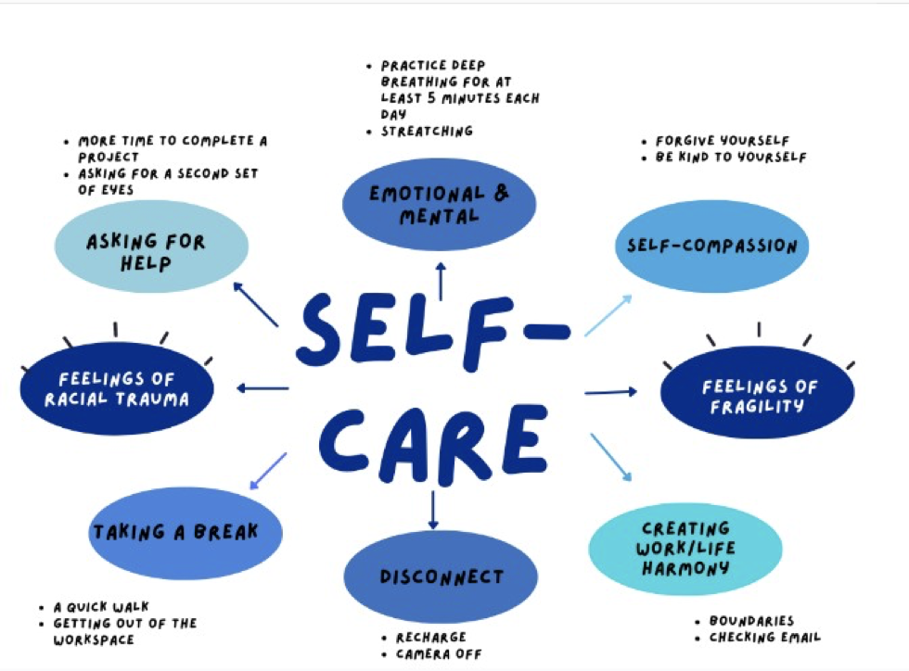

Courtesy of Universal Human Right Initiative, https://www.uhri.ngo/
Notes:
9:55 - 10

Slide 5
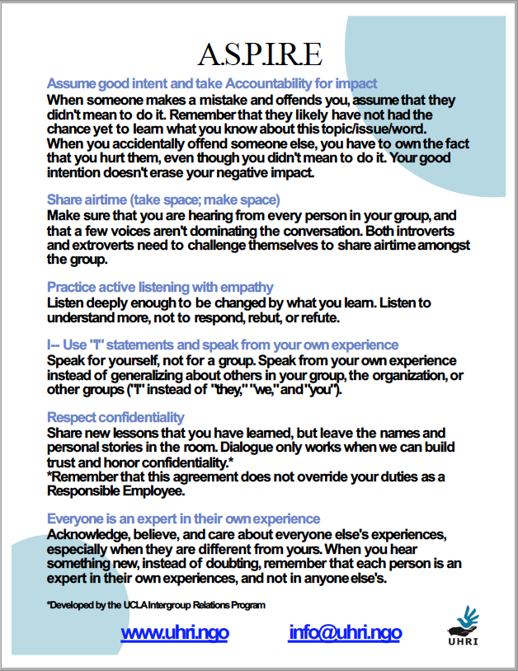
Community Guidelines
A
S
P
I
R
E
Assume good intent and take Accountability for impact
Share airtime (take space; make space)
Practice active listening with empathy
I-- Use "I" statements and speak from your own experience
Respect confidentiality
Everyone is an expert in their own experience
Notes:
Present this as guidelines and ask if there is anything to add. Print ASPIRE and put in binder.

Slide 6
Summit Goals
  Through participation in this Summit, we hope to:
  Celebrate/Share the successes of IE@OSU
  Reconnect with critical friends and ensure alignment with the strategic plan
  Understand the power & process of the IE Academy
  Explore data from past and present
  Re-energize/motivate the people who are trying to make a difference
  Build and participate in a sustaining community of practice around the goals of IE@OSU
Notes:
2 min
Important themes that weave throughout - MAKE THESE EXPLICIT to the participants & give opportunities to think about, write about, plan for etc.
Energy to go forth and do
Embodiment/affect of instructor
Thinking about student experience
Useable practices for right now - maybe using video & role play to make this happen

Slide 7
Name Placards
First Name
pronouns
What you wanted to be when you were 8
Inequities you worry about
Courtesy of D. Ebert-May
Notes:
5 min 10:10 - Make sure to tell about back of card. Fill out card; introduce yourself and talk with person on left about something you are good at; what you wanted to do at 8 with person across from or behind you;, inequities you worry about in your classroom or at your institution.
Values affirmation here:
What did you want to do for a career when you were 8?
What are some inequities that you worry about in your classroom or institution?

Slide 8
Reflection
What does “inclusive excellence”
mean to you?
Notes:
2-3 min reflect
10:10
Purpose Just in Time Teaching
Improve academy
Evaluation

Slide 9
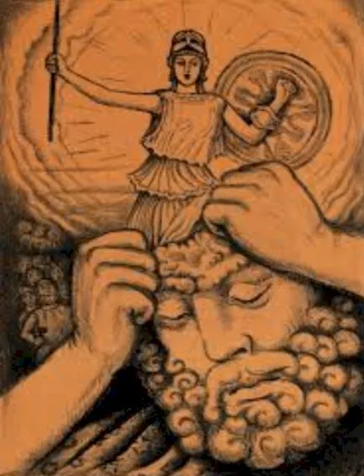
What motivated the IE@OSU Project?

Slide 10

HHMI Inclusive Excellence Initiative
“challenges U.S. colleges and universities to substantially and sustainably increase their capacity for inclusion of all students, especially those students who belong to groups underrepresented in science. ”

Slide 11
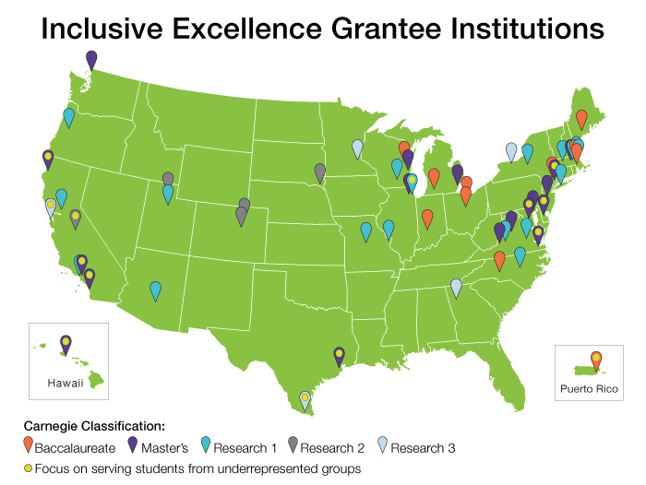
HHMI Initiative Rationale & Intention
Persistent inequities in STEM education, despite HHMI investment for 40+ years
Beginning in 2017, funded 57 diverse institutions to enact 2nd order change
Faculty focus change initiative, fix the institution, not the students

Slide 12
How was HHMI IE Supposed to be different?
Culture Change – difficult, painful, involving trial & error/rethinking/re-doing
IE – ‘Stance not Destination’
Readiness – to address practices & policies that confer advantages/ disadvantages that result in equity gaps
‘Experiment’ – to adapt and scale ‘what works’ within/between disciplines and within/between institutions

Slide 13
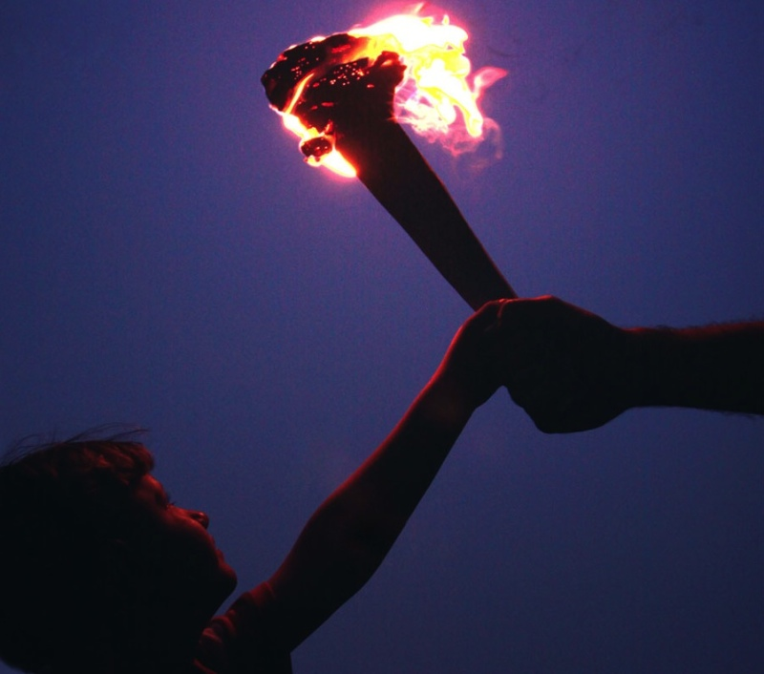

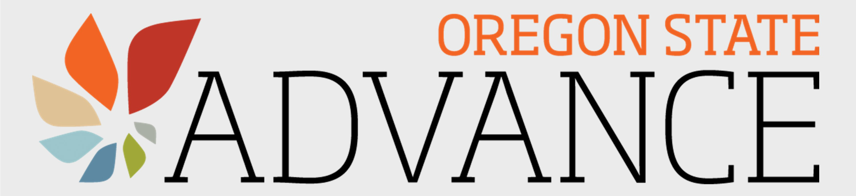
Why IE@OSU?
IE caught the torch from ESTEME & ADVANCE
Additional backdrop
  2013/2014 Trayvon Martin, Mike Brown inspire Black Lives Matter
  2015 OSU Student Speak out & Office of Institutional Diversity created
  2020 George Floyd & COVID-19 Pandemic
  2021 COS Diversity Action Plan
Our team was ready
  Our internal collaborations
Notes:
Somewhere DEI was added to handbook

Slide 14
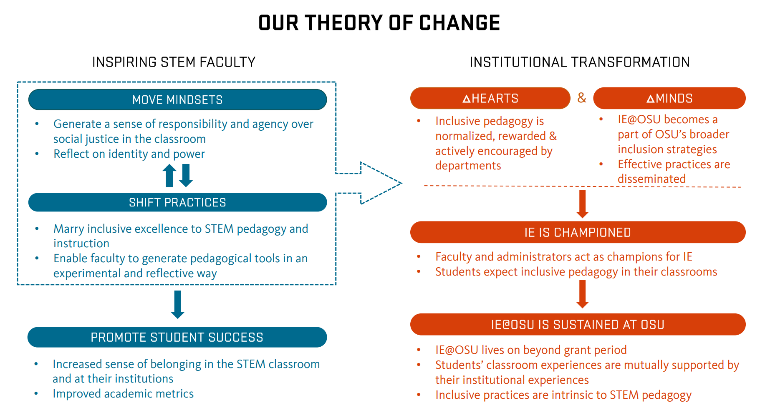
Notes:
Our mission was this. Our lever for change was stem faculty and associated non -teaching faculty partners hwo influenc academic programs and student experiences in different ways. - inadvertently increase student success onf underrepresented groups some focus on first gen, disability that might be unique to OSU

Slide 15
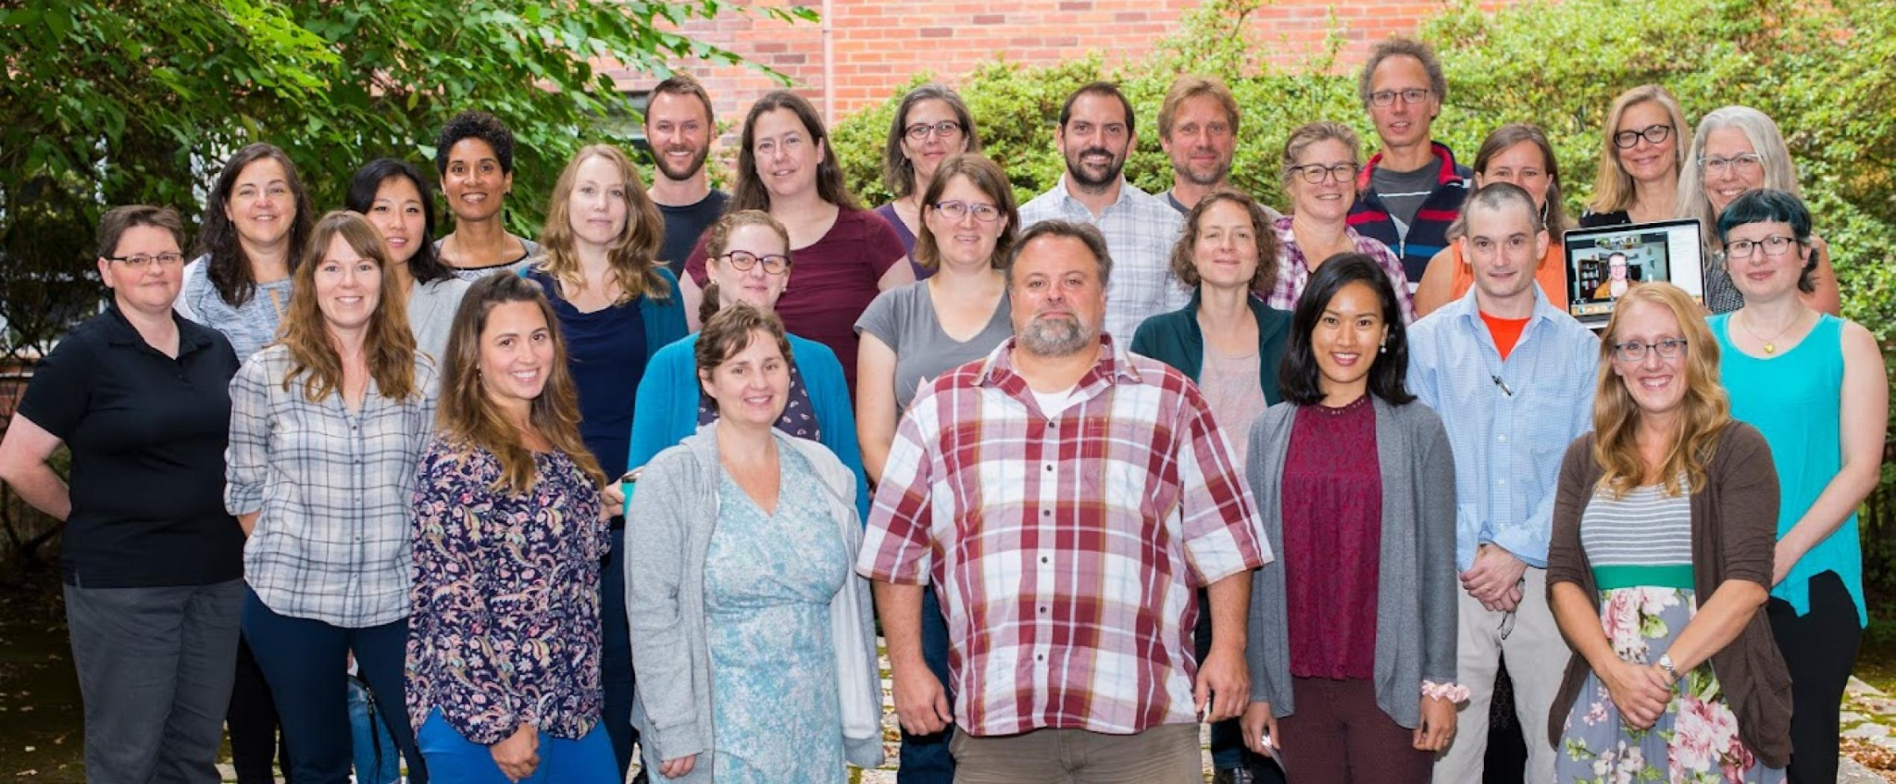
IE@OSU Fellowship Program
Faculty and Allies (13-20 per cohort)
  Oregon State University
  Linn-Benton Community College
  Lane Community College
Notes:
~40 hours per total experience

Slide 16
IE@OSU Fellowship Experience
Summer | Fall | Winter | Spring
Academy! Finalize action plan Action Plan Share Out (Sept - TBD) | Inclusive Excellence Connection Sessions Professional Learning Community (2 hours) Faculty, Food and Fun (2 hours) | Faculty, Food & Fun (2 hours) Professional Learning Community (2 hours) Collaborative work in teams (4 hours) | Faculty, Food & Fun (Action Plan Showcase) (2 hours) Professional Learning Community meeting (2 hours) Collaborative work in teams (4 hours)
Develop and implement action plan and evaluation activities
Notes:
~40 hours per total experience, ~20 hours in academy, 20 hours more of PLC
Iterative, adaptable for COVID especially
Whole curriculum available
Academy outcomes:
Develop a shared understanding of why Inclusive Excellence is important and what it means in our context
Develop empathy and understanding of historically excluded and marginalized individuals, particularly in STEM
Use our understanding of the community that we serve (i.e. our learners, our GTAs, our faculty, etc.) in our work
Reflect on our individual identities and experiences and how these bias our practice
Recognize the role that we, as holistic individuals, play in building an inclusive and critical academic community
Describe how pedagogical practices have the potential to impact students’ sense of belonging
Develop and implement an action plan that includes goals, outcomes, actions and assessment of actions
Envision levers and anticipate barriers to achieving the goals of IE@OSU in our spheres of influence
Prioritize inclusion, equity, access, and social justice in our work in STEM
Build and participate in a sustaining community of practice around the goals of IE@OSU

Slide 17
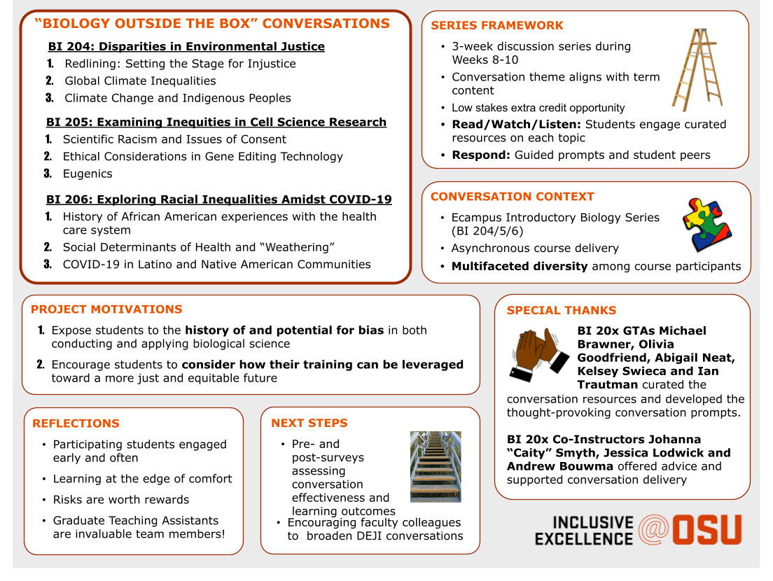
Example Action Plan: “Biology Outside the Box: Social justice conversations through a biological lens - Jeremy Rose (Cohort 2)
Notes:
In online course
Discussion boards
Now permeated throughout all sections

Slide 18
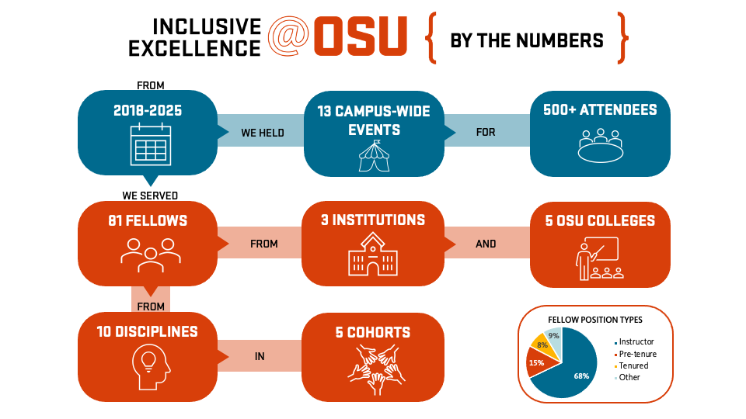

Slide 19
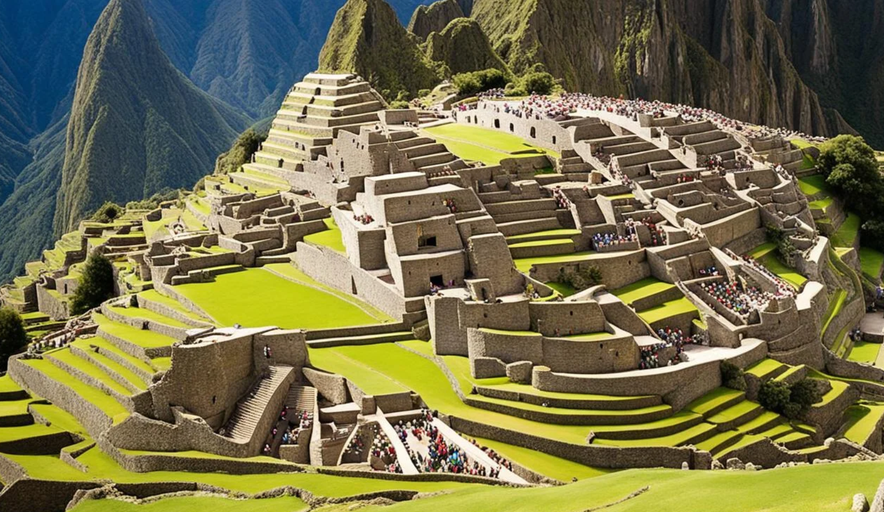
Lasting Accomplishments
Strong cohort community
Levers for 2nd order change
  Inclusion of fellows on DEI leadership teams
  Workshops on inclusion and anti-racism led by former fellows
  Faculty motivated to advocate for change
  Key administrators on IE@OSU advisory board
  Gen Ed Reform
  Quality Teaching Framework/SLE changes
https://www.continents.us/peru-inca-civilization-masters-program-cusco-peru/

Slide 20
Agenda for the Day
9:30 - 9:45 am Welcome
9:45 - 10:30 am Introduction to IE@OSU Project
10:30 - 10:45 am Break
10:45 - 11:30 am Experience a moment in the IE Academy
11:30 - 11:40 am Break
11:40 - 12:15 pm Evaluation Findings: Impact over Years
12:15 - 1:10 pm Lunch
1:10 - 2:00 pm IE@OSU Faculty Fellows Panel
2:00 - 2:50 pm Looking Forward
2:50 - 3:00 pm Closing Remarks

Slide 21
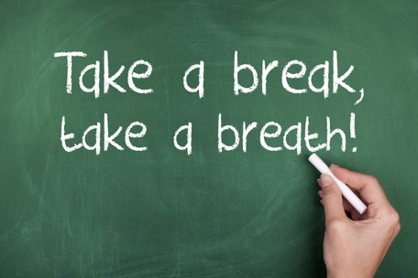
Break Time (15 min)

Slide 22
Experience a moment of the IE@OSU Academy

Slide 23
Session Outcomes
Recognize how our identities inform how we show up in our disciplines/at our institutions/and in the classroom
Examine the intersection of experience and identity in your own life and others
Explore the significance of self-knowledge to successful inclusive teaching
Leverage strengths and motivations to inform action plan creation

Slide 24
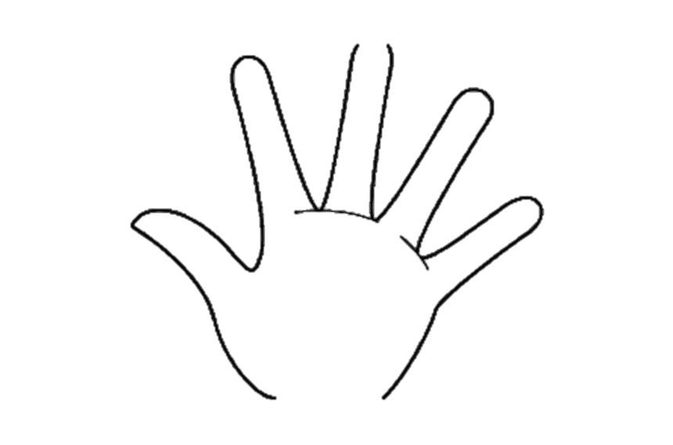
Create Your Own Identity Chart
Draw an outline of your hand, write or draw things that shape your identity, such as gender, names, religion, physical features, languages, family, etc. Please do not include anything on this chart that you are not willing to share.
Outside the hand outline, write or draw examples of how other people identify or “label” you (both positive and negative). Consider how your colleagues and/or students might perceive you.
Notes:
5 minutes
10:50-10:55

Slide 25
Paired Discussion
Present your identity chart to your partner. Explain some of your choices.
When you look at your identity charts, what is most significant in shaping your work as an academic:
  in your discipline/field?
  at your institution?
  in the classroom?
Why is this significant, and in what ways?
Notes:
15 minutes Groups of 2
Share out further?
11-11:15

Slide 26
Write to self:
How have your own experiences and identities shaped your teaching?
Write down 1 key idea on a piece of paper

Slide 27
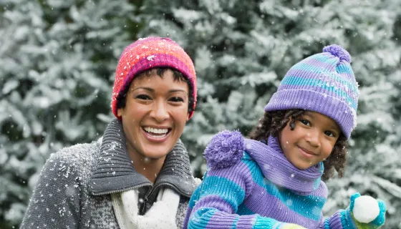
Summarize discussion on how experiences and identities shape teaching:
Snowball and read key ideas

Slide 28
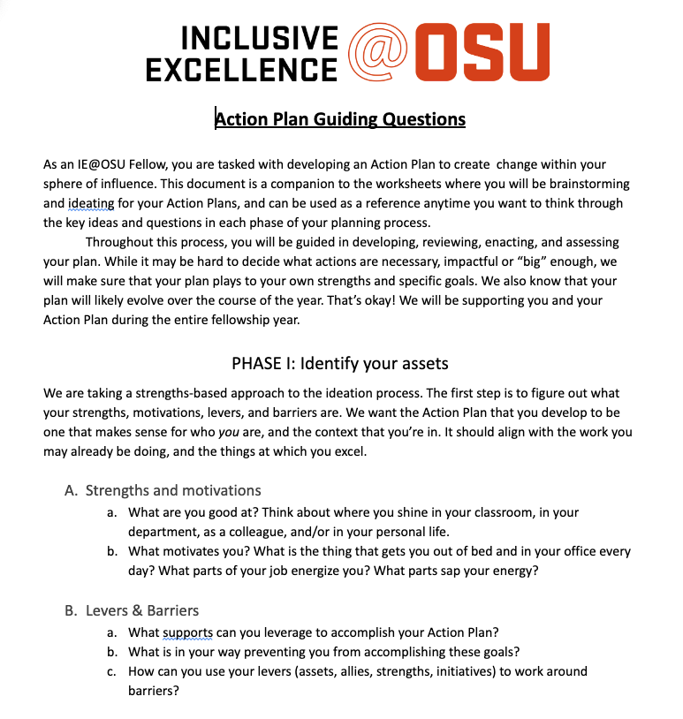
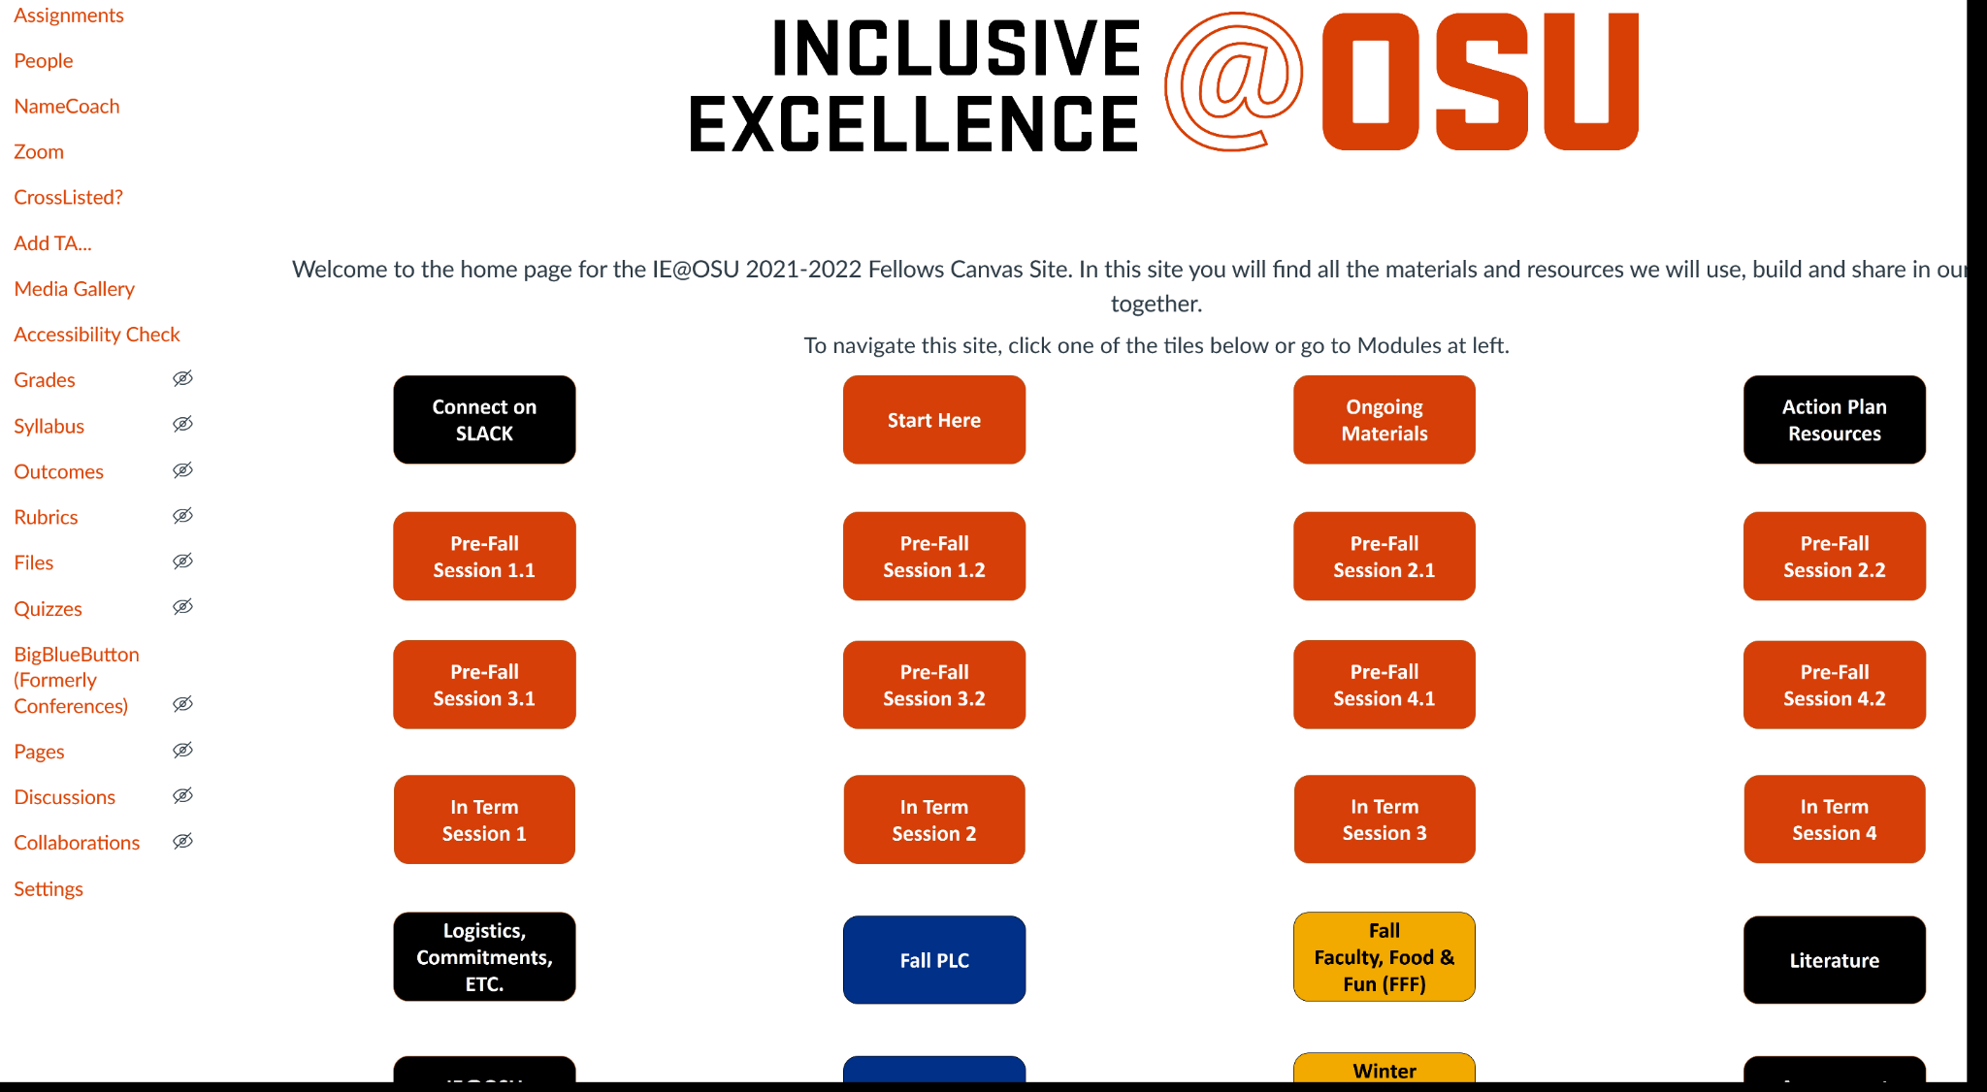
Action Plan Development
Action Plan Guiding Questions
Notes:
Action Planning 11:15-11:45

Slide 29
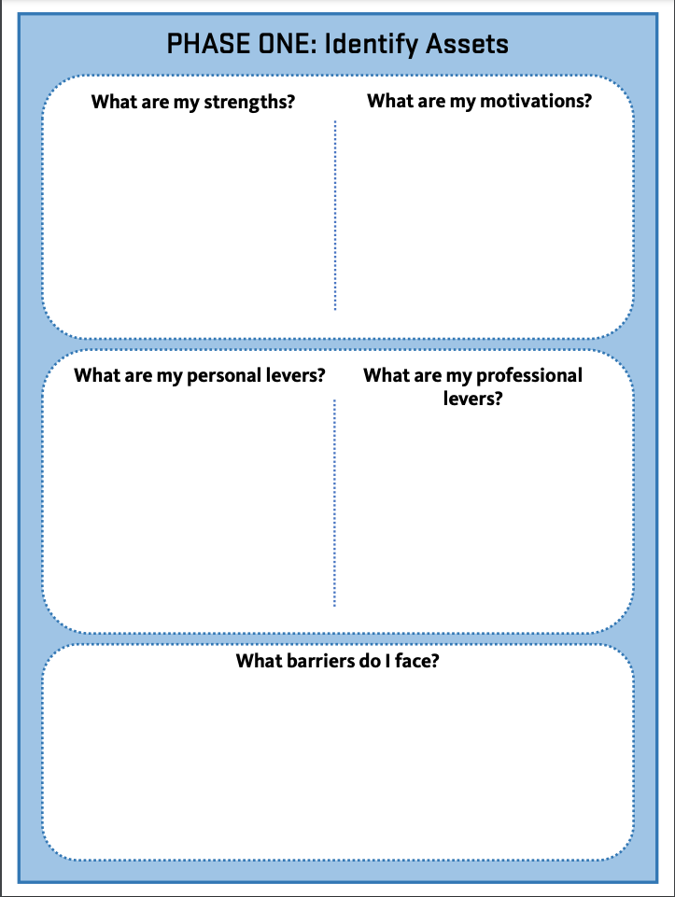
Action Plan: Phase 1

Slide 30
BRAINSTORM

Slide 31
Pairs/Tri Discussion
Share your strengths and motivations with a partner
Notes:
15 share

Slide 32
Reflect
What did these exercises in identity and experience tell you about your identity, your teaching and students?

Slide 33
Agenda for the Day
9:30 - 9:45 am Welcome
9:45 - 10:30 am Introduction to IE@OSU Project
10:30 - 10:45 am Break
10:45 - 11:30 am Experience a moment in the IE Academy
11:30 - 12:15 pm Evaluation Findings: Impact Over the Years
12:15 - 1:10 pm Lunch
1:10 - 2:00 pm IE@OSU Faculty Fellows Panel
2:00 - 2:50 pm Looking Forward
2:50 - 3:00 pm Closing Remarks

Slide 34
Evaluation findings
IE@OSU’s impact over the years

Slide 35
What does Inclusive Excellence mean to you?
Actively supporting and being in community with my colleagues who are impacting their educational spaces and personal growth.
IE@OSU has pushed us to be better, pushed us to innovate, explore, make mistakes and improve. Having a community of humans who are actively working to stretch pedagogically, as well as with their own DEI values are critical to being the humans our students need us to be.
-IE@OSU Fellow, retrospective survey response

Slide 36
Evaluation questions
How did fellows take action?
How did IE@OSU support fellows to become change-makers?
How did fellows sustain the work they began in IE@OSU?
What challenges did fellows experience?

Slide 37
Data sources
The data for these evaluation findings come from four main sources:
End of Academy surveys (n = 67) administered after completing the Academy
End of Year surveys (n = 64) administered after completing the fellowship
An Action Plan inventory (n = 53) analyzing key features of the Action Plans that fellows developed and implemented
Retrospective fellow survey (n = 36) sent to all program alumni as of spring 2024, exploring the types of change work that they were and currently are engaging in.

Slide 38
What did it look like to take action?
53 fellow action plans were analyzed to identify their overall goals and spheres of influence
Affective outcomes | Projects that focused on improving how students felt about their educational experience
Equitable course outcomes | Projects that aimed to make course outcomes more equitable for enrolled students
Social justice education | Projects that incorporated education about social justice into course curriculum
Increasing access to opportunity | Projects that aimed to make it easier for underrepresented groups to participate in STEM
Capacity building | Projects that aimed to increase the capacity for faculty or departments to engage with principles of equity and inclusion
Training and sharing knowledge | Projects that focused on sharing fellows’ knowledge of equity and inclusion in STEM with key audiences
Notes:
Affective: hearts, minds, feelings, wellness

Slide 39
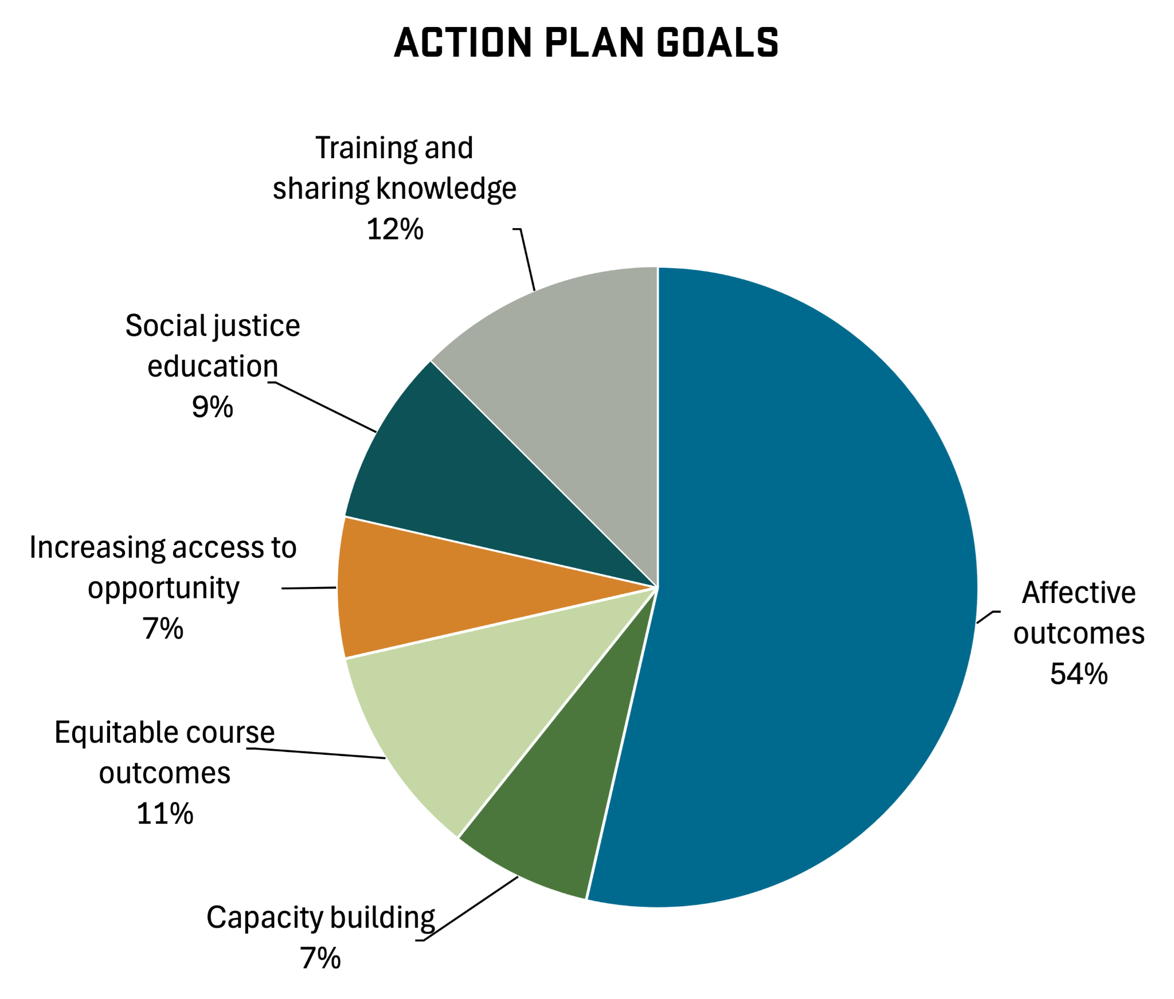
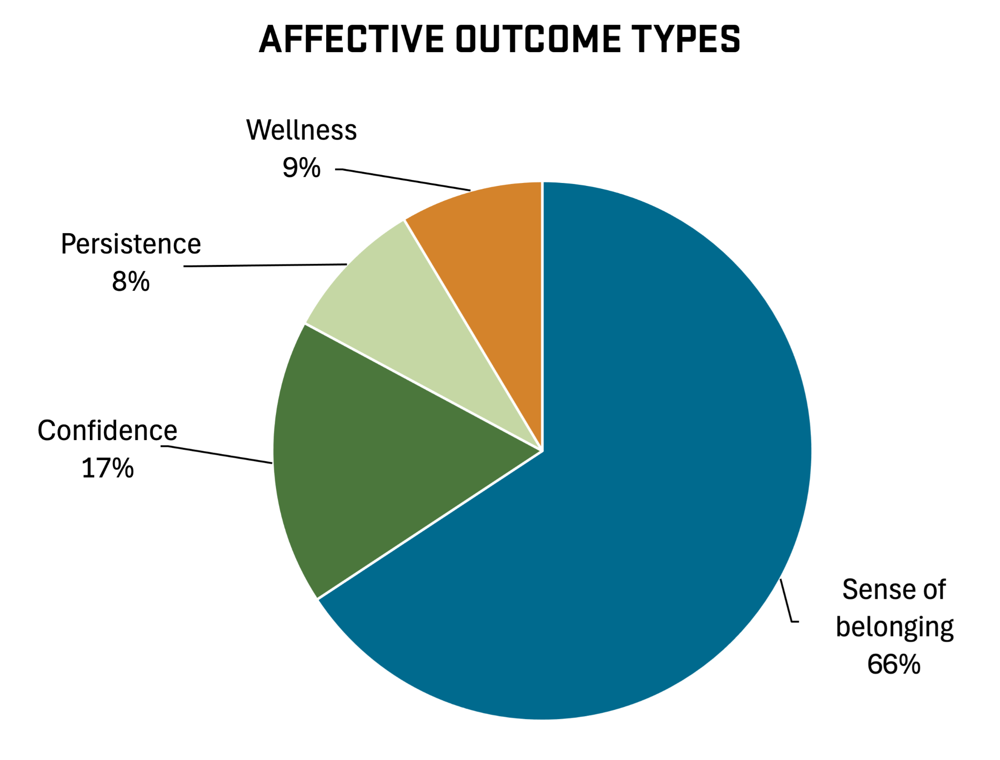
What did it look like to take action?

Slide 40
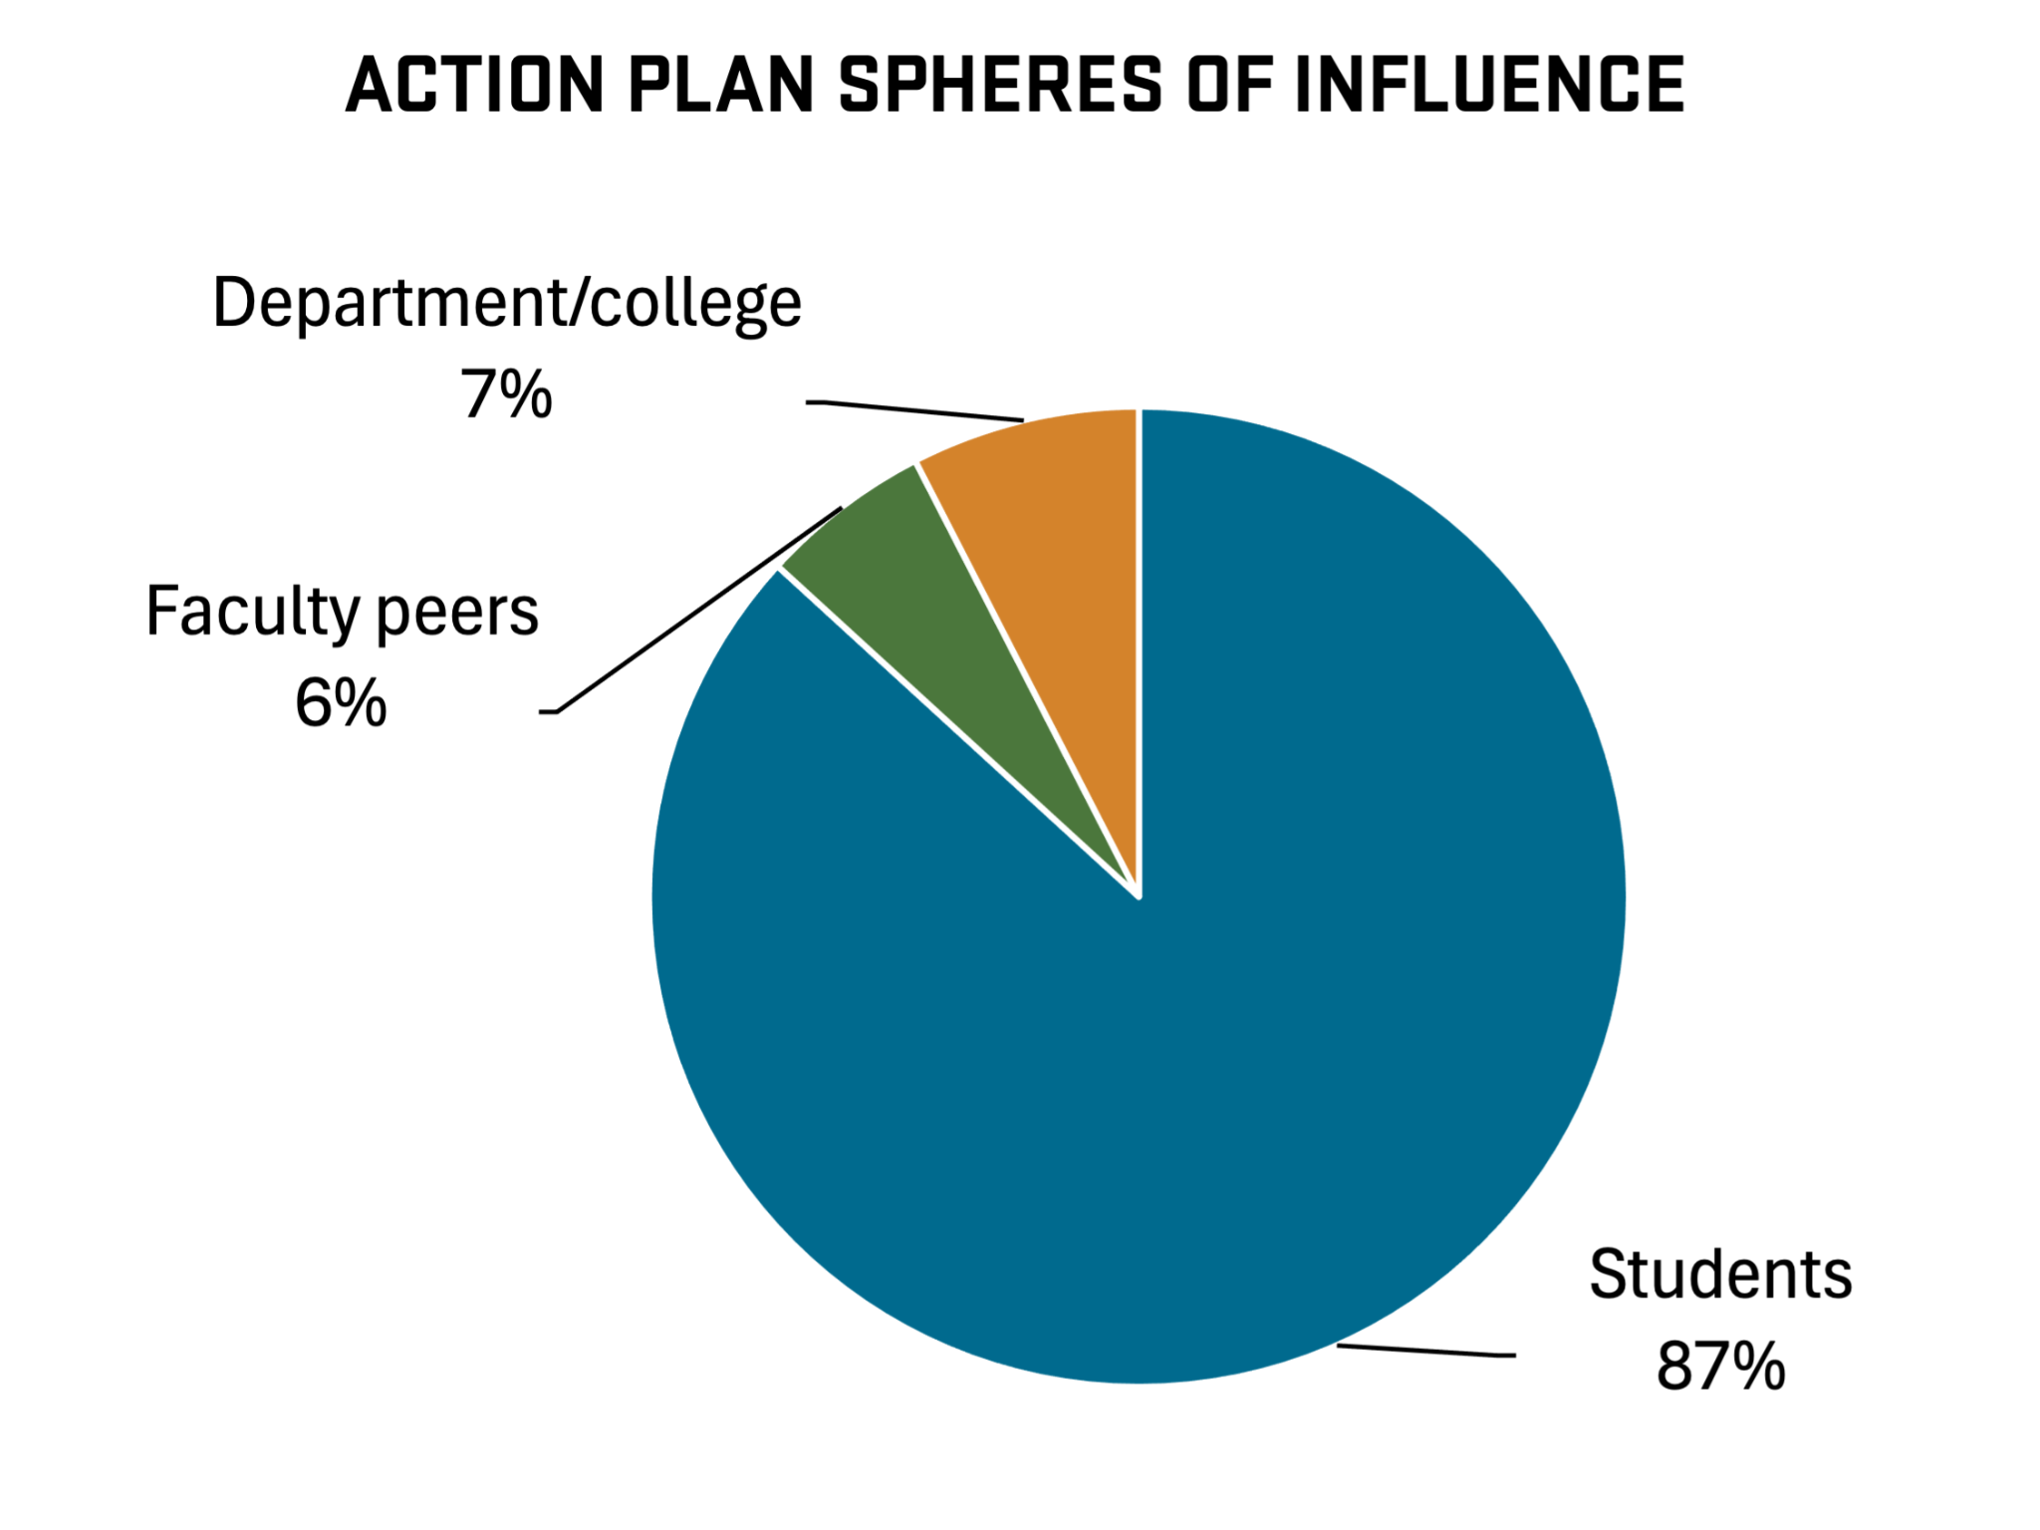
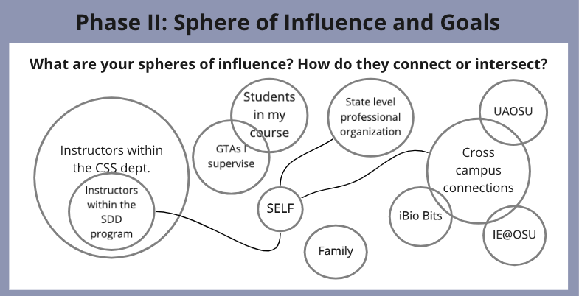
Where did fellows take action?
Spheres of influence are what we called the various connecting and intersecting spaces in which a fellow has influence on others; fellows were encouraged to think about which spheres afforded them agency, and what “levers” and barriers were associated with each sphere

Slide 41
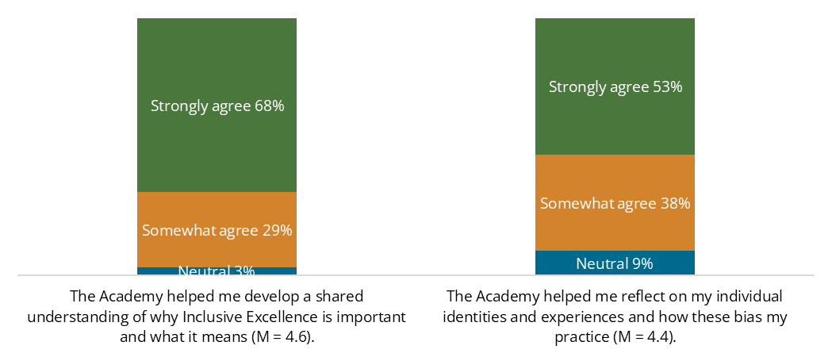
How did IE@OSU help fellows become change-makers?
IE@OSU helped fellows develop a personal understanding of the importance of inclusion and equity.¹
¹EoA survey
Notes:
The Academy was successful, and here’s how.

Slide 42
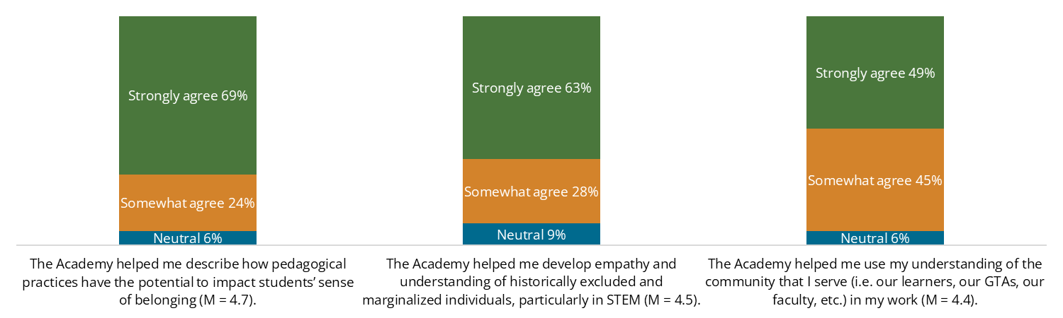
How did IE@OSU help fellows become change-makers?
IE@OSU helped fellows reflect on how their practices affect others.¹
¹EoA survey

Slide 43
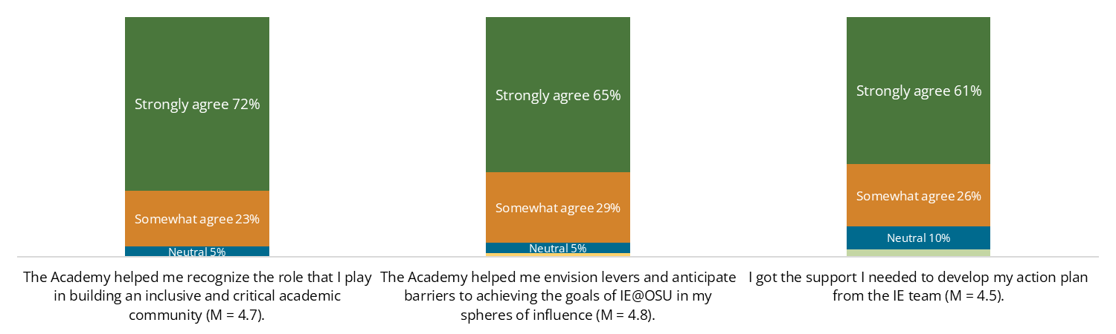
How did IE@OSU help fellows become change-makers?
IE@OSU helped fellows recognize their ability to act.¹
¹EoA survey

Slide 44



What key supports did IE@OSU offer fellows?¹
A shared understanding of tools, resources, and actionable ideas:
Whereas before, inclusive teaching practices look like a laundry list of "100 tips to...", now I feel that there is a specific web of principles underlying specific practices. There are still a *lot* of potential focus areas, but I value the framework we built together.
An intentional community of facilitators and like-minded fellows:
There is a community of wonderful people who are all interested in inclusive and equitable teaching practices. I have a network of people that I can bounce ideas off and that are diverse in disciplines.
An acknowledgment that action must be persistent but can be small, iterative, and experimental:
It's important to have support in making change and to understand that sometimes changes work, and other times they may not work as well. . . That doesn't mean that your change overall didn't function as intended. I think it's important to. . .continually be willing to examine your pedagogy … that includes not only how we talk, but how our learning materials talk to our students.
¹EoY survey
Notes:
The “framework” included learning about signature and critical pedagogies, active learning approaches, case studies, the action plan, and posters.
People as resources. Community included small groups, one-on-one discussions with facilitators and fellow peers, brainstorming and thoughtpartnership. For designing action plans, evaluations, practicing inclusive language4, and sharing teaching practices.

Slide 45
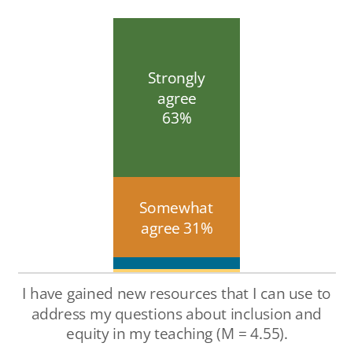
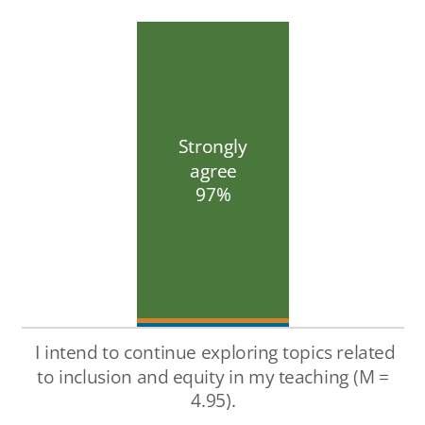
What did it look like to be a change agent?
IE@OSU fellows indicated a desire to continue exploring equity and inclusion topics in their teaching.¹
¹EoY survey

Slide 46
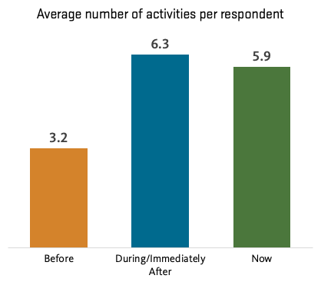
Fellows’ engagement with change persisted
Fellows were given a list of equity and inclusion related activities and asked to select the things that they had engaged in before their fellowship, during/immediately after, and what they were currently engaged in.

Slide 47
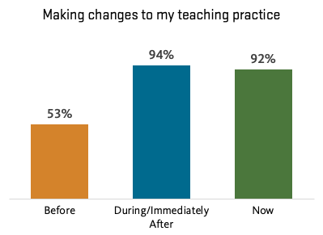
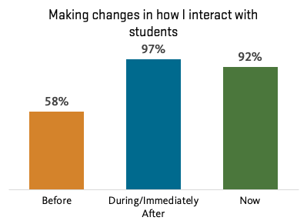
Fellows sustained changes to their teaching practice
Notes:
Activities most sustained

Slide 48
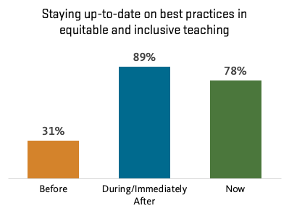
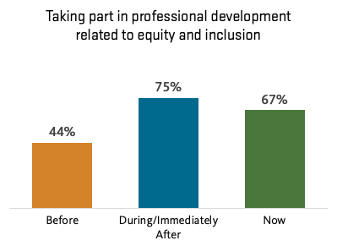
Fellows continued to develop professionally

Slide 49
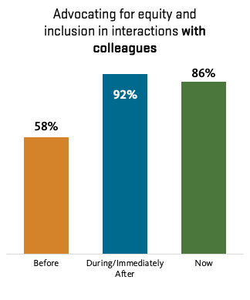
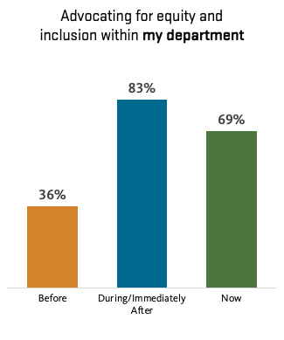
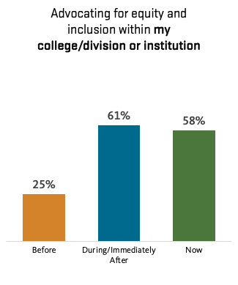
Fellows became advocates for equity and inclusion

Slide 50
What are some challenges that IE@OSU fellows face?¹
Initiating action
Getting started. That had two parts. First was carving out time to do it - in part convincing myself it should be a priority. Second was recruiting help so I could get it done. It involves a fair number of hours of research and creating
Time, capacity, and balancing responsibilities
Time commitment to implementing the action plan on top of teaching three courses per term.
¹EoY survey
Notes:
The fellows are no different from other changemakers and other people teaching at OSU, LBCC, LCC and

Slide 51
What are some challenges that IE@OSU fellows face?¹
Pushback
Student resistance! Even though changes are constantly made through an equity lens, and actually benefit the students, that work is intangible to them and many see it as "different from what other classes do and therefore more difficult to adapt to".
Institutional capital
I think my project was unfortunately the wrong one to pick because I didn't have significant influence with faculty, and therefore lost steam.
Staying motivated to work against norms and without recognition.
¹EoY survey
Notes:
The fellows are no different from other changemakers and other people teaching at OSU, LBCC, LCC and

Slide 52
What were IE@OSU fellows proud of?¹
All the significant changes to my curriculum. The students have improved retention dramatically and I feel that their confidence and mental health have improved.
Students sending thanks about the changes made to the courses I teach and noticing the changes as a positive for their experience in the course.
I'm proud of the greater overall awareness I now have of issues that underrepresented students face, like implicit bias, microaggressions, and structural racism. I feel I have been able to connect and empathize with students in ways that I didn't before the fellowship.
¹Retrospective survey

Slide 53


How can we support fellows in creating change?
Providing funding opportunities or personnel to offset the time and capacity challenges.
Honestly, time to work on implementing the plan. I would not be as far along if it was not for the graduate student supported by IE funding.¹
Maintaining a faculty community across STEM disciplines and institutions around IE.
Finally I think it would be fabulous to have occasional "office hours" or "social hours" where IE fellows from various cohorts can come together to ask questions / share new things, etc. Or even just an email listserv.²
¹EoY survey
²EoA survey
Notes:
Space for community, for practice, shared resources, wisdom, and experiences. For confidence.

Slide 54
Key takeaways
Fellows became effective change-makers in their spheres of influence
IE@OSU supported fellows to develop their own understanding of and ability to take action, as well as a community of changemakers.
Fellows have persisted in creating change, in increasingly broader spheres of influence at their institutions.
Notes:
Through boosting student belonging, wellbeing, and persistence. And through sharing their knowledge with others.

Slide 55
Looking forward: Now what?
Notes:
We just heard a bunch of data about the program, and we started planning this summit 4 months ago, with everything OSU & IE has done….

Slide 56
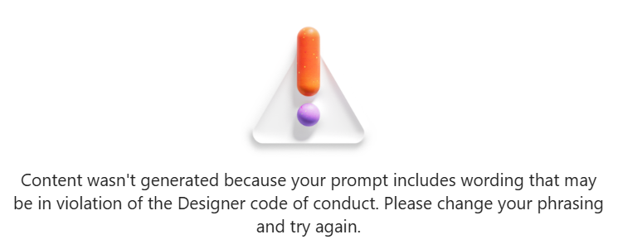
We asked AI…
What does the Future of DEI look like in America?
Notes:
what does the future of DEI look like in America right now?
Show me in an image

Slide 57
Agenda for the Day
9:30 - 9:45 am Welcome
9:45 - 10:30 am Introduction to IE@OSU Project
10:30 - 10:45 am Break
10:45 - 11:30 am Experience a moment in the IE Academy
11:30 - 11:40 am Break
11:40 - 12:15 pm Evaluation Findings: Impact over Years
12:15 - 1:10 pm Lunch
1:10 - 2:00 pm IE@OSU Faculty Fellows Panel
2:00 - 2:50 pm Looking Forward
2:50 - 3:00 pm Closing Remarks

Slide 58

Lunch break (12:15-1:10 pm)

Slide 59
IE@OSU Faculty Fellows Panel Discussion

Slide 60
Faculty Fellow Panelist
Jeneva Anderson , Lane Community College
Ashley D’Antonio, Oregon State University
Sean Daniels, Linn-Benton Community College
Rachel Palmer, Oregon State University
Lisa Turnbull, Lane Community College

Slide 61
Panel Questions
In what ways were you able to implement change when you were an IE@OSU fellow?

Slide 62
Panel Questions
In what ways were you able to implement change when you were an IE@OSU fellow?
What features of the program helped you to implement change?

Slide 63
Panel Questions
In what ways were you able to implement change when you were an IE@OSU fellow?
What features of the program helped you to implement change?
What are some things that you took away from being an IE@OSU fellow that has helped you to sustain the inclusion & equity work you currently do and want to see done? What initiatives/features would you like to see implemented at your institutions to continue this work?

Slide 64
Panel Questions
In what ways were you able to implement change when you were an IE@OSU fellow?
What features of the program helped you to implement change?
What are some things that you took away from being an IE@OSU fellow that has helped you to sustain the inclusion & equity work you currently do and want to see done? What initiatives/features would you like to see implemented at your institutions to continue this work?

Slide 65

Break (5 min)
Notes:
10 minutes

Slide 66
Looking forward: Now what?
Notes:
We just heard a bunch of data about the program, and we started planning this summit 4 months ago, with everything OSU & IE has done….

Slide 67



Every Student Graduates
Notes:
We want to achieve this goal
We want to do it in partnership with our faculty at LBCC & LCC
These are our shared students, community and responsibility

Slide 68
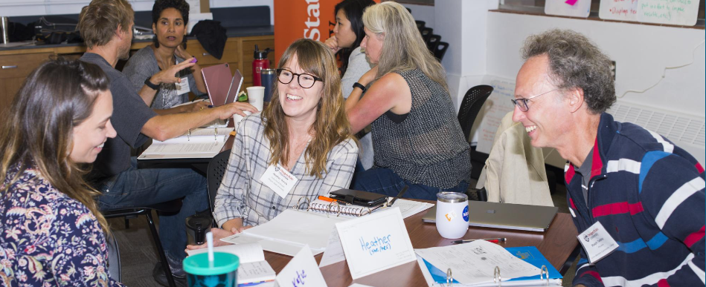
Supporting faculty to achieve this goal
Notes:
We used our spheres of influence to build this program and do this work
And we trained faculty to use their spheres of influence to enact their plans
How can we continue this? We want you to do the same

Slide 69
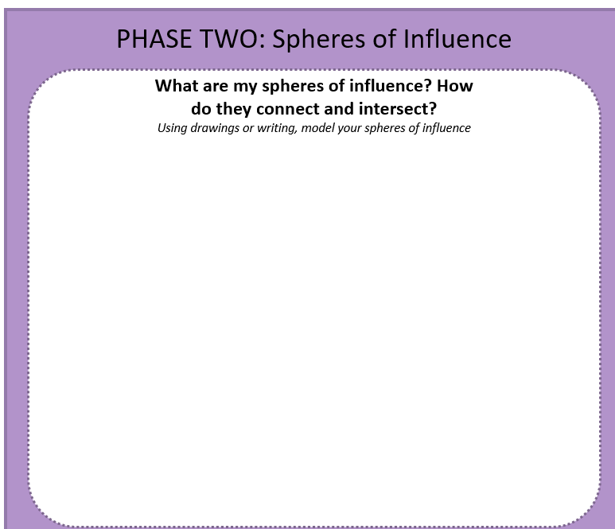
What are your spheres of influence
to continue the work?
Notes:
5 min work to self,
Talk to table 5 min -

Slide 70
Brainstorm at your table, leverage your spheres of influence…..
How can we work across campuses to support our faculty in this work?
Notes:
10 minutes at your table

Slide 71
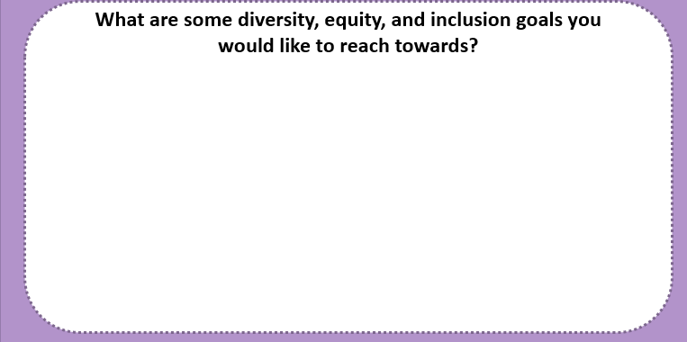

Now, as an individual…
To support faculty to help to achieve
Every Student Graduates?
Notes:
Focus on the faculty
Sometimes the start is as helpful as the start
5 min

Slide 72
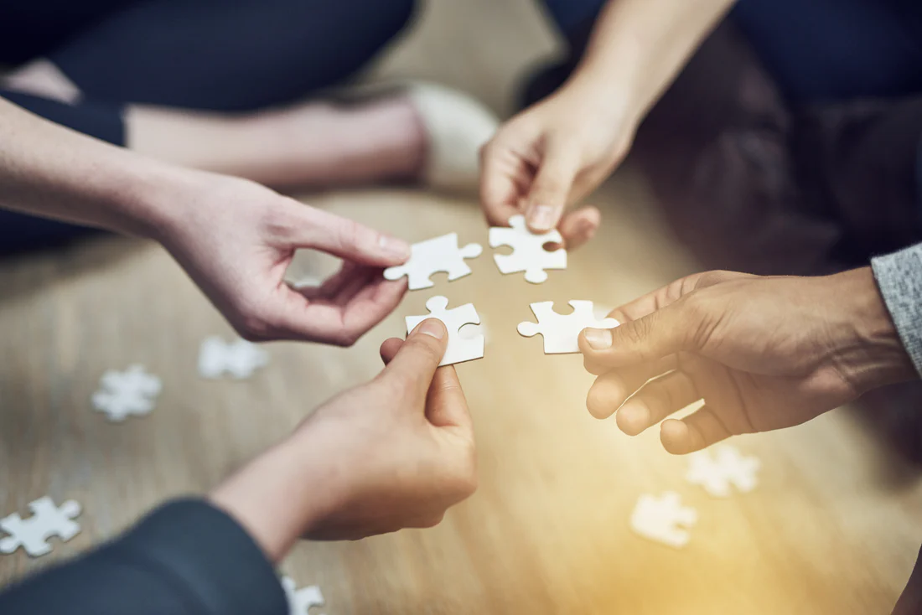
In one sentence…
Share one goal you developed
Whip!
Notes:
Whip around
This was a technique we used in the academy, everyone contributes something, even if it is not completely formed, a start, a stop, a continue….
https://craft-hub.com/blogs/puzzles/benefits-of-doing-puzzles-at-corporate-team-building-events

Slide 73
Closing Remarks

Slide 74
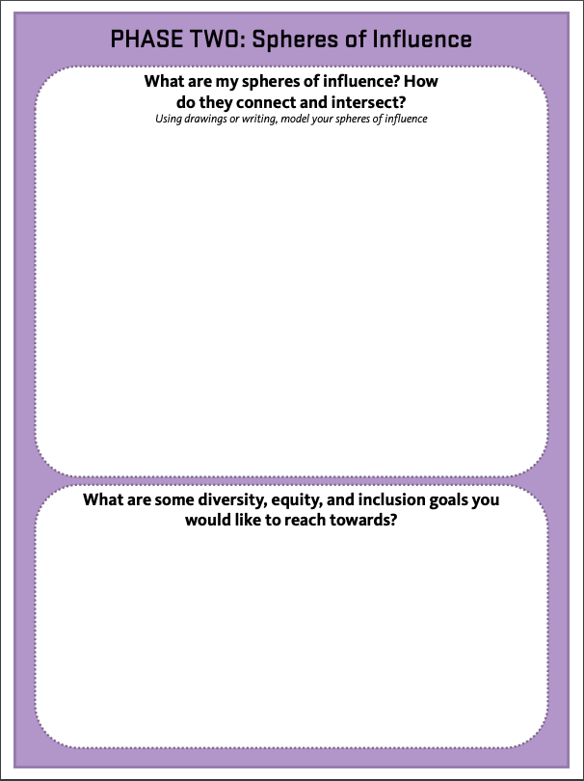
Action Plan
Take 10 min to work on Phase II: Spheres of Influence
Build circles
Show how they overlap/intersect
Add connection lines to show how they connect
Consider some of the inclusive and critical goals that you want to reach for
Consider - How do you feel you can influence a particular sphere and what spheres seem to have a lot of barriers or levers?
Notes:
Free work time for 10 min,
-How/why do you feel you can influence a particular sphere? What spheres of influence seem to have a lot of barriers?

Slide 75
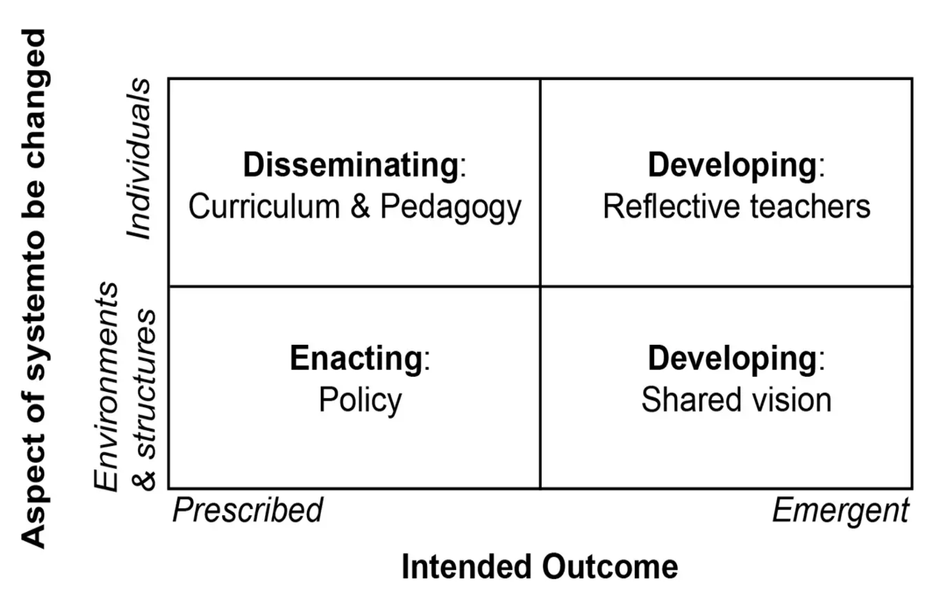

Slide 76
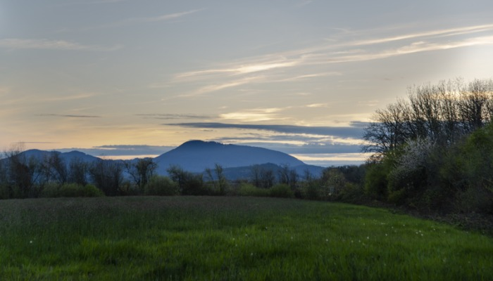
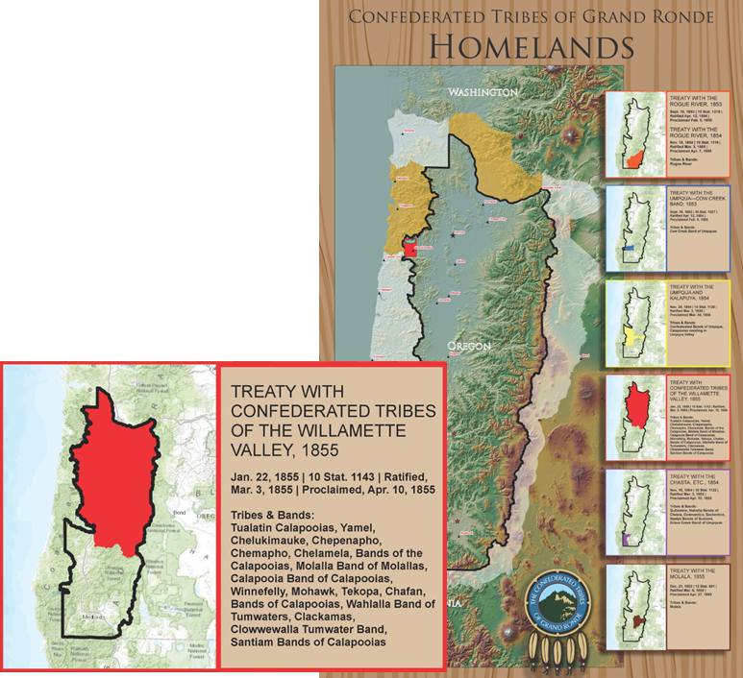
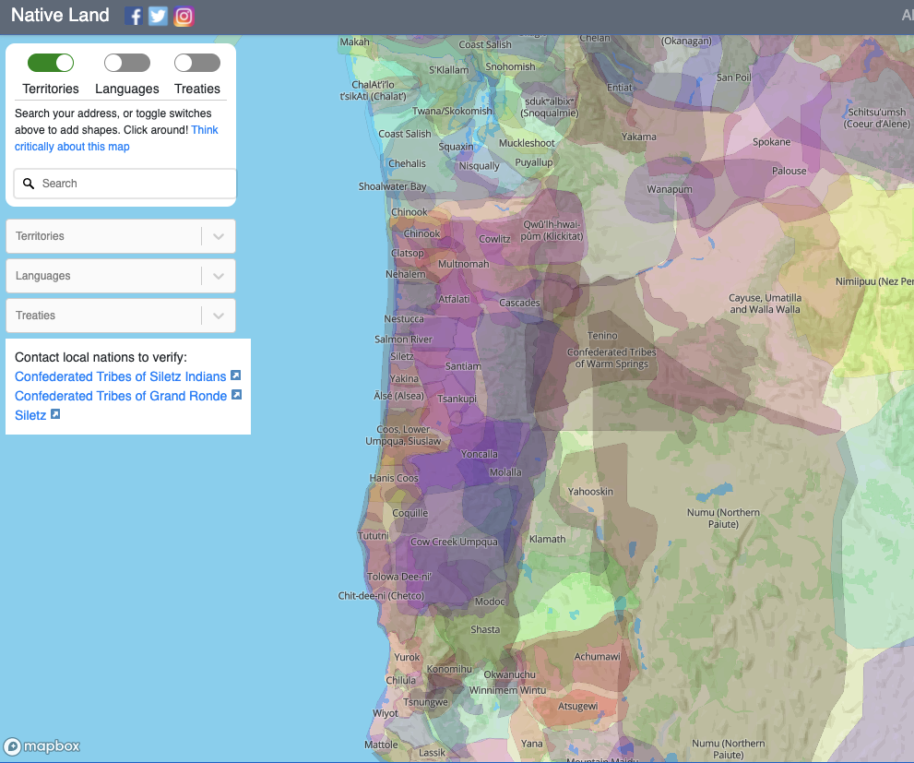
Land Acknowledgement
Oregon State University in Corvallis is located within the traditional homelands of the Marys River or Ampinefu Band of Kalapuya. Following the Willamette Valley Treaty of 1855, Kalapuya people were forcibly removed to reservations in Western Oregon. Today, living descendants of these people are part of the Confederated Tribes of Grand Ronde Community of Oregon and the Confederated Tribes of the Siletz Indians. Indigenous people are valued, contributing members of the Oregon State community and represent multiple sovereign tribes among students, faculty, staff and alumni.
Oregon State University accepts its responsibility for understanding the continuing impact of that history on these communities. Oregon State is committed — in the spirit of self-reflection, learning, reconciliation and partnership — to ensure that this institution of higher learning will be of enduring benefit, not only to the state of Oregon, but also to the people on whose ancestral lands it is now located.
Use the https://native-land.ca/ tool to learn more about native territories OR
Text a zip-code to 855-917-5263
Notes:
https://oregonstate.edu/land-acknowledgment
5 min CHOM-pin-A-foo)
Ever since the first time that I gave a land acknowledgement, I take time to stop and reflect and learn about the people whose land we occupy. I did that this week. This week due to the current political climate, I have been thinking a lot about the importance of place. How lucky I am to be in this place right now, to raise my children here in a community where they feel safe. I did not grow up in Oregon so I don’t know how my children will feel but I have often imagined imagine that after they move away that as they drive back into town on HWY 34 that they will see Mary’s Peak and think “this is my place, this is home”. What I learned as I was preparing for this land acknowledgement was that Mary’s Peak was sacred to the Kalipooya people. That they called it tcha Timanwi or chintimini which mean a place of spiritual power. I feel like right now we can all use a place of spiritual power to make us strong to help guide us through the months and years to come to be the thing that makes us feel “ this is home”.
Like most modern-day U.S. institutions, Solid Ground benefits from the unaddressed legacy of stolen labor at the foundation of this nation and its vast and inequitable wealth.
We respectfully acknowledge our debt to the enslaved people, primarily of African descent, whose labor and suffering built and grew the economy and infrastructure of a nation that refused to recognize their humanity.
While the 13th Amendment to the Constitution technically ended “slavery” in the U.S., we know that slavery’s ongoing impacts are still felt by countless people forced – through violence, threats, and coercion – to work in the U.S.
We recognize our debt to exploited workers past and present whose labor was and continues to be stolen through unjust practices.
We acknowledge our collective debt to the Indigenous peoples of this land whose labor was forced and exploited, the Chinese immigrants who built railroads that allowed for westward American development, Japanese Americans whose properties and livelihoods were taken from them while incarcerated during World War II, and migrant workers from the Philippines, Mexico, and Central and South America who have worked Pacific Northwest farms and canneries.
We recognize the immigrant and American-born workers of African, Asian, and Central and South American descent whose labor remains hidden in the shadows but still contributes to the wellbeing of our collective community.
We recognize that our economy continues to rely on the exploited labor of incarcerated people, largely people of color, who earn pennies an hour while generating billions in goods and services each year. And we know there are many other people, too numerous to mention, who are prevented from reaping the true value of their labor by unjust systems and cruel practices.
I spent some time mulling over these ideas and learning about land acknowledgement and also about the people that originally occupied the lands where OSU sits, in preparation for sharing this land acknowledgement. I learned that over 30 tribes and bands from Kalapuya, Molalla, Chasta, Umpqua, Rogue River, Chinook, Tillamook and others make up todays Confederated Tribes of the Grande Ronde Community of Oregon. 27 bands and tribes from Umpqua, warm springs, Tillamook, Molalla, and Alsea and others make up the Confederated Tribes of the Siletz Indians. Oregon State University is built on the homelands of these indigenous peoples whose ancestors were forcibly removed from this Land. The over 10,000 combined members of these two indigenous communities remain active throughout their ancestral homelands, including here are Oregon State University. We take these few moments to acknowledge these truths. I encourage you all to dedicate future moments to discover the stories of the people and this land where we conduct our work and the injustices of the land-grant processes that built this institution. Let’s phase a moment and think about land acknowledgements in higher education and in building inclusive practices.
Stop here and share resources and discuss why we might want to share a land acknowledgement in different scenarios. Recognize some of the ways that OSU has address valuing this legacy such as renaming building Chempinefoo lodge. And the Native American Longhouse: https://dce.oregonstate.edu/nal Land-Grab Universities,” the exposé that grew out of this massive data project, convincingly presents a detailed argument showing that land-grant universities were built “not just on Indigenous land, but with Indigenous land.” This is not to suggest that OSU played any real role in this bloody piece of history. However, it is the case that a majority of the land that kick-started the school was acquired by the U.S. Government under the same treaty that displaced the Modoc tribe and precipitated the Modoc War. https://fiveoaksmuseum.org/exhibit/this-is-kalapuyan-land/
Every county, town, and city in the U.S. is located on ancestral lands of indigenous tribes and communities. Land acknowledgement serves as a starting point for open dialogue about those communities, while highlighting the adversity Native Peoples still face and overcome today.
Newport: As you can see, most of the current names of places along the Oregon Coast actually are named after the Indigenous Tribes of the areas. All of these tribes, from the Northern California coast to Southern Washington coast, have been joined together in the Confederated Tribes of Siletz Indians (Clatsop, Chinook, Klickitat, Molala, Kalapuya, Tillamook, Alsea, Siuslaw/Lower Umpqua, Coos, Coquelle, Upper Umpqua, Tututni, Chetco, Tolowa, Takelma, Galice/Applegate, and Shasta). This group formed when 27 bands of Native Americans were forced onto the Siletz Reservation in the 1800s. Native Americans along the coast had many different ways of living, but there were similarities in terms of diet. They subsisted on hunting, fishing and gathering of lamprey, whale, ocean fishes, salmon, mussels and other shellfish, deer, and a variety of plants. Homes were made from cedar or sugar pine with a plank structure, sometimes reaching over 100 feet in length with the hearth slightly underground.
Lane:
I’d like to start our meeting with the acknowledgment that the land we are on is the traditional homelands of the Kalapuya people. The Kalapuya were stewards of this very land for over 14,000 years before their traditional way of life was forever disrupted and destroyed. We start our meeting with humility and reverence for the original inhabitants, the Kalapuya.
In Bend, Oregon we are on the traditional territory of the Northern Paiute, the Wasco, and the Warm Springs tribes, which now comprise The Confederated Tribes of Warm Springs. Acknowledging territory shows respect for Indigenous Peoples who called the land home before the arrival of settlers, and in many cases, still call it home. It’s important to recognize that we are simply guests on this land. Eight tribal groups regularly and customarily belonged to this region.
Columbia River Tribes (Wasco [Chinookan], Tenino, Tygh, Wyam, and John Day [Sahaptin]) came south from the Columbia River on seasonal rounds to gather, hunt, and fish. These lands were also the traditional lands of the Wascoes, the Warm Springs, and the Paiutes. Today, Wasco, Warm Springs, and Paiute peoples live on in our region and are recognized as The Confederated Tribes of Warm Springs.
According to the Confederated Tribes of Warm Springs, each of these bands are related to this region, but traditionally they observed very different ways of life:
"The Wasco bands on the Columbia River were the eastern-most group of Chinookan-speaking Indians. Although they were principally fishermen, their frequent contact with other Indians throughout the region provided for abundant trade of root bread, salmon meal, and bear grass.
The Warm Springs bands lived along the Columbia’s tributaries speaking Sahaptin. Unlike the Wascoes, the Warm Springs bands moved between winter and summer villages, and depended more on game, roots and berries. However, salmon was also an important staple for the Warm Springs people. Though they spoke different languages and observed different customs, the Warm Springs and Wasco bands interacted frequently.
The Paiutes lived in southeastern Oregon and spoke a Shoshonean dialect. The lifestyle of the Paiutes was considerably different from that of the Wasco and Warm Springs bands. Their high-plains existence required that they migrate further and more frequently for game. The Paiute language was foreign to the Wasco and Warm Springs bands, and commerce among them was infrequent. In early times, contact between them often resulted in skirmishes." Learn more from the Confederated Tribes of Warm Springs.
We would like to acknowledge that the beautiful land known as Bend, Oregon north to the Columbia
River is the original homelands of the Confederated Tribes of Warm Springs. The Confederated Tribes
ceded this land in the Treaty of 1855 while retaining regular and customary hunting, fishing, and
gathering rights. The Wana Łama (Warm Springs), Wasq’ú (Wasco) and Northern Paiute people
inhabited this area in certain seasonal times that clearly established their presence. It is also important
to note that the Klamath Trail ran north through this region to the great Celilo Falls trading grounds. This
trade route expanded the impact of commerce between Tribal nations. We acknowledge and thank the
original stewards of this land. It is our hope that guests continue to honor and care for this land.
(map and explanation plus this) https://ndnhistoryresearch.com/
Confederated Tribes of the Grande Ronde: https://www.grandronde.org/
Confederated Tribes of the Siletz Indians: http://www.ctsi.nsn.us/
Video: https://diversity.oregonstate.edu/we-are-all-treaty-people
Nash, M. A. (2019). Entangled Pasts: Land-Grant Colleges and American Indian Dispossession. History of Education Quarterly, 59(4), 437-467.
https://doi.org/10.1017/heq.2019.31

Slide 77
Every Student Graduates:
Inclusive Excellence in STEM Summit
Notes:
Keep this slide here for guest speakers.

Slide 78
Logistics
Bathrooms: men’s, women’s, all users
Planned breaks throughout the day
  Morning: 10:30
  Lunch: 12:15 - 1:10 pm
  Afternoon: ~2 pm
Wifi: OSU_Guest
Handouts
Notes:
Handouts - includes agenda
Next slide is take care of self

