Slide 1
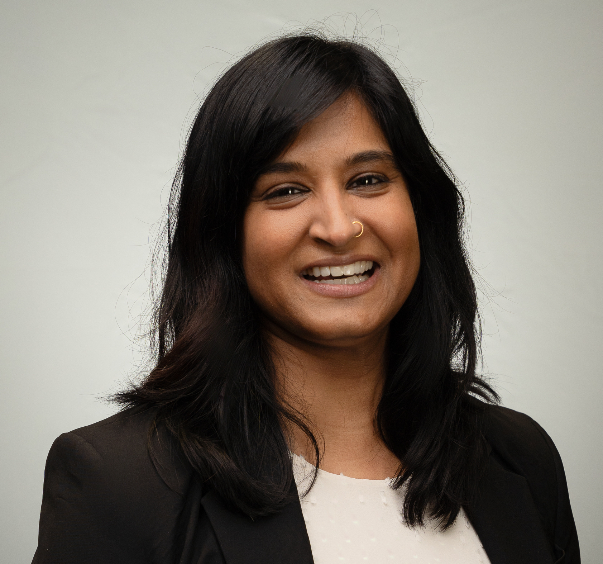
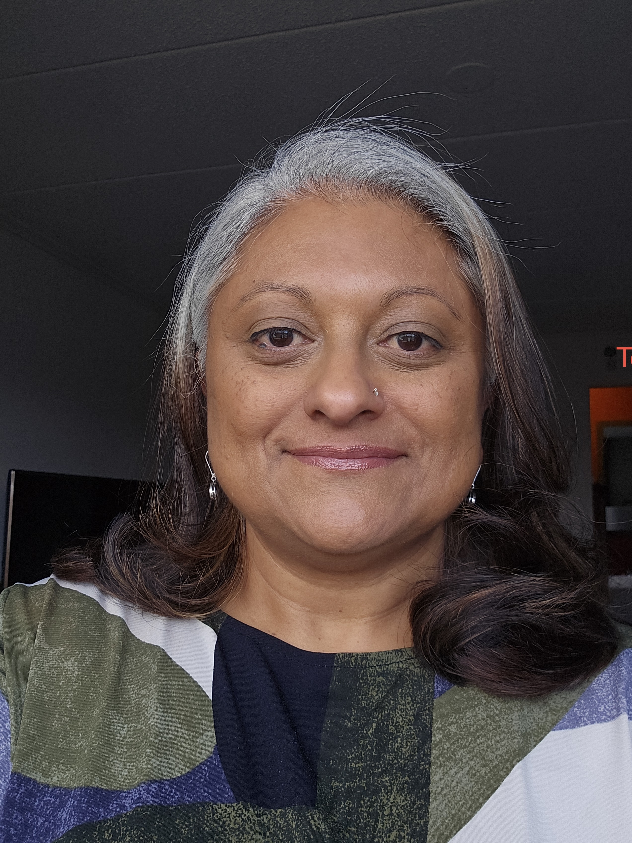
Creating Equitable Leadership for Change
Srividhya Swaminathan,
Associate Dean of
Undergraduate Studies
at St. John's University.
She serves as the Project
Lead for the St. John's
team and was elected to
the Vice Chair position for the LCC3 Year 3
grant. She will continue on the leadership
team for Year 4 LCC3 work.
Anupama Seshan,
Associate Professor of
Biology at
Emmanuel College.
She serves as the Project
Lead for the Emmanuel
Team. She was elected
to serve as LCC3 liaison to HHMI from Jan 2022 – July 2022 and as Vice Chair of LCC3 for Year 1. She plans to join the LCC3 leadership team for Year 4.

Slide 2
The Accidental Collective
2019: 354 institutional teams propose 6-year projects
30 teams to be awarded $1 million each
2021 Phase I: 107 teams randomly organized into 7 Learning Community Clusters
Each of the 107 teams awarded $30K learning grant to work on individual projects
2022 Phase II: Each LCC prepares a collaborative 6-year proposal
$8 million shared amongst a 14-institution collective
Me
You
You
Me
LCC3
You
Me
Notes:
Vidhya - Brief background of the leadership formation: IE1 and IE2 formed of individual institutions who were funded. Our initial competition was for that model and the pandemic forced a re-set of HHMI’s goals. They wanted the project to have a broader reach, so they identified an initial cut of 100+ institutions who were given individual learning grants of $30K and organized into Learning Community Clusters. Those LCCs were then invited to submit a collaboratively written proposal and apply for the funding that would be divided across institutions. Issues that the structure surfaced:
How do we move from individual projects (as informed by those learning grants) to collective action?

Slide 3
LCC3 course correction
Traditional Leadership Model
Centering of Whiteness
Undue burden on POCs
Failed strategies
Power rooted in race and gender hierarchies
Notes:
Anu:
On whom did the burden of this work fall and why? We noticed trends in organizing that were common to creating collaborative space: unintentional centering of whiteness; undue burden placed on faculty of color; default to traditional leadership models that would not serve the work. A
In looking at minoritized students and the barriers that they faced were the dynamics we wanted to unravel. Ironically, those same dynamics were taking over our group. To create change, we had to acknowledge and name these structures as operating our predominantly white group.
**Rework this so that from 6/18/21 to 01/21/22 at first, the usual power dynamics were at play (race/gender/hierarchy were dictating power dynamics). The things that happen in our classrooms that we are trying to mitigate were happening with us. Reckoning: identifying a need for norm setting and external facilitator.

Slide 4

Community Norms and Values (with Dr. Bridget McCurtis)
Guiding Questions:
How do we treat each other?
How do we do the work?
How do we cultivate environmental needs?
How do we manage disagreements/conflict?
Development of Norms and Values are reflective and iterative.
Notes:
Vidhya: Developing a leadership model that moves from accidental collective to intentional and inclusive collaboration:
We had no “stewardship” from HHMI, only a set of imperatives. Bridget McCurtis gave us a set of organizing questions, collected our answers, and developed a working set of community norms.
These values are the basis for how we behave as members of this critical friend community. Our facilitator, Dr. Bridget McCurtis, with whom we have been working with for the past year, solicited responses from our community on how we will develop and nurture our critical friendships.

Slide 5
Enacting Equity and Accountability
Equity
We support our collective learning with 10% of our overall budget.
The remaining 90% is split evenly between the 14 member institutions for the institutional project activities.
Accountability
Each institution is responsible for an annual financial report.
LCC3 collectively produces an annual written reflection which will include records of institutional participation.
By-Laws
define minimum expectation of institutional engagement without ‘policing’ or penalties
describe procedures for how LCC3 will support institutions struggling to maintain engagement
contain mechanisms through which to change the By-Laws
Notes:
Anu: Out of those norms, we created working definitions of equity and accountability. Created a set of by-laws to codify the values outlined in our conversations. The most important points:
Minimum expectation of institutional engagement
Procedures for LCC3 support of institutions struggling to maintain engagement
Mechanism through which to change the By-Laws
We have agreed to use 10% of our funds for Inclusive Collaboration functions. These funds will be used to fund the LCC3 Leadership Team and Coordinator positions, to bring virtual workshops and speakers to all LCC3 members, and to organize two in-person meetings amongst our group. These funds are also being used to engage a professional inclusive
Accountability is based on what HHMI has communicated.
Operating principles - we are used to “carrots and sticks” but we are building critical friendships, and these erode the trust involved. We will get out of this inclusive collaboration what we put in. Nobody is the “Equity Police.”

Slide 6
Our LCC3 ‘Framing Question’
What would it take for institutions to make a comprehensive shift from deficit- to achievement-oriented frameworks in their thinking and practices?
Notes:
Vidhya: Our framing question not only guided our work but also our work in collaboration. It became part of our iterative process in evaluating leadership
This phrase was repeated in every single meeting we held.

Slide 7
LCC3 Leadership & Communication Cycle
Representation from all 14 institutions
Elected Chair and Vice Chair
Norm setting
Centering our 'Framing Question'
Moderating intra-LCC3 communication
Treasurer
Ensures equitable distribution of funds
Advisory Committee
Liaison function between project communities and Chair/VC
Assessment and Dissemination Working Groups
Opportunities for collaboration and professional development
Project Communities
Members of institutional teams working in our three major areas of interest
Chair & Vice Chair
Advisory Committee
Project Communities
Treasurer
Notes:
Vidhya: Leadership Structure—focus on the collective, not the individual institutions. The structure for our LCC3 would be funded by common funds and would require participation from each institution. We developed fourteen leadership positions that would rotate with representatives from each institution allowing for more engagement and for professional development opportunities.
Dissemination Working Group and Assessment Working Group (3 members each)
Advisory Committee (5 members) serve as liaisons between groups and provide feedback to Chair/Vice Chair
Treasurer disburses funds from common funds
Inter-related project communities that encompass all of the activities that each LCC3 institution has conceptualized as being important for the shift toward achievement oriented thinking and practices. The areas we have identified are Student Empowerment, Continuing Education, Inclusive Curricula and Broader Transformation. Purpose of Project Communities - is find the right critical friends to focus on the work that you have underway and to develop new interventions that are relevant for your institutional context. As LCC3 members, we expect to collaborate on approaches and ideas and to get feedback to reveal perspectives that we may not have considered in our work.

Slide 8
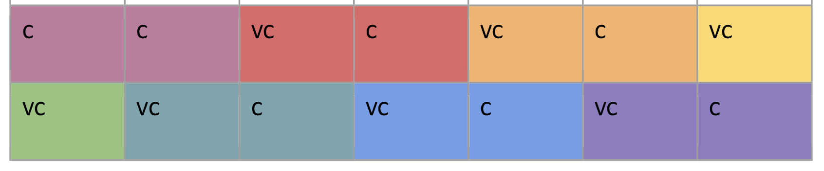
Chair and Vice Chair Structure
Year 6
Year 5
Year 6+
Year 4
Year 3
Year 2
Year 1
Notes:
Anu: Broad organizational work done by Chair and Vice Chair, elected to 2-year terms. Chair serves first as VC and then as C with new VC in order to maintain a continuity of structure. Continuity and Innovation are prioritized

Slide 9
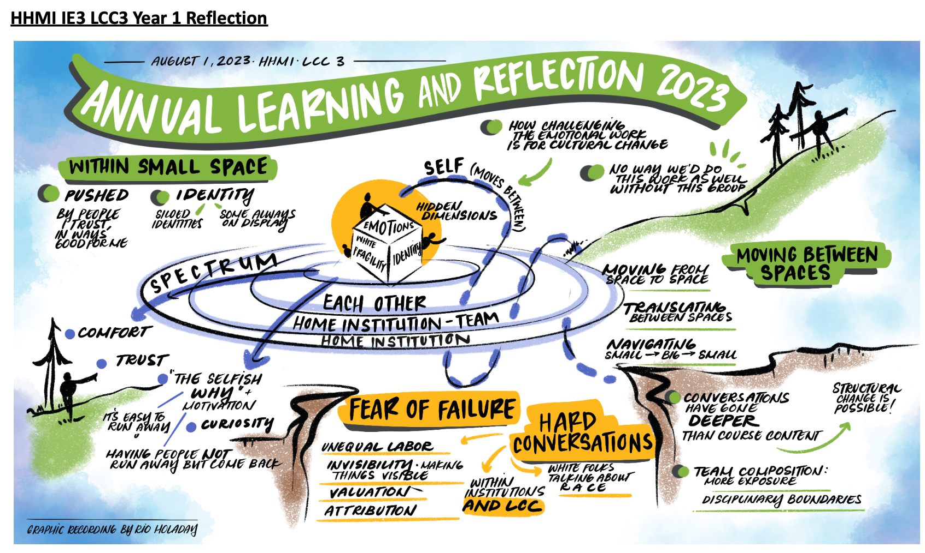
Selfish Why and Welcome – Iterative Backwards Design
Notes:
Both Vidhya and Anu:
Structures are iterative so must be nimble to allow us to pivot, which is what we had to do with the cancelation of the grant. [institute a welcome process for new members—What is your “selfish why?” introspection before participation; avoids virtue signaling]
Equitable leadership requires risk-taking and trust—you have to believe this is going to move things forward. Compensation is only a small way to mitigate risk. [Anu shares a personal story—too easy to step back]
No blame, no shame for mistakes, and commitment to progress after processing what did not go as well as intended

Slide 10
Thank you, LCC3!
Alo Basu (College of the Holy Cross)
Mark Kuhlman
Danika Leduc
Rich Londraville
Angela McKinney
Douglas McMahon
Kristin Morgan
Mark Mort
Jennifer Queen
Kasandra Riley
Josipa Roksa
Suparna Roychoudhury
Kevin Schultz
Lisa Sharpe Elles
Chelsea Ward
Lindsay Wheeler
Lisa Whitenack
Mary Allen
Ana Almeida
Clarissa Arms-Chavez
Janet Bean
Tara Beziat
Cynthia Brame
Renae Brodie
Lindsay Buford
Timothy Chapp
Donald Cotter
Kathy Friedman
Andrea Greenhoot
Brad Hersh
John Huss
Keisha John
Notes:
PDs and Year 1 and Year 2 Leadership

