Slide 1
Resilient by Design: Sustaining and
Advancing Student-Ready STEM Education
Dr. Tia Brown McNair
Partner, Sova

Slide 2
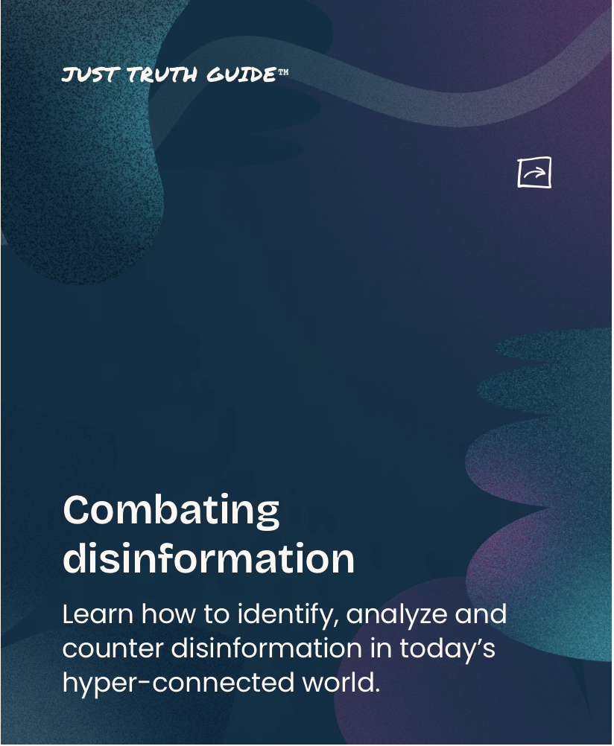
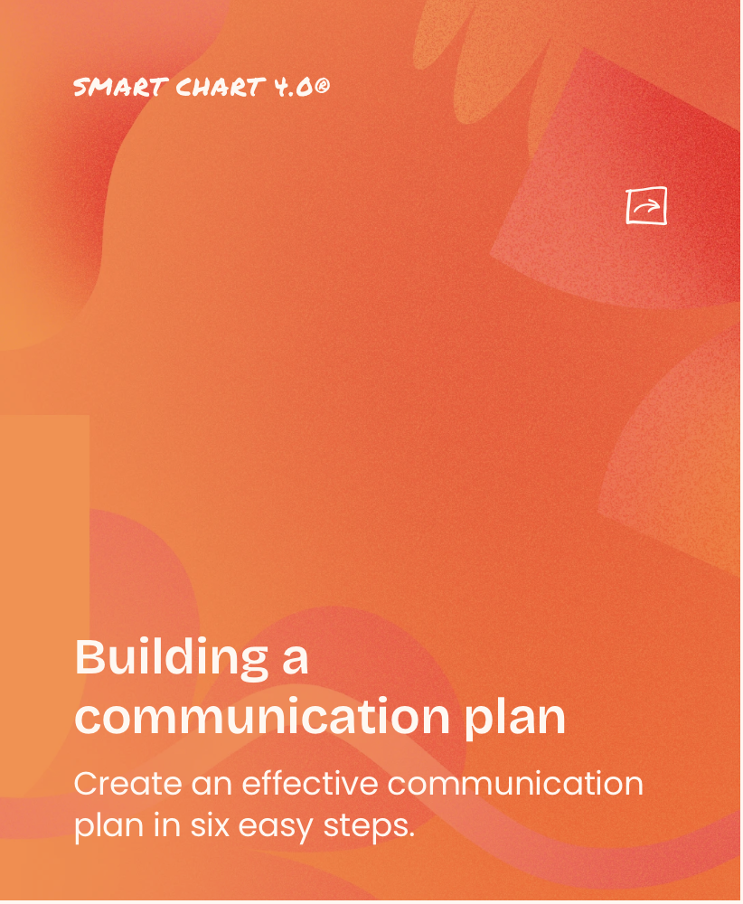
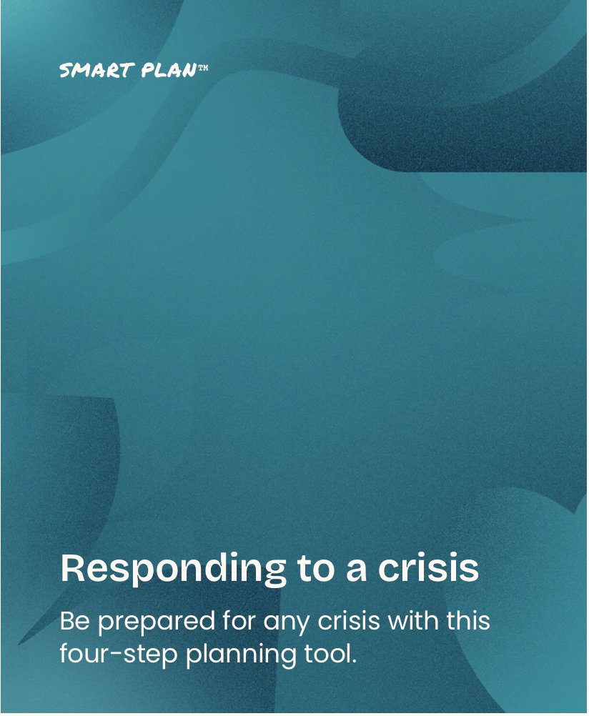
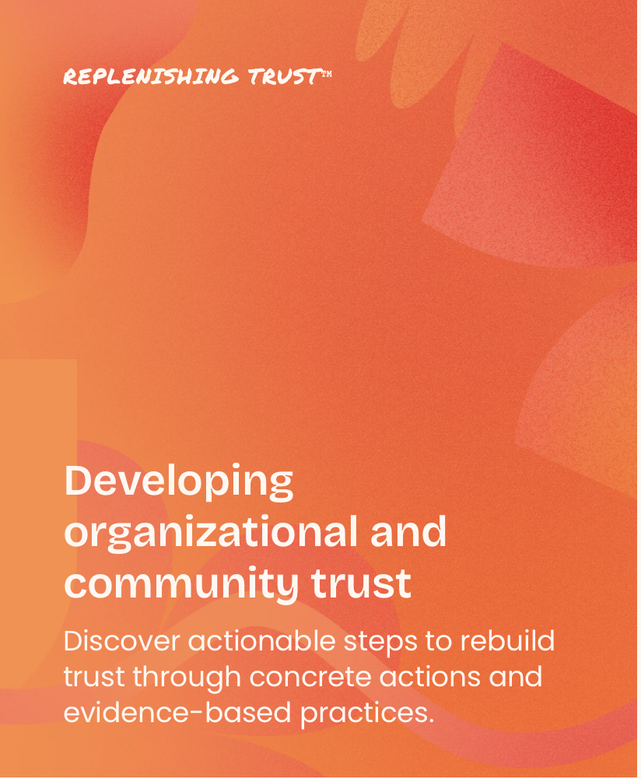
Higher Ed Forward
AAUP www.aaup.org
Center for Strategic and Inclusive Governance strategicinclusivegovernance.org
USC Race & Equity Center www.race.usc.edu
PEN America www.pen.org
Education Trust. www.edtrust.org
Spitfire Strategies www.spitfirestrategies.com

Slide 3
Becoming a Student-Ready College
Institutional Transformation
Students
and
Educators
What Gets Transformed
Higher
Education
Institutions
Evidence-Based
Strategies for
Advancing
Student Success

Slide 4
Guiding Questions
What are emerging approaches for sustaining and advancing student-ready STEM education structures and practices in today’s environment?
How are educators continuing to advance STEM education goals to serve all student populations through intentional design strategies that are mission-aligned and value-centered?
What practical frameworks and actionable strategies can be utilized to maintain and create accessible, supportive, and effective STEM education pathways?

Slide 5
We Are Resilient By Design
Adaptive Mindset to Achieve Purpose-Driven Goals
Relationship and Community Centered Approaches
Committed to Serving All Students
Professional Learning Communities
Importance of Public Scholarship

Slide 6
Student-ready leaders are committed to institutional mission, vision, values and goals.
Practices Reflect Purpose

Slide 7
Characteristics of Student Ready Leaders
They know who their students are, how they are doing, and what they need to succeed.
They are self aware and opportunistic.
They understand the big picture and think long term.
They observe, act, innovate, and prioritize accountability.
They are truth seekers and truth tellers.
They are intentional.
They build and strengthen people capacity to achieve student-centered goals.

Slide 8
Practices Reflect Purpose
Example: High-Impact Practices

Slide 9
High-Impact Practices that Help Students Achieve Outcomes
First-Year Seminars and Experiences
Common Intellectual Experiences
Learning Communities
Writing-Intensive Courses
Collaborative Assignments & Projects
Undergraduate Research
Diversity/Global Learning
Service Learning, Community-Based Learning
Internships
Capstone Courses and Projects
E-portfolios

Slide 10
Developing an Inquiry Plan
Planning inquiry activities that provide opportunities for you to collect close-to-practice qualitative and quantitative data that will help explain the “how” and the “why” of HIPs.
Outlining an intentional and reflective data examination process that is student-centered and culturally responsive.
Developing inquiry questions that reflect your institution’s goals and priorities for implementing HIPs.
Develop an action plan with specific student success goals for targeted efforts to eliminate inequities in student outcomes.
Building Capacity for Large-scale Change In Higher Education

Slide 11

https://sc.edu/about/offices_and_divisions/national_resource_center/about/affiliates/national_partners/advising_success_network.php#hipsmapping
Mapping High-Impact Practices to Advising
A research brief series published by the National Resource Center for The First-Year Experience and Students in Transition in collaboration with the National Survey of Student Engagement (NSSE).
This four-issue series explores a range of novel connections between advising and HIPs, elaborating on the multiple ways advising can be transformative in undergraduate education.

Slide 12
Culturally Responsive Teaching
“Students’ culture and lived experiences that influence how they understand and make sense of the world or themselves are integral part of who they are as learners.”
A strong knowledge base about cultural diversity.
Culturally relevant curricula.
High expectations for all students.
An appreciation for different communication styles.
The use of multicultural instructional examples.
https://www.edweek.org/teaching-learning/culturally-responsive-teaching-culturally-responsive-pedagogy/2022/04

Slide 13

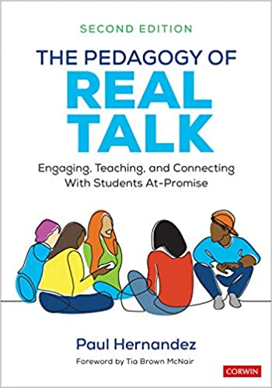


Slide 14
Practices Reflect Purpose
Example: Campus Climate

Slide 15
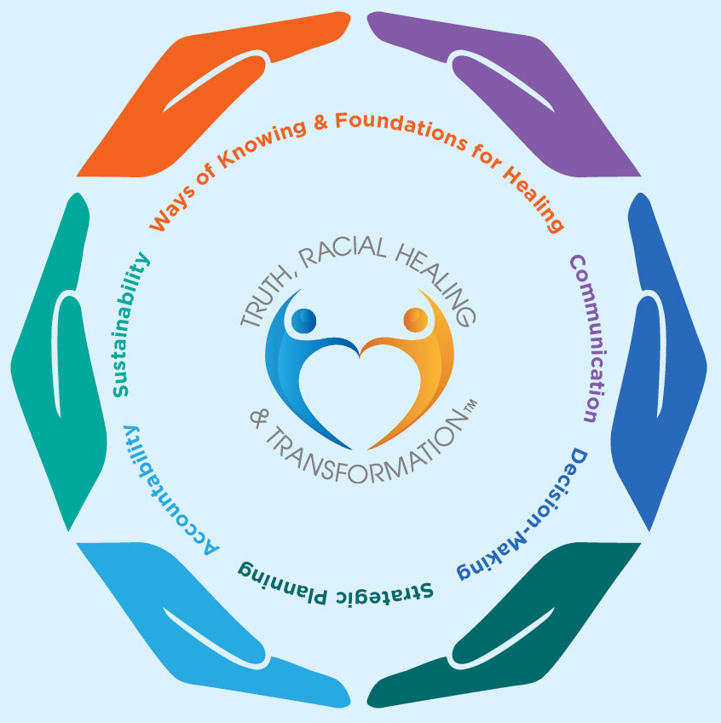
Truth, Racial Healing & Transformation™ focused Campus Climate Assessment Toolkit
A web-based toolkit that complements existing campus climate assessment tools and offers reflection-based and action-oriented guidance, strategies, and tools informed by the TRHT approach to support institutional transformation efforts.
https://www.aacu.org/trht-campus-climate-assessment-toolkit

Slide 16
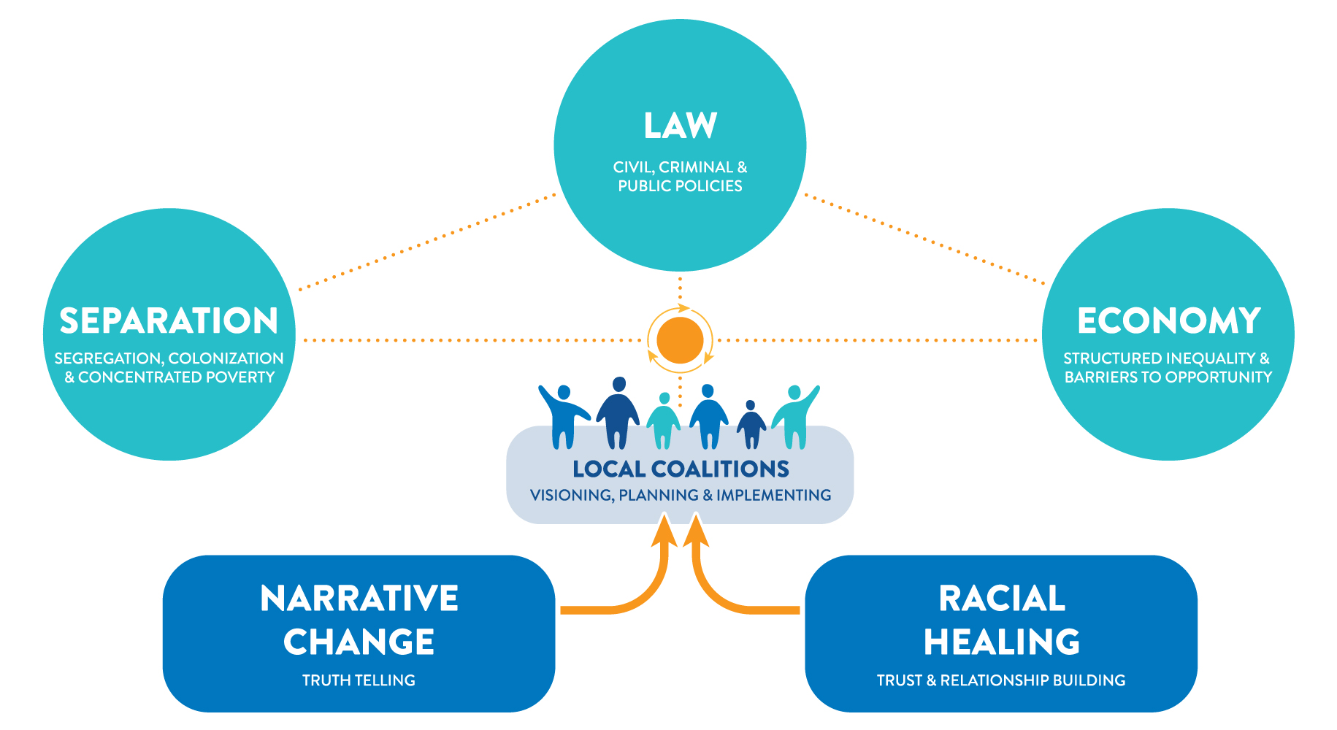
TRUTH, RACIAL HEALING & TRANSFORMATION™️
(TRHT) FRAMEWORK
What will our communities
look, feel, and be like
when the false belief
in a hierarchy of human value
no longer exists?
Source: W.K. Kellogg Foundation, https://healourcommunities.org

Slide 17
“TRHT aims to jettison the false belief in a hierarchy of human value and replace that archaic notion with a reverence and appreciation for the equal and interconnected nature of the human family."
--Gail C. Christopher

Slide 18
Toolkit Content Areas
Ways of Knowing & Foundations for Healing
Communication
Decision-Making
Strategic Planning
Accountability
Sustainability (Human & Financial Resources)

Slide 19
Thank you!
Dr. Tia Brown McNair
Partner
tia.mcnair@sova.org

